Slide 1
Python Programming
(60 hours)
Notes:
Title - The learning outcome
Subtitle - Duration

Slide 2
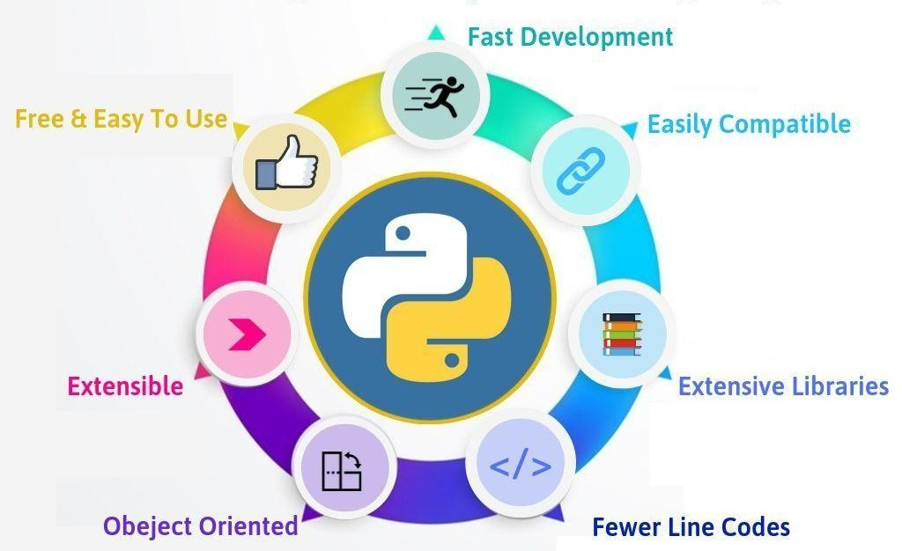
Introduction to Python
Image source:

Slide 3


In this section, we will discuss:
Introduction to Python.
History.
Features
Setting Up Path
Basic Syntax Variable
Data Types Operator
Conditional Statement
Looping
Control Statement

Slide 4
In this section, we will discuss:
String Manipulation
Lists
Tuple
Functions and Methods
Dictionaries
Functions
Modules
Input and Output
Exception Handling

Slide 5
Introduction to Python
Image source:

Slide 6
Introduction to Python
Characteristics of Python
Simple Syntax
GUI Programming.
Scalable
Free and Open Source
Variety of Usage and Application.
Interpreted and Interactive
Object Oriented
Image source:

Slide 7
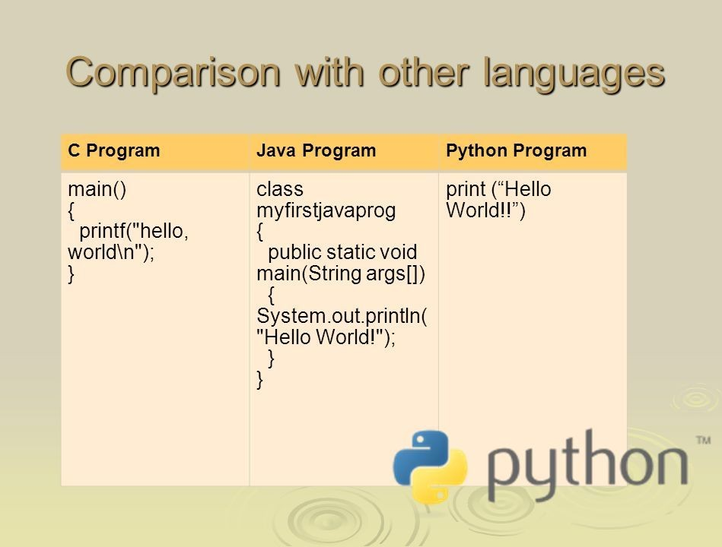
Introduction to Python
Advantages over other languages
Simple code
It is easy to understand
It is Free
It Needs Less Coding
All Kinds of Businesses Can Afford it
It is one of the most Trending Language.
Source of image
© Edunet Foundation. All rights reserved.

Slide 8
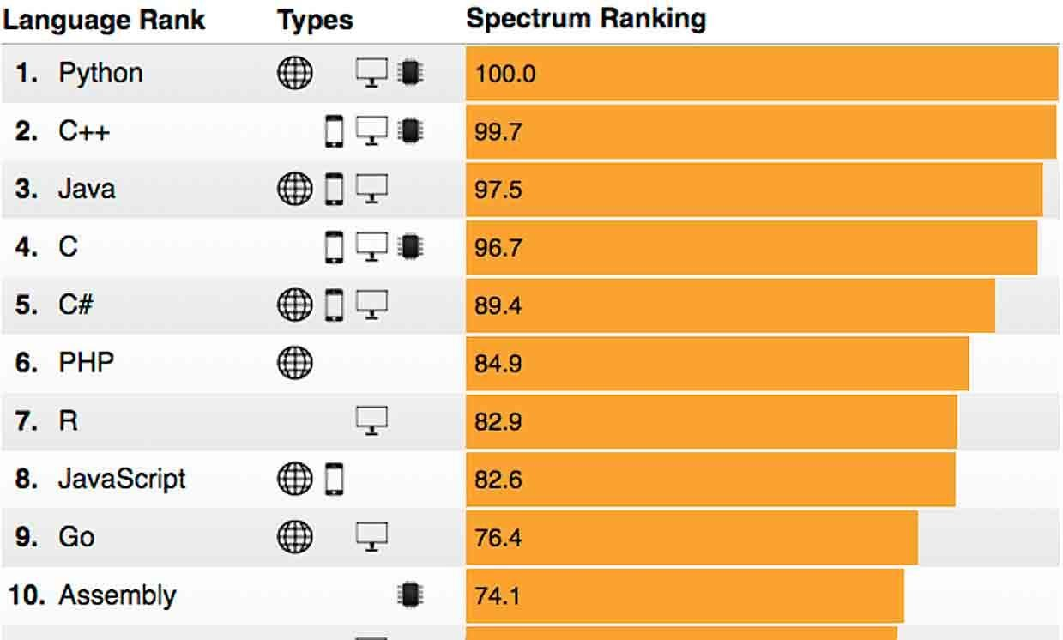
History
Source of image:

Slide 9
History
Python Timeline/History and IEEE rankings
Python was conceptualized by Guido Van Rossum in the late 1980s.
Rossum Published the first version of Python code(0.9.0) in February 1991 at CWI(Centrum Wiskunde & Informatica) in Netherland, Amsterdam.
Python is Derived from ABC Programming Language that had been developed at the CWI.
Source of image:

Slide 10
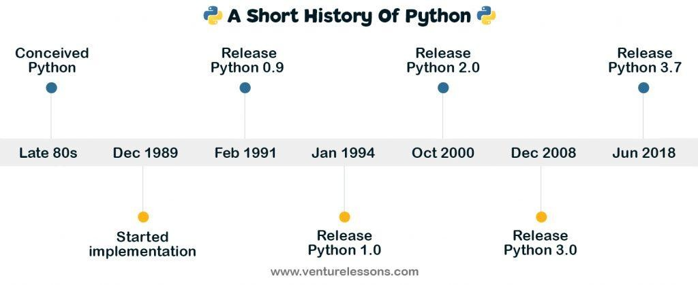
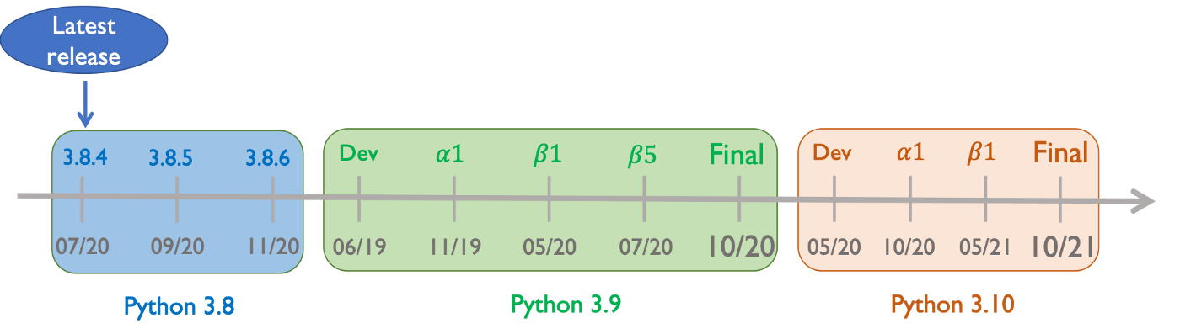
History
Python Timeline/History and IEEE rankings (Contd..)
Rossum choose the name “Python” , since he was a big fan of Monty Python’s Flying Circus.
Python is now maintained by a core development team at the institute, although Rossum still holds a vital role in directing its progress.
Image Source:

Slide 11
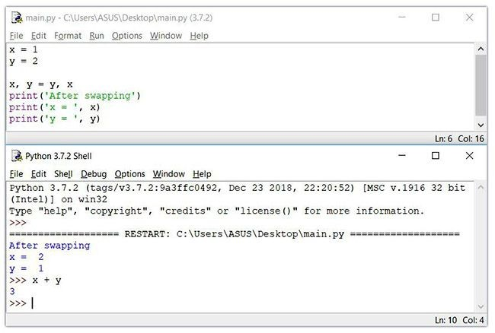
Features
Source of image:https://cdn.programiz.com/sites/tutorial2program/files/python-idle.JPG

Slide 12
Features
Easy to Code and Understand
Python has simpler syntax when compared to C, C++, Java and other programming languages.
This enables any newbie to quickly pick up the basics of Python.
Also, despite being a high-level language, Python code looks very short much readable due to its English like commands. In short,
it is a developer-friendly language.
Source of image:https://cdn.programiz.com/sites/tutorial2program/files/python-idle.JPG
©
Edunet Foundation. All rights reserved.

Slide 13
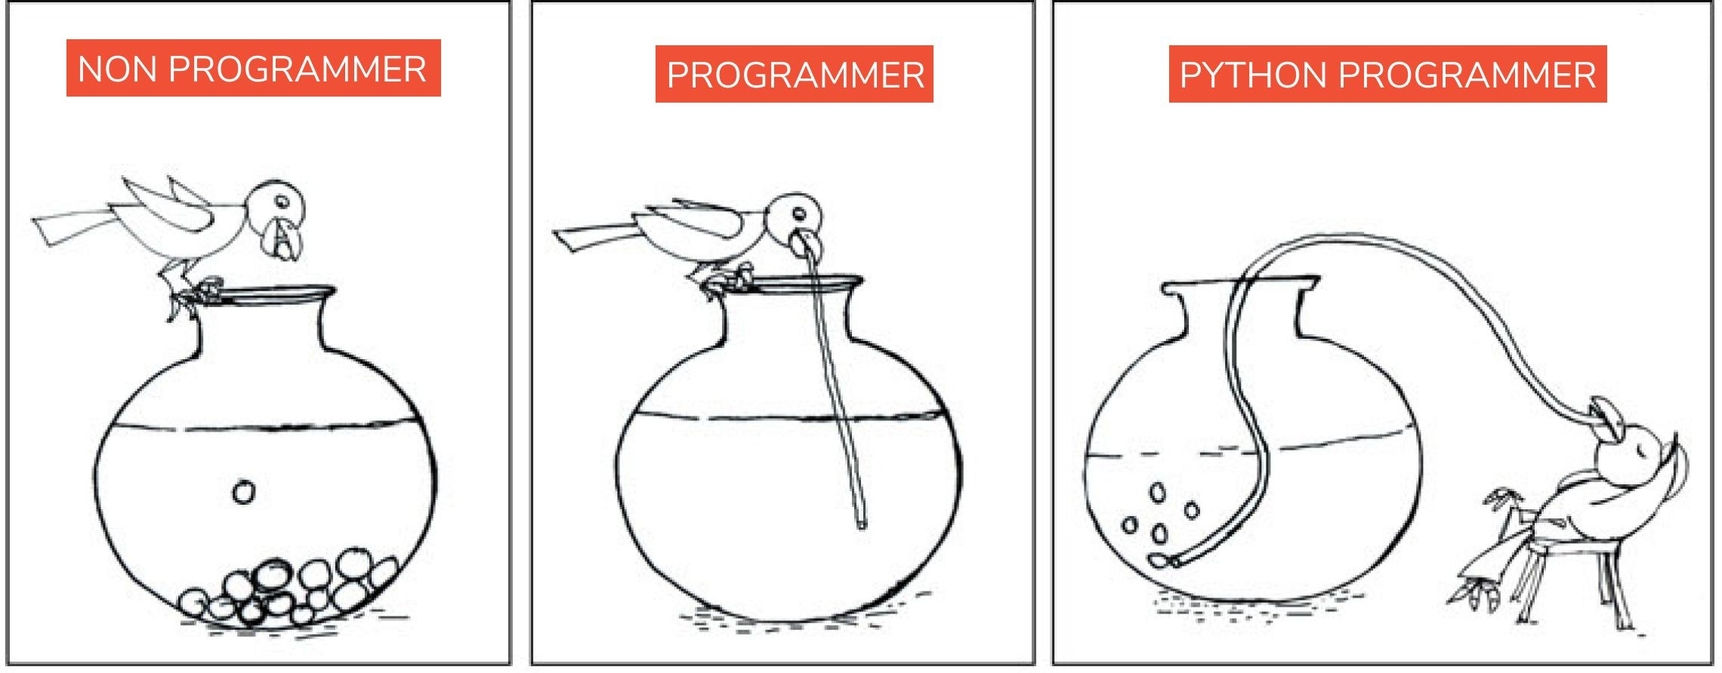
Features
Expressive Language
Python is very expressive when compared to other languages.
By expressive, we mean, in Python a single line of code performs a lot more than what multiple lines can perform in other languages.
In simple it means that fewer lines of code are required to write a program in Python.
Source of image:

Slide 14
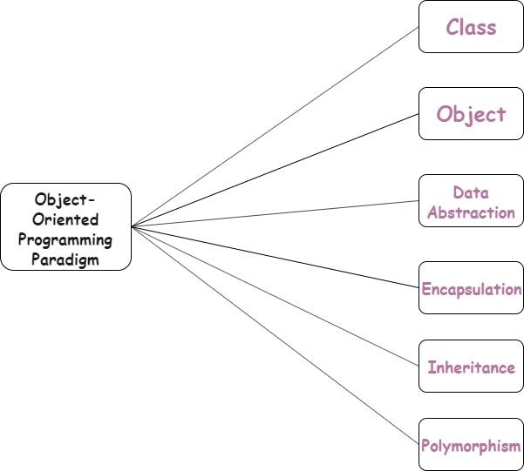
Features
Object Oriented
Python is a multi-paradigm programming language. Meaning, it supports different programming approach.
One of the popular approach to solve a programming problem is by creating objects.
This is known as Object-Oriented
Programming (OOP).
Source of image:

Slide 15
Features
Object Oriented (Contd..)
Python is an “object-oriented programming language.”
This means that almost all the code is implemented using a special construct called classes.
●
Source of image:
© Edunet Foundation. All rights reserved.

Slide 16
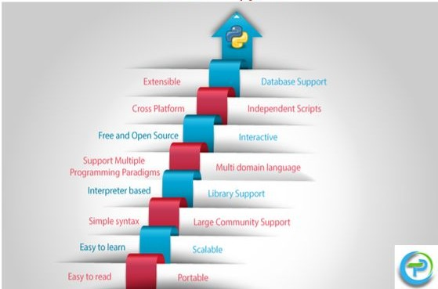
Features
Extensible Language
In case you want to write a part of your Python code in C++ or Java etc, then you can do it.
Since Python is an extensible language, it lets you do this with ease.
Source of image:
© Edunet Foundation. All rights reserved.

Slide 17
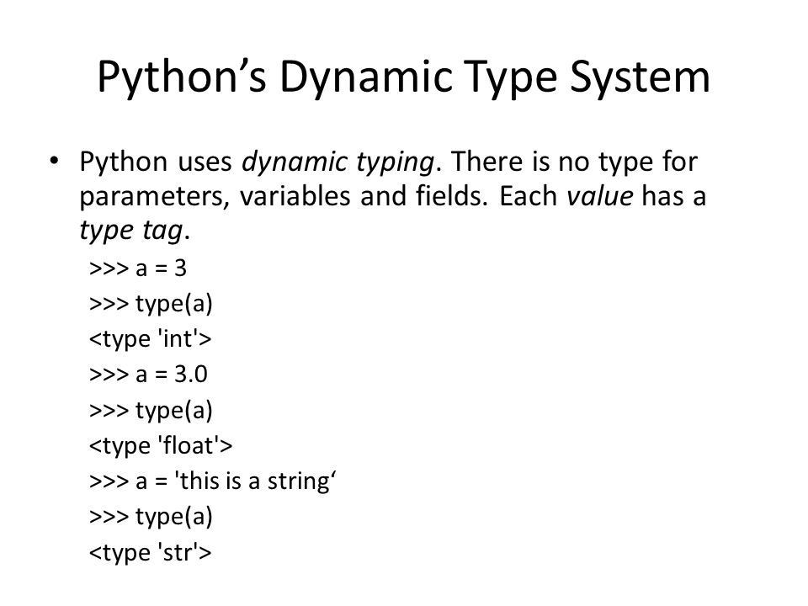
Features
Dynamically typed Programming Language
Python is a dynamically typed language.
This means, whenever a variable is declared, the programmer need not mention its data type.
Rather, the type of the variable is decided during run time.
Source of image:
© Edunet Foundation. All rights reserved.

Slide 18
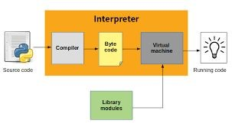
Features
Use of Interpreter
Python installation interprets and executes the code line by line at a time.
Python interpreter offers some pretty cool features:
Interactive editing
History substitution
Code completion on systems with support for readline
Source of image:
© Edunet Foundation. All rights reserved.

Slide 19
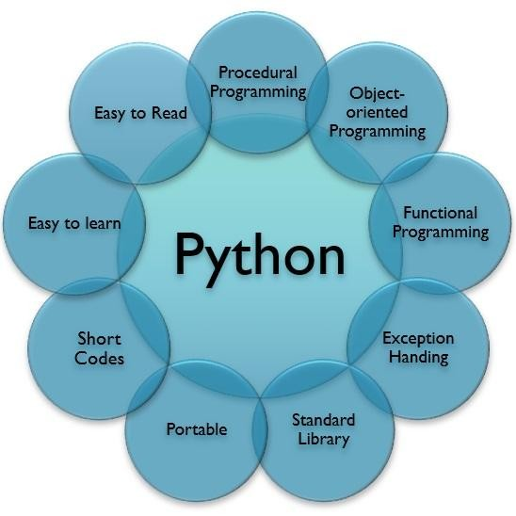
Features
Free & Open Source
Python language is freely available
i.e without any cost.
It is open and available to anyone.
Anyone can freely distribute it,read the source code and edit it.
Pythons license is administered by the Python Software Foundation.
Image source:
© Edunet Foundation. All rights reserved.

Slide 20
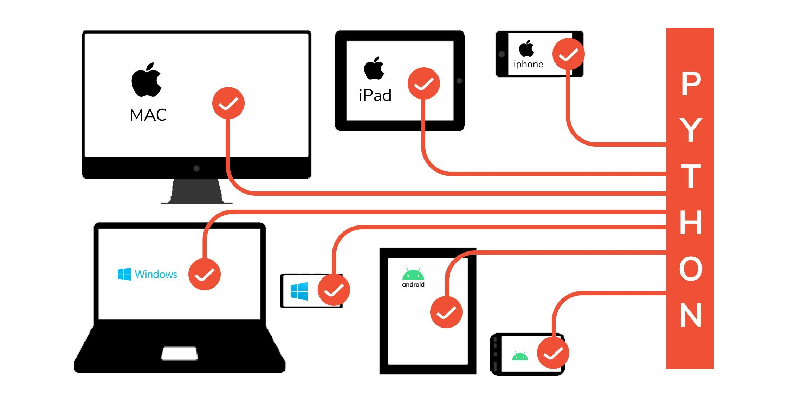
Features
Cross Platform Language
Python can run equally well on variety of platform-
Windows
Linux/Unix
Macintosh
Smart Phones etc
We can also say that Python is a portable language.
Source of image:
© Edunet Foundation. All rights reserved.

Slide 21
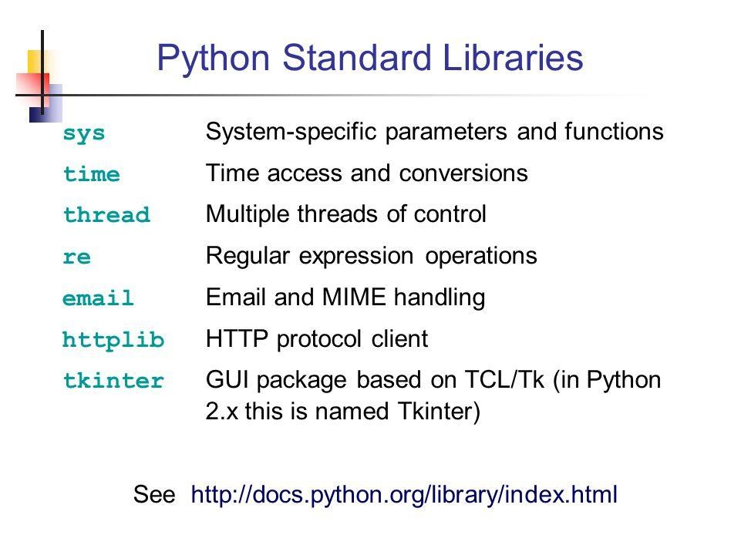
Features
Large Standard Library
Python has a large standard library and this helps save the programmers time as you don't have to write your own code for every single logic.
There are libraries for expressions, unit-testing, web browsers, databases, CGI, image manipulation etc.
Image Source:
© Edunet Foundation. All rights reserved.

Slide 22
Features
Large Standard Library (Contd..)
Python provide rich set of module and functions for rapid application development
Python’s bulk of the library is very portable and cross-platform compatible on UNIX, Windows and Macintosh.
Image Source:
© Edunet Foundation. All rights reserved.

Slide 23
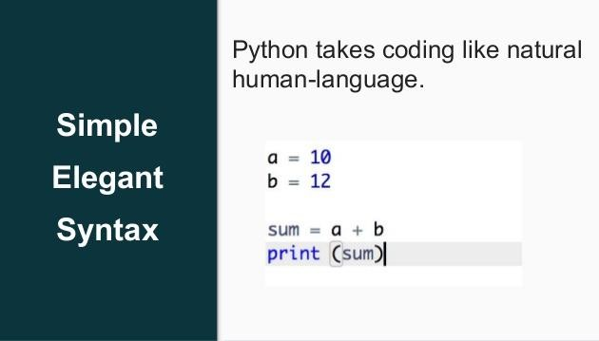
Features
Elegant Syntax
Python Elegant Syntax means it is more capable to expressing the code’s purpose than many other languages.
Python can easily test even small portion of code.
Python’s elegant syntax and dynamic typing, together with its interpreted nature, make it an ideal language for scripting and rapid application development in many areas on most
Image Source:
platforms.
© Edunet Foundation. All rights reserved.

Slide 24
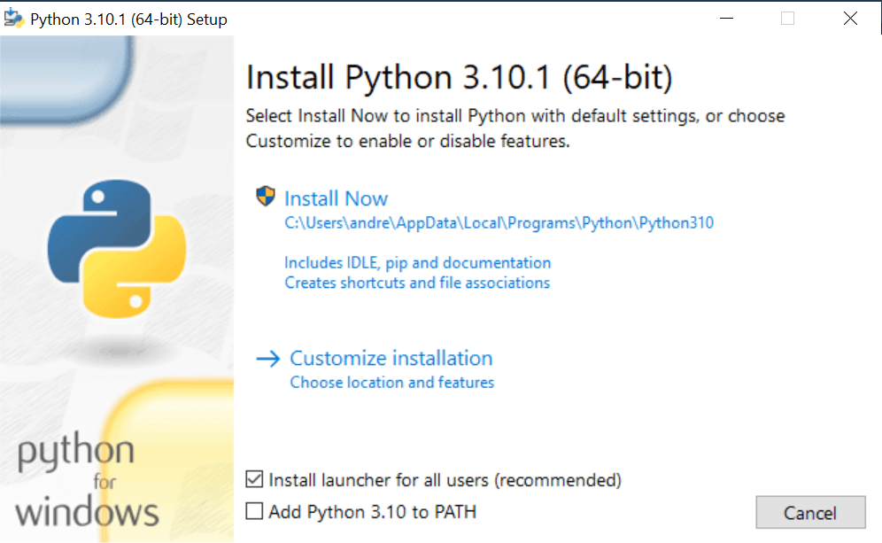
Setting Up Path
Installation of Python IDLE
List of Hardware/Software Requirements:
Laptop/Computer with Windows/Linux OS-Ubuntu 18.04LTS
Python Software
Installation Steps:
Install Python software in the system.
Open the browser and type the python.org/downloads.
Image source:

Slide 25
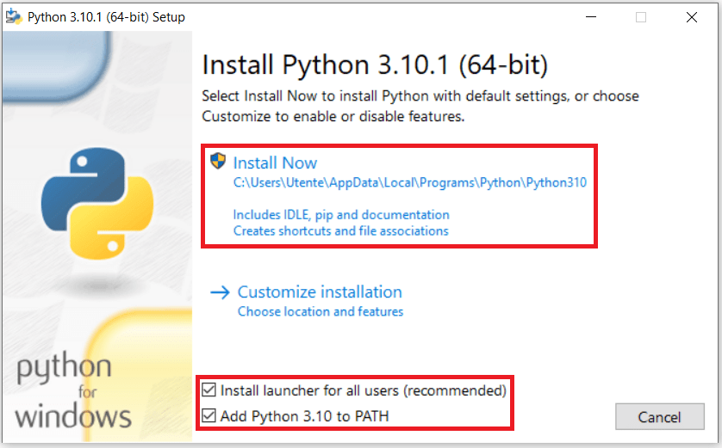
Setting Up Path
Installation of Python in Windows(Contd..)
Choice either Windows x86-64 executable installer for 64-bit or Windows x86 executable installer for 32-bit.
After downloading a file this page will appear.
Install the software
Select Add Python 3.10 to Path
Image source:

Slide 26
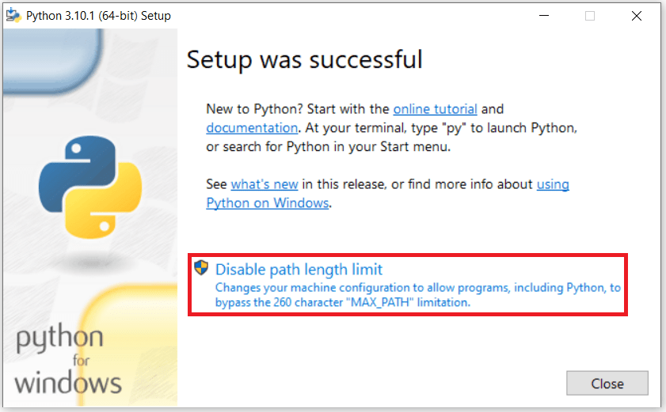
Setup Successful
Image Source:
© Edunet Foundation. All rights reserved.

Slide 27
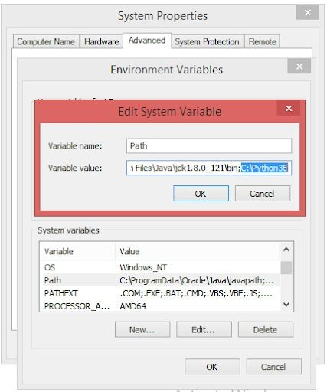
Setting Up Path
How to set Python Path in Windows
To permanently modify the default
environment variables :
My Computer > Properties > Advanced System Settings > Environment Variables > Edit
Image Source:
© Edunet Foundation. All rights reserved.

Slide 28
Setting Up Path
How to set Python Path in Windows(Contd..)
Right-click 'My Computer'.
Select 'Properties' at the bottom of the Context Menu.
Select 'Advanced system settings'
Click 'Environment Variables...' in the Advanced Tab
Under 'System Variables': Click Edit
Add python path to the end of the list (the paths are separated by semicolons(;))
Image Source:
© Edunet Foundation. All rights reserved.

Slide 29
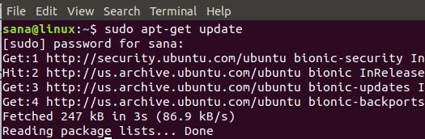
Setting Up Path
Installation of Python in Linux
Linux is an open source Operating System. There are many Linux based operating systems. Popular are Ubuntu, Fedora, Linux Mint, Debian.
Open the terminal or Command prompt from your linux based OS. Type the following commands.
If you are using Ubuntu 16.0 or newer version, then you can easily install Python 3.6 or Python 2.7 by typing the following commands
Image Source:

Slide 30
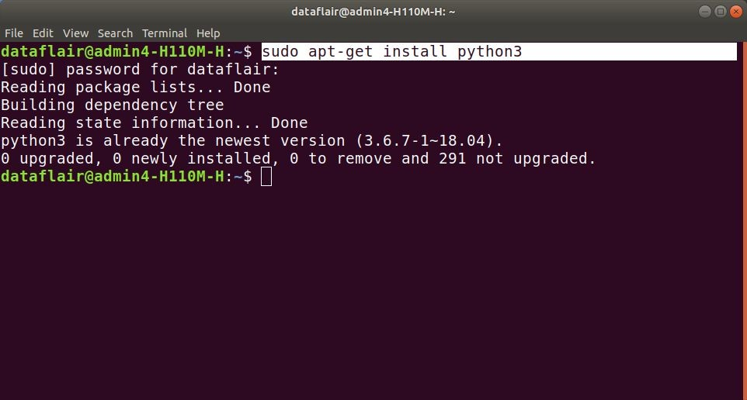
Setting Up Path
Installation of Python in Linux (Contd..)
$ sudo apt-get update
$ sudo apt-get install python3
or
$ sudo apt-get update
$ sudo apt-get install python2.7
Image Source:
© Edunet Foundation. All rights reserved.

Slide 31
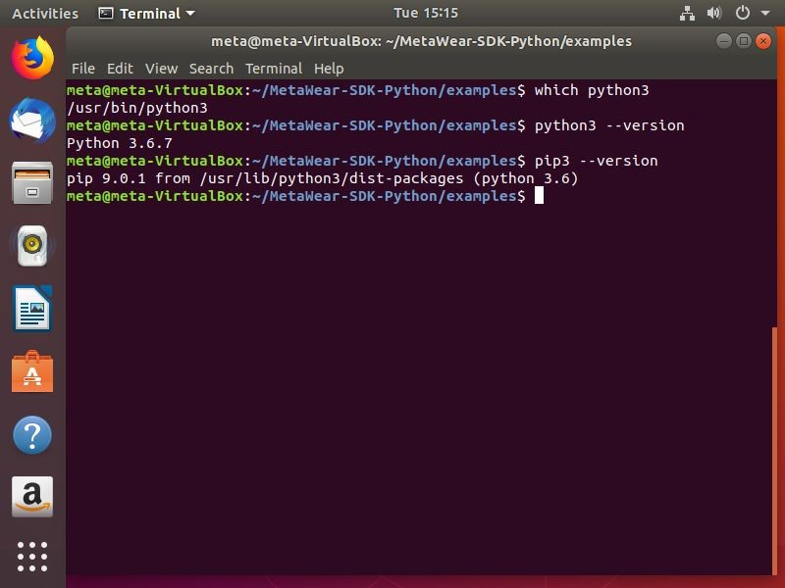
Setting Up Path
Installation of Python in Linux
(Contd..)
You can check it is installed or not by
typing the following commands in terminal.
For Python3:-
$ python3 --version
For Python2:-
$ python2 --version
Image Source:
© Edunet Foundation. All rights reserved.

Slide 32
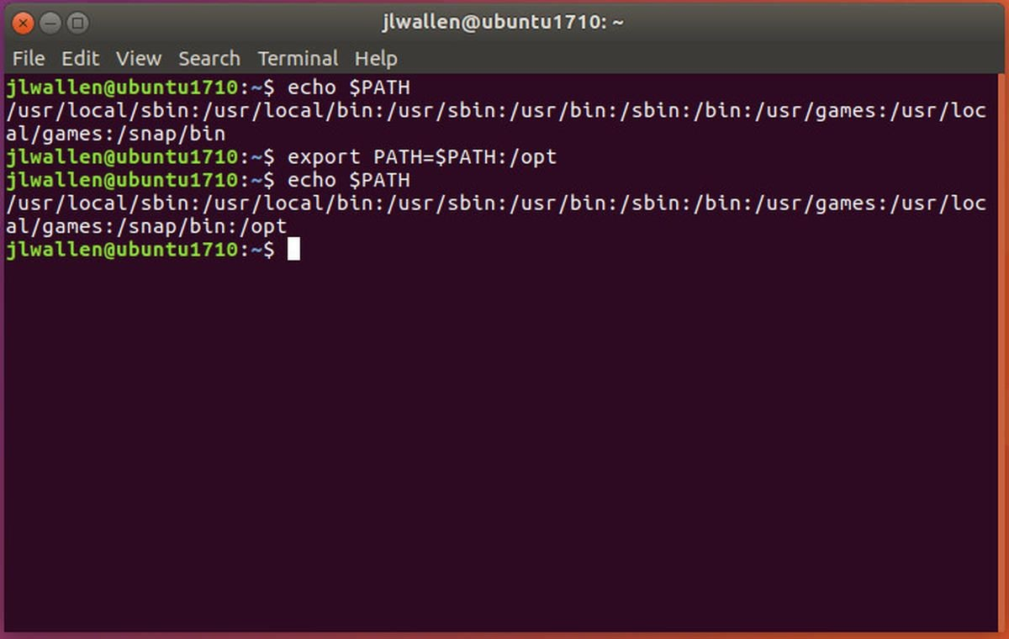
Setting Up Path
How to Set Python Path in Linux
The steps for adding Path in Linux are fairly straight forward, just follow the steps outlined below.
In the csh shell, type the following sentence:
PATH “$PATH:/usr/local/bin/python” and press Enter.
Image Source:
© Edunet Foundation. All rights reserved.

Slide 33
Setting Up Path
open up the bash shell and type the following phrase
export PATH=”$PATH:/usr/local/bin/python” and press Enter.
If you have access to either sh or ksh shell, then open up the terminal and type the following,
PATH=”$PATH:/usr/local/bin/python”and press Enter.
Image Source:
© Edunet Foundation. All rights reserved.

Slide 34
Setting Up Path
How to Set Python Path in Linux (Contd..)
One of the most important things to note
when you are adding Path to Python in Unix or Linux is that,
/usr/local/bin/python is the default path of the Python directory.
Image Source:
© Edunet Foundation. All rights reserved.

Slide 35
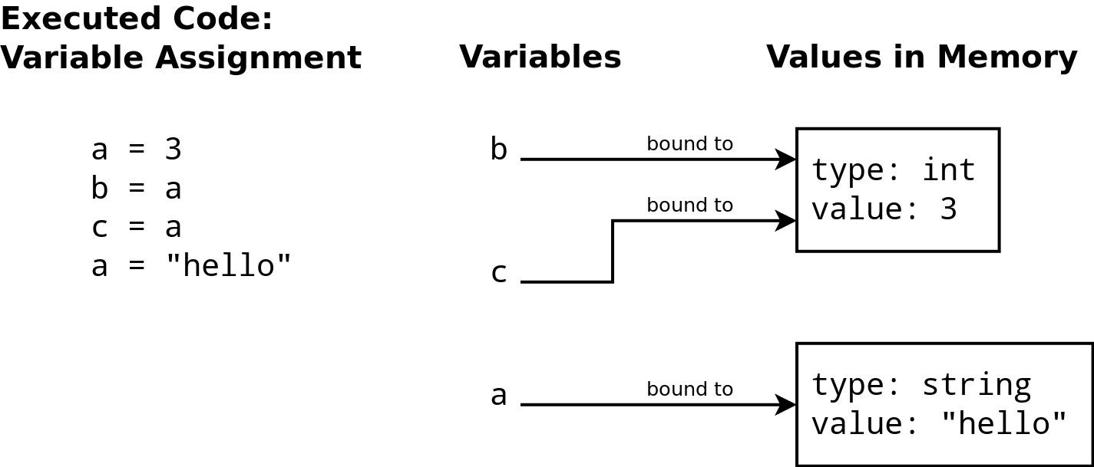
Basic Syntax Variable
Image Source:

Slide 36
Basic Syntax Variable
Variables
A variable is a container for a value.
It can be assigned a name, you can use it to refer to it later in the program.
Based on the value assigned, the interpreter decides its data type.
Image Source:

Slide 37
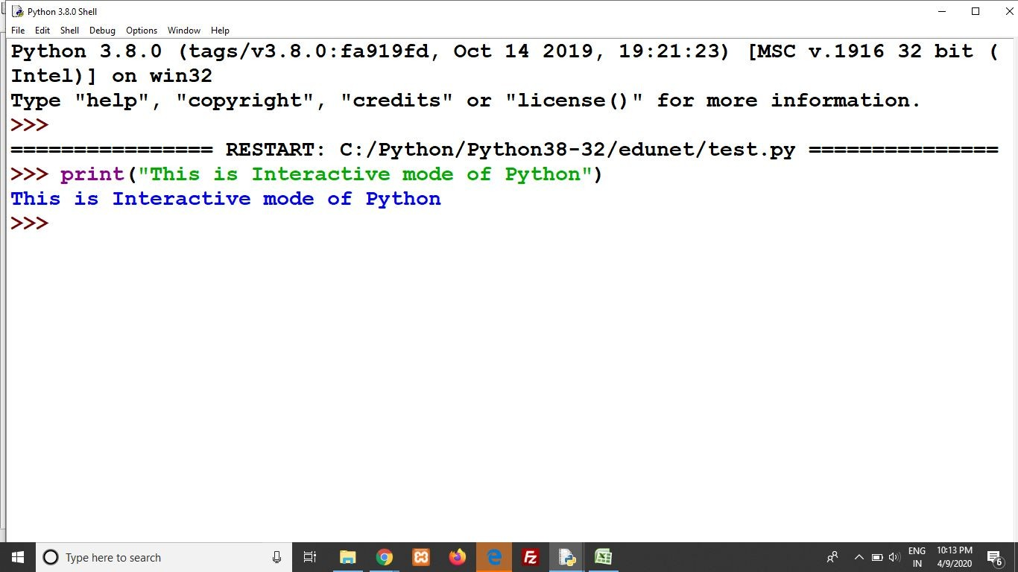
Basic Syntax Variable
Interactive Mode Programming
In Python, the code executes via the Python Shell, which comes with Python Installation.
To access the Python shell, open the terminal of your operating system and then type "python". Press the enter key and the Python shell will appear.

Slide 38
Basic Syntax Variable
Interactive Mode Programming (Contd..)
The indicates that the Python shell
>>>
is ready to execute and send your commands to the Python interpreter.
The result is immediately displayed on the Python shell as soon as the Python interpreter interprets the command.

Slide 39
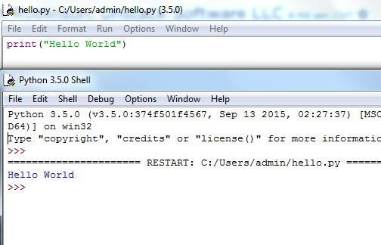
Basic Syntax Variable
Script Mode Programming
Script mode is used to work with lengthy codes.
In Script mode, You write your code in a text file then save it with a .py extension.
you can run your code by clicking”Run” then “Run module” or simply press F5.
You can use any text editor to wite the code like- Sublime, Atom, Notepad++, etc.
Image Source:
© Edunet Foundation. All rights reserved.

Slide 40
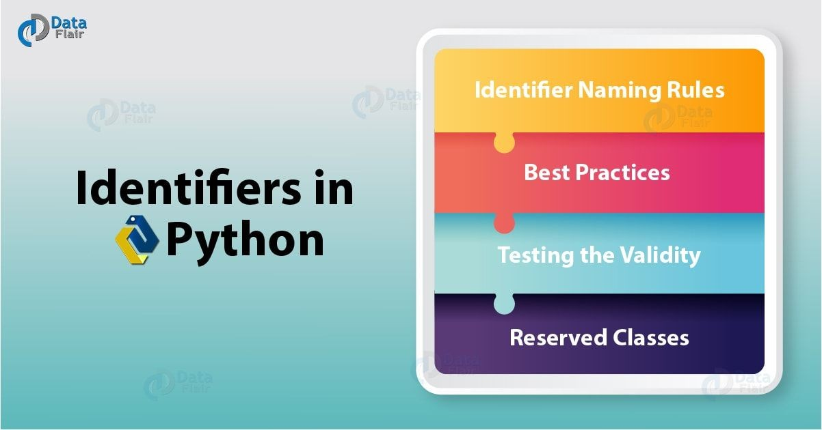
Basic Syntax Variable
Python Identifiers
A Python identifier is a name used to find a variable, function, class, module or other object.
An identifier begin with a letter A to Z or a to z or an underscore(_) followed by zero or more letters and digits (0 to 9).
Python doesn’t permit punctuation character such as @, $ and % within identifiers.
Python is a case sensitive Programming Language.
Image Source:
© Edunet Foundation. All rights reserved.

Slide 41
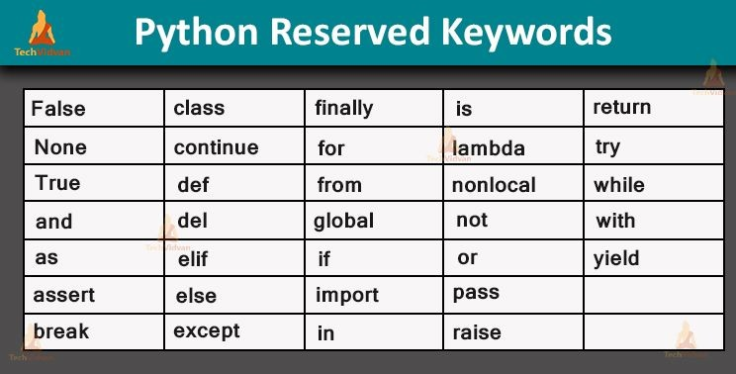
Basic Syntax Variable
Reserved Keywords
There are reserved words and cannot use them as constant or variable or any other identifier names.
All the Python keywords contain lowercase letters only.
Image Source:
© Edunet Foundation. All rights reserved.

Slide 42
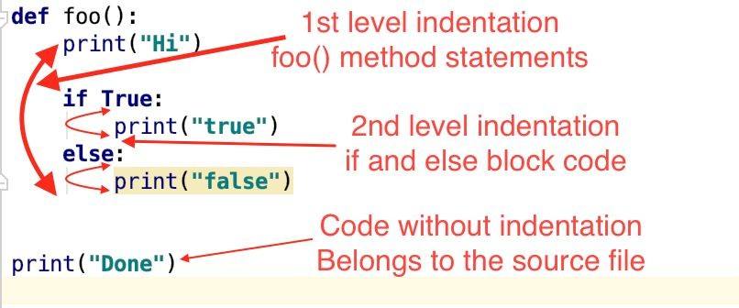
Basic Syntax Variable
Lines and Indentation
Python provides no braces to indicate blocks or code for class and function definitions or flow control.
Blocks of code are denoted by line indentation, which is rigidly enforced.
The number of spaces in the indentation is variable, but all statement within the block must be indented the same amount.
Image Source:
© Edunet Foundation. All rights reserved.

Slide 43
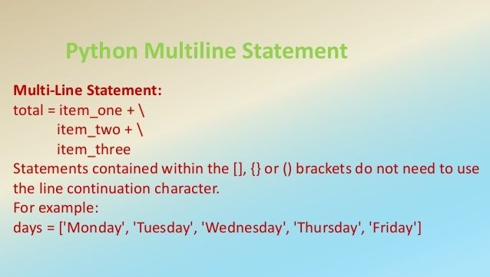
Basic Syntax Variable
Multi Line Statement
Python is to be able to easily print across multiple lines.
Statements contained within the [],{} or () brackets do not need to use the line continuation character.
Image Source:
© Edunet Foundation. All rights reserved.

Slide 44
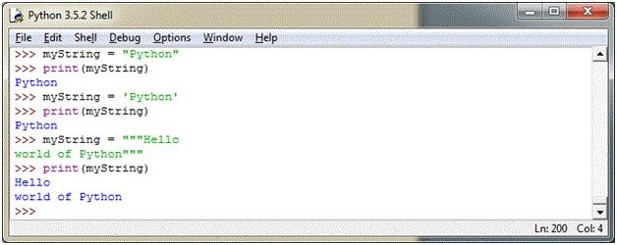
Basic Syntax Variable
Quotation in Python
Python accepts single (‘), double (“), and triple (''' or " "") quotes to denote string literals, as long as the same type of quote starts and ends the strings.
The triple quotes are used to span the string across multiple lines.
Image Source:
© Edunet Foundation. All rights reserved.

Slide 45
Basic Syntax Variable
Quotation in Python (Contd..)
For example, all the followings are legal-
word = ’word’
sentence = “This is a sentence”
Paragraph = “””This is a paragraph. It is made up of multiple lines and sentences.”””
Image Source:
© Edunet Foundation. All rights reserved.

Slide 46
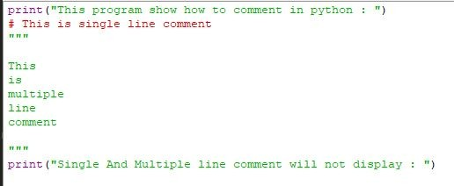
Basic Syntax Variable
Comments in Python
A hash sign (#) that is not inside a string literal begins a comment.
All characters after the # and up to the end of the physical line are part of the comment and the Python interpreter ignores them.
Image Source:
© Edunet Foundation. All rights reserved.

Slide 47
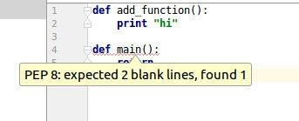
Basic Syntax Variable
Using Blank Lines
A line containing only whitespaces, possibly with a comment, is known as a blank line and Python totally ignores it.
In an interactive interpreter session, you must enter physical line to terminate a multiple statement.
Image Source:
© Edunet Foundation. All rights reserved.

Slide 48
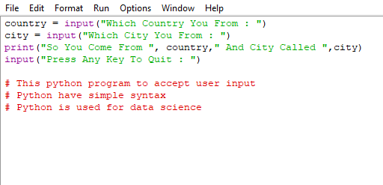
Basic Syntax Variable
Input from the User
Builtin function - input()
Image Source:

Slide 49
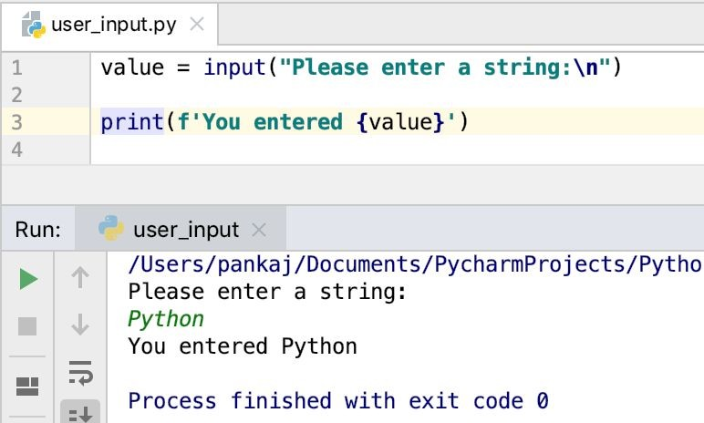
Basic Syntax Variable
Input from the User (Contd..)
even when the user inputs an integer value, it will still be considered as a string.
input()-
input() interprets and evaluates the input entered by the user, which means if the user enters an integer, an integer will be returned and if the user enters a string, a string will be returned.
Image Source:

Slide 50
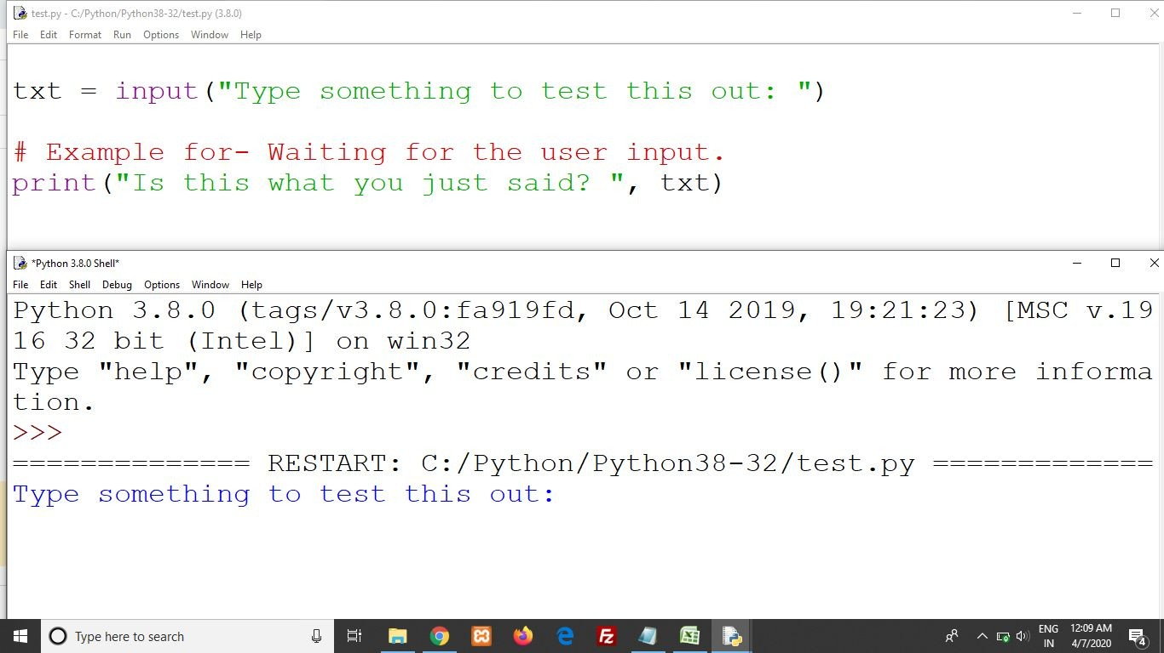
Basic Syntax Variable
Waiting for the User
The following line of the program displays the prompt, the statement saying “Press the Enter key to Exit”.
Wait for the user to take action-
raw_input(“/n/n Press the Enter key to Exit.”).
Here, /n/n is used to create two new lines before displaying the actual line.

Slide 51
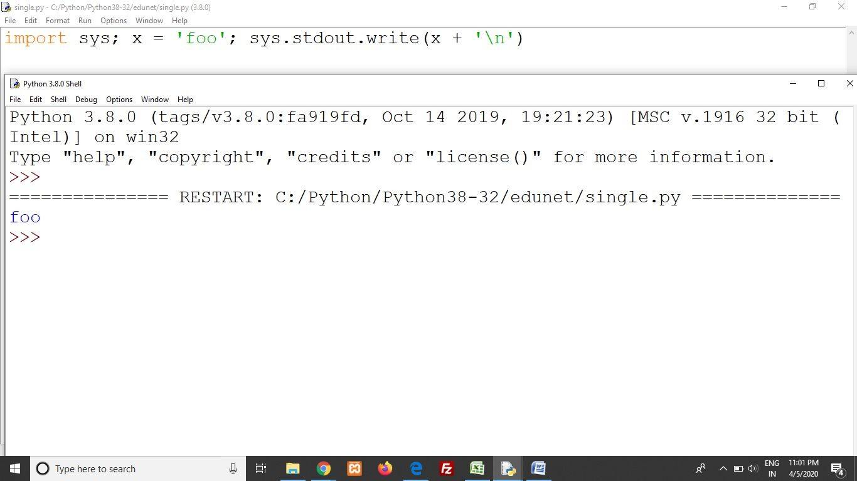
Basic Syntax Variable
Multiple Statement on a Single Line
The Semicolon (;) allows multiple statements on the Single Line given that neither statement starts a new code block.
Here is a simple snip using the semicolon-
Import sys;x=”foo”sys.stdout.write(x+’\n’)

Slide 52
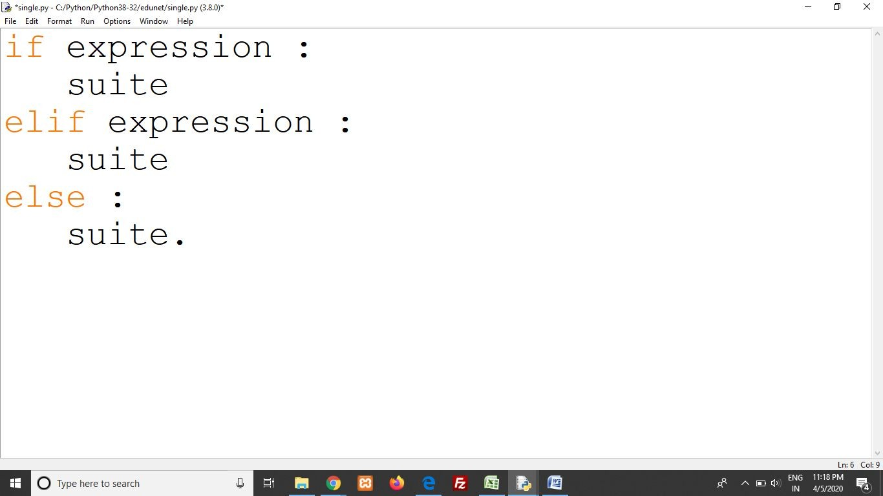
Basic Syntax Variable
Multiple Statement Groups as Suites
A group of individual statements, which make a single code block are called Suites in Python.
Compound or complex statements, such as if, while, def, and class require a header line and a suite.
Header lines begin the statement (with the keyword) and terminate with a colon ( : ) and are followed by one or more lines which make up the suite.

Slide 53
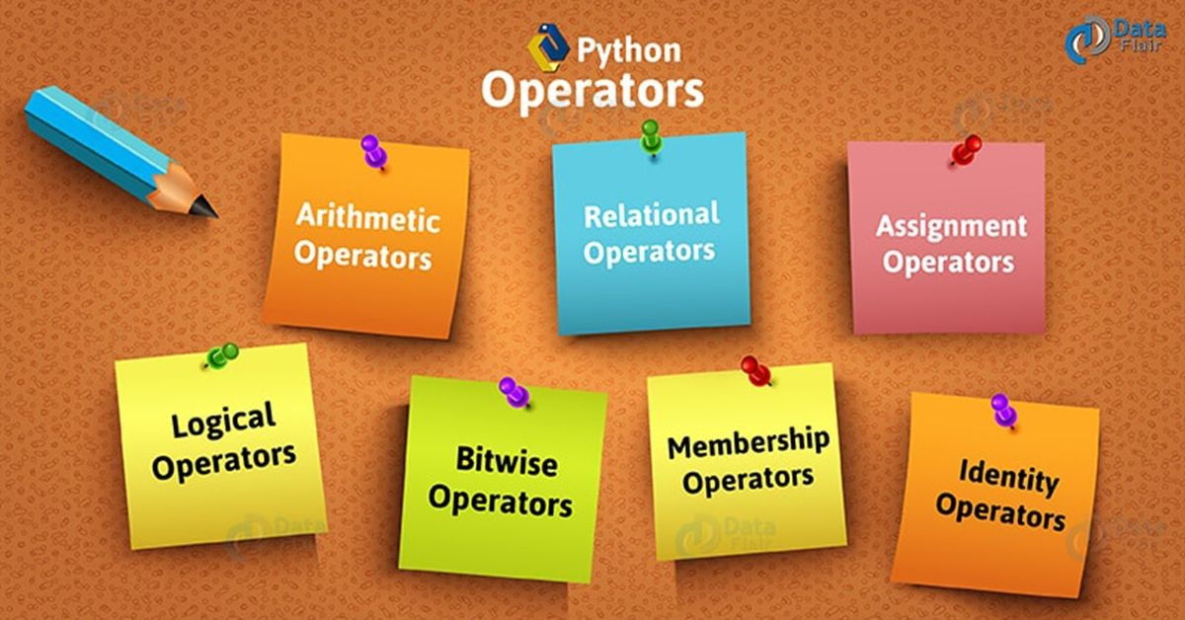
Data Types Operator
Image Source:

Slide 54
Data Types Operator
Types of Operator
Python Arithmetic Operator
Python Comparison Operator
Python Assignment Operator
Python Bitwise Operator
Python Logical Operator
Python Membership Operator
Python Identity Operator
Python Operator Precedence
Image Source:
© Edunet Foundation. All rights reserved.

Slide 55
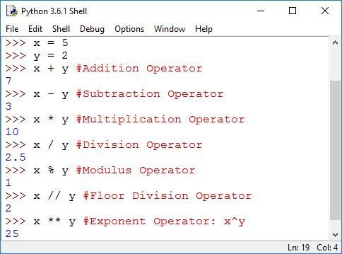
Data Types Operator
Python Arithmetic Operator
Arithmetic Operators are used to perform mathematical operations like addition, subtraction, multiplication etc.
Image Source:
© Edunet Foundation. All rights reserved.

Slide 56
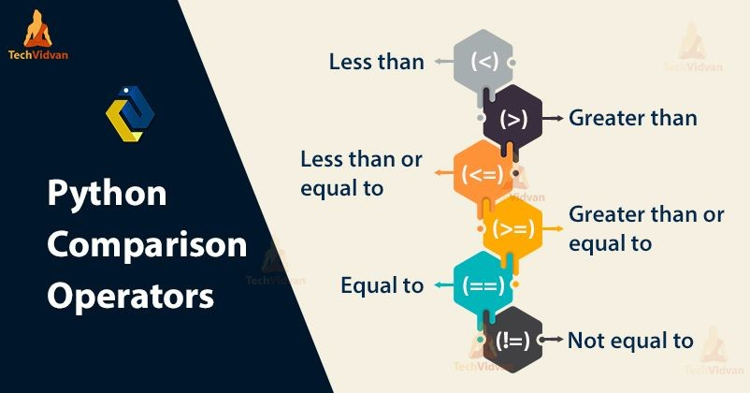
Data Types Operator
Python Comparison Operator
Comparison Operators are used to compare values.
It either returns True or False according to the condition
Image Source:
© Edunet Foundation. All rights reserved.

Slide 57
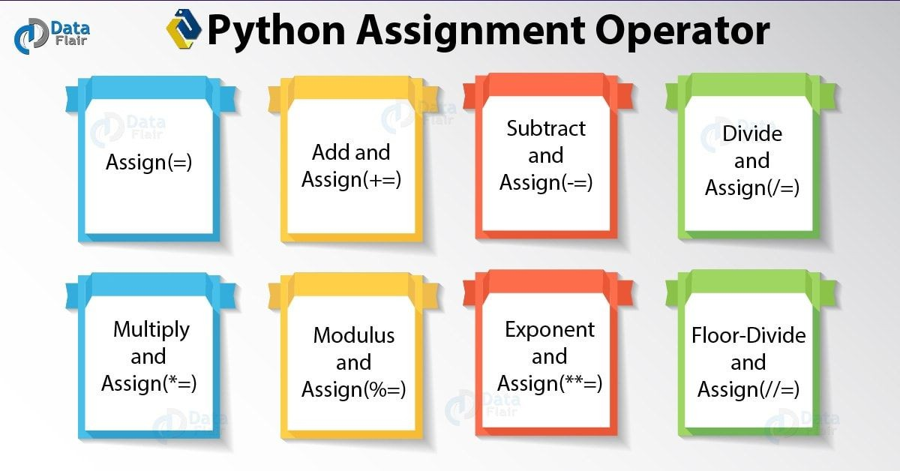
Data Types Operator
Python Assignment Operator
Assignment Operator are used to Python to assign values to variable.
Equals (=) operator is the most commonly used assignment operator in Python.
Image Source:
© Edunet Foundation. All rights reserved.

Slide 58
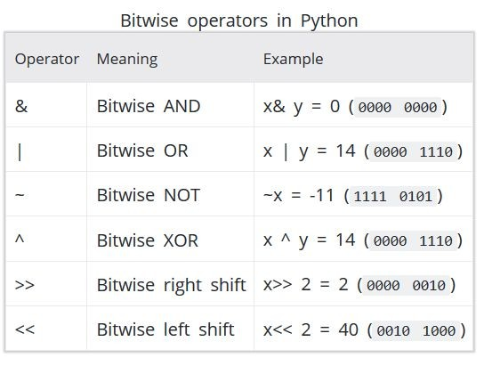
Data Types Operator
Python Bitwise Operator
Bitwise Operators act an Operand as if they were string of binary digits. It operates bit by bit hence, the name.
For eg- 2 is 10 in binary and 7 is 111.
Now In this table
Let x=10 (0000 1010 in binary) and y=4 (0000
0100 in binary)
Image Source:
© Edunet Foundation. All rights reserved.

Slide 59
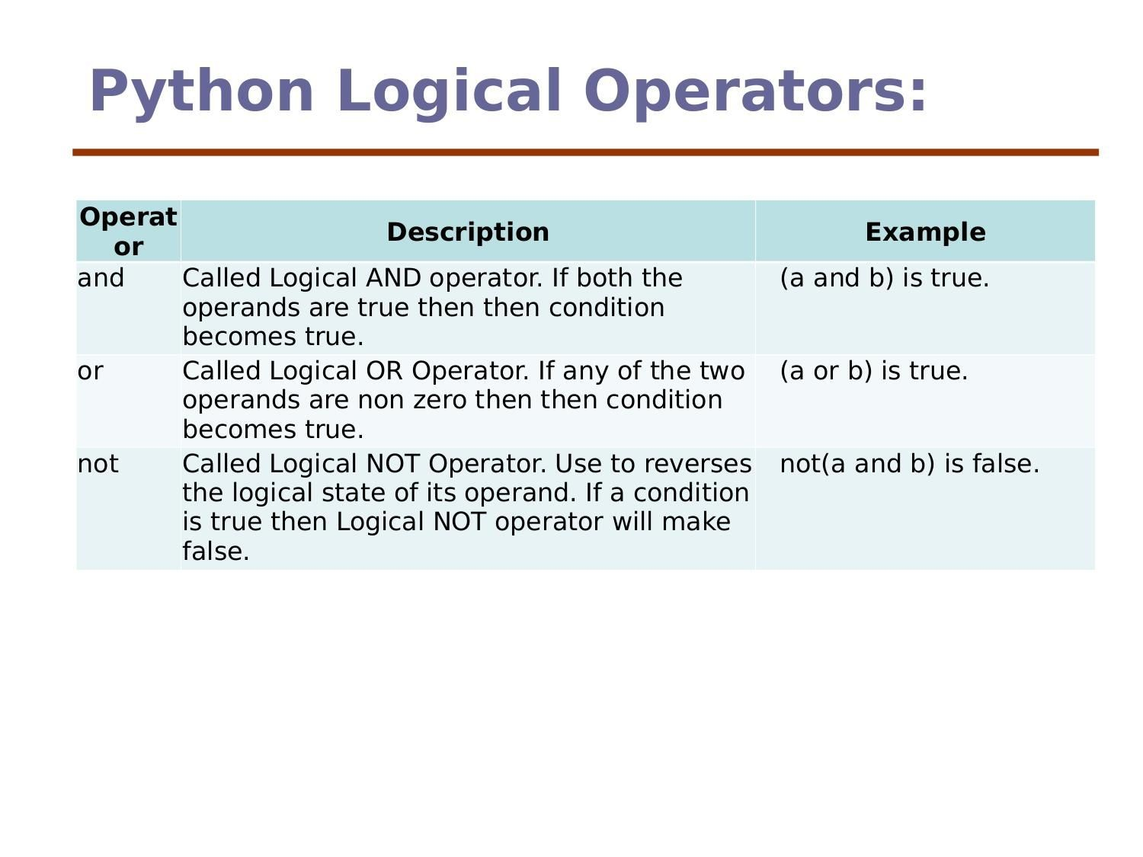
Data Types Operator
Python Logical Operator
There are three types of Python Logical Operator-
And Operator
Or Operator
Not Operator
Image Source:
© Edunet Foundation. All rights reserved.

Slide 60
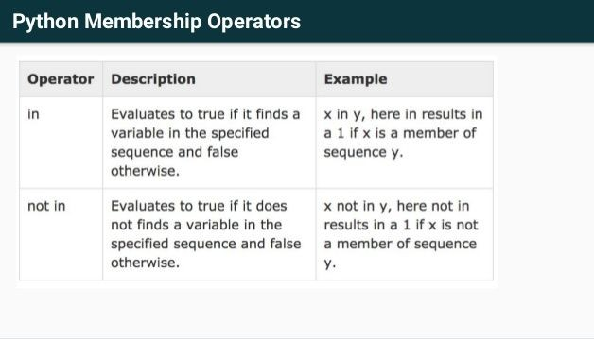
Data Types Operator
Python Membership Operator
in and not in are the membership operators in Python.
They are used to test whether a value or variable is found in a sequence (string, list, tuple, set and dictionary).
Image Source:
© Edunet Foundation. All rights reserved.

Slide 61
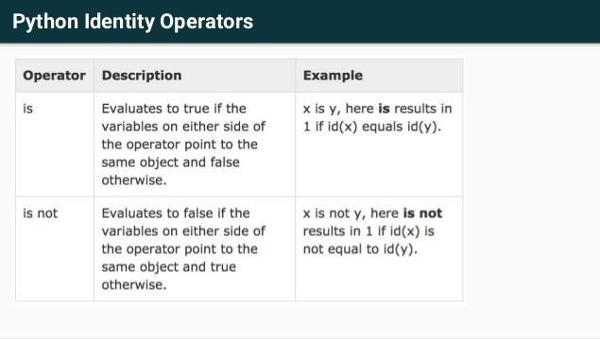
Data Types Operator
Python Identity Operator
is and is not are the identity operators in Python.
They are used to check if two values (or variables) are located on the same part of the memory.
Two variables that are equal does not imply that they are identical.
Image Source:
© Edunet Foundation. All rights reserved.

Slide 62
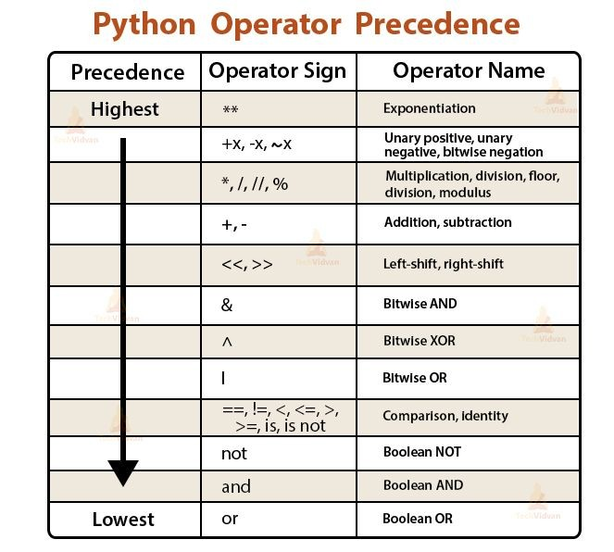
Data Types Operator
Python Operators Precedence
From the highest Precedence to the
lowest down the table.
Operators on the same row have the same Precedence.
Image Source:
© Edunet Foundation. All rights reserved.

Slide 63
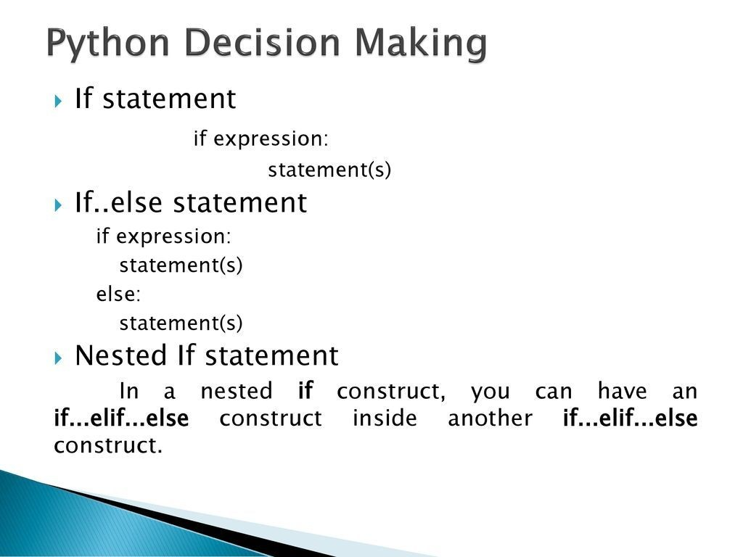
Conditional Statement

Slide 64
Conditional Statement
Statement And Description (Contd..)
The basic Decision statements in Computer is Selection Structure.
The Decision is described to computer as a conditional statement that can be answered True or False.
Python language provide the following conditional (Decision Making) statements.
If Statement
If...else Statement
If...elif...else Statement
Nested if...else Statement
© Edunet Foundation. All rights reserved.

Slide 65
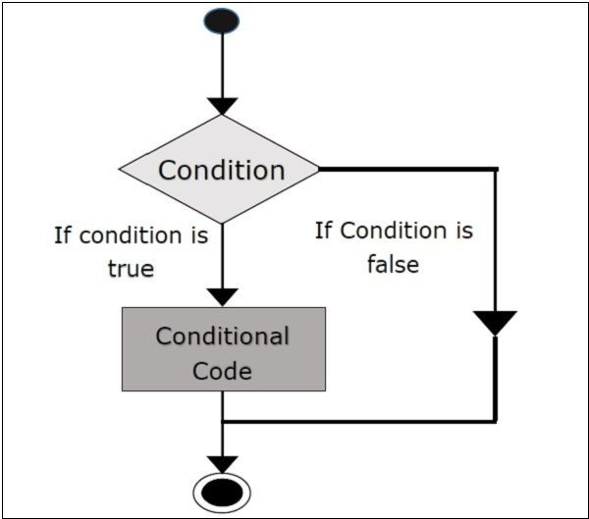
Conditional Statement
Statement And Description (Contd..)
If statement-
The If statement is decision making statement.
It is used to control the flow of the statement and also used to test logically whether the condition is true or false.
Syntax-
If test expression:
Image Source:

Slide 66
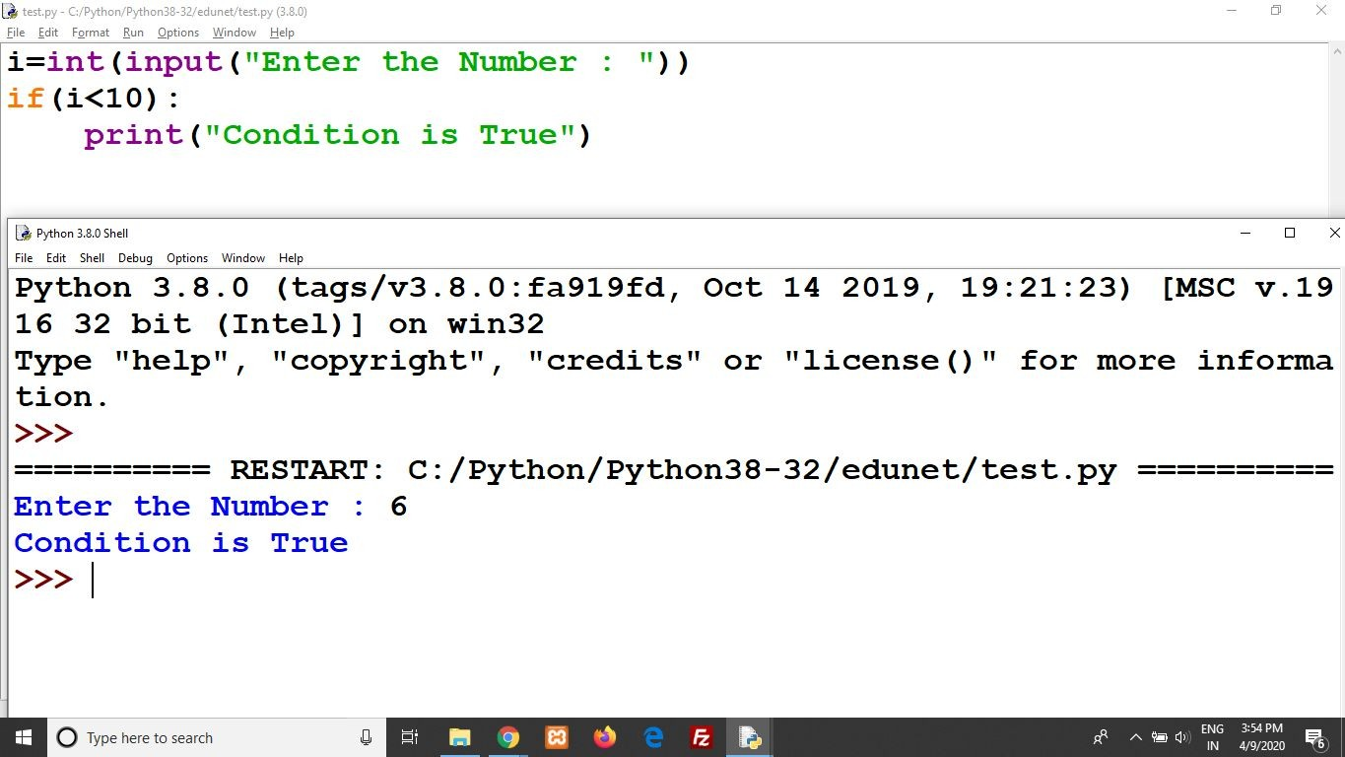
Conditional Statement
Statement And Description(Contd..)
Example Program:
i=int(input("Enter the Number : ")) if(i<10):
print("Condition is True") OUTPUT-
Image Source:
© Edunet Foundation. All rights reserved.

Slide 67

Conditional Statement
Statement And Description (Contd..)
If..else statement-
The if..else statement is called alternative execution, in which there are two possibilities and the condition determines which one get executed.
Image Source:
© Edunet Foundation. All rights reserved.

Slide 68
Conditional Statement
Statement And Description (Contd..)
Syntax-
If test expression:
Body of if
Else:
Body of else
○
Image Source:
© Edunet Foundation. All rights reserved.

Slide 69

Conditional Statement
num=int(input("Enter the Number : "))
if(num%2)==0:
print("Given number is Even") else:
print("Given number is Odd")
OUTPUT-

Slide 70

Conditional Statement
Statement And Description (Contd..)
Elif Statement-
Elif is a keyword used in python in replacement of else if to place another condition in the program.
This is called chained conditional.
Chained conditions allows than two possibilities and need more than two branches.
Image Source:
© Edunet Foundation. All rights reserved.

Slide 71
Conditional Statement
Description (Contd..)
If expression:
Body of if Elif expression:
Body of elif
Else:
Body of else
Image Source:
© Edunet Foundation. All rights reserved.

Slide 72

Conditional Statement

Slide 73
Conditional Statement
Statement And Description (Contd..)
elif(b<a)and(b<c):
print("b is greater") else:
print("c is greater")
OUTPUT-

Slide 74

Conditional Statement
Statement And Description (Contd..)
Nested if...else statement-
We can write an entire if..else statement in another if..else statement called nesting, and the statement is called nested if.
In a nested if construct, you can have an if..elif..else construct inside an if..elif..Else construct.
Image Source:
© Edunet Foundation. All rights reserved.

Slide 75
Conditional Statement
Statement And Description (Contd..)
If expression1:
statement(s) If expression2:
statement(s) Elif expression3:
statement(s)
Else:
Image Source:
© Edunet Foundation. All rights reserved.

Slide 76

Conditional Statement
Statement And Description (Contd..)
Example Program-
num = -99 if num > 0:
print("Positive Number") else:
print("Negative Number")
Image Source:
© Edunet Foundation. All rights reserved.

Slide 77
Conditional Statement
Statement And Description (Contd..)
#nested if
if -99<=num:
print("Two digit Negative Number")
OUTPUT-

Slide 78

Conditional Statement
Single Statement Suites
If the suite of an if clause consists only of a single line, it may go on the same line as the header statement.
Here is an example of a one-line if clause −

Slide 79

Looping
Image Source:

Slide 80
Looping
Loop Types and Description
The first statement in a function is executed first, followed by the second, and so on.
. There may be a situation when you need to execute a block of code several number of times.
A loop statement allows us to execute a statement or group of statements multiple times.
The following diagram illustrates a loop statement −
Image Source:

Slide 81

Looping
Loop Structure
Program statement are executed sequentially one after another. In some situations, a block of code needs of times.
These are repetitive program codes, the computers have to perform to complete task,
Image Source:
© Edunet Foundation. All rights reserved.

Slide 82
Looping
Loop Structure (Contd..)
The following are the loop structures available in Python.
While Statement
For loop Statement
Nested Loop Statement
Image Source:
© Edunet Foundation. All rights reserved.

Slide 83

Looping
While Loop
A while loop statement in Python programming language repeatedly executes a target statement as long as a given condition is true.
It test the condition before executing the loop body.
The syntax of a while loop in Python programming language is −
While expression:
Statements(s)
Image Source:

Slide 84

Looping
While Loop (Contd..)
Example Program-
count=0 while(count<5):
print(“The count is:”,count) count=count+1
OUTPUT-

Slide 85

Looping
For Loop
Executes a sequence of statements multiple times and abbreviates the code that manages the loop variable.
The syntax of a for loop in Python programming language is −
for iterating_var in sequence: statements(s)
Image Source:

Slide 86

Looping
For Loop (Contd..)
Example Program-
fruits=[“apple”,”banana”,”cherry”] For x in fruits:
print(x)
OUTPUT-

Slide 87

Looping
Nested Loop
You can use one or more loop inside any another while, for or do..while loop.
A nested loop is a loop inside a loop.
The "inner loop" will be executed one time for each iteration of the "outer loop".
Image Source:

Slide 88

Looping
Nested Loop (Contd..)
Example Program- adj=[“red”,”big”] fruits=[“apple”,”banana”] For x in adj:
For y in fruits:
print(x,y)

Slide 89

Control Statement
Image Source:

Slide 90
Control Statement
Loop Control Statement
Loop control statements change execution from its normal sequence.
When execution leaves a scope, all automatic objects that were created in that scope are destroyed
Python supports the following control statements.
Break Statement
Continue Statement
Pass Statement
Image Source:
© Edunet Foundation. All rights reserved.

Slide 91

Control Statement
Break Statement
Terminates the loop statement and transfers execution to the statement immediately following the loop.
If break statement inside a nested loop (loop inside another loop), break will terminate the innermost loop.
Image Source:
© Edunet Foundation. All rights reserved.

Slide 92

Control Statement
Break Statement (Contd..)
Example Program-
For num in[11, 9, 88, 10, 90, 3, 19]:
print(num) if(num==88):
print(“The number 88 is found”) print(“Terminating the loop”) Break
OUTPUT-

Slide 93

Control Statement
Continue Statement
Causes the loop to skip the remainder of its body and immediately retest its condition prior to reiterating.
The continue statement can be used in both while and for loops.
Image Source:

Slide 94

Control Statement
Continue Statement (Contd..)
Example Program-
For num in[20, 11, 9, 66, 4, 89, 44]:
If num%2==0: print(num)
OUTPUT-

Slide 95

Control Statement
Pass Statement
The pass statement in Python is used when a statement is required syntactically but you do not want any command or code to execute.
The interpreter does not ignore a pass statement, but nothing happens and the statement results into no operation.
Image Source:

Slide 96

Control Statement
Pass Statement (Contd..)
Example Program-
For num in [20, 11, 9, 66, 89, 44]:
If num%2==0:
Pass
else:
print(num)
OUTPUT-

Slide 97

String Manipulation
Image Source: https://static.javatpoint.com/python/images/strings-indexing-and-splitting2.png

Slide 98
String Manipulation
Introduction
Python string is an ordered collection of characters which is used to represent and store the text-based information.
Strings are stored as individual characters in a contiguous memory location.
It can be accessed from both directions: forward and backward.
Characters are nothing but symbols.
Strings are immutable, which means that once a string is created, they
cannot be changed.
Image Source: https://static.javatpoint.com/python/images/strings-indexing-and-splitting2.png

Slide 99


String Manipulation
Create Strings
Strings can be created by enclosing characters inside a single quote or double-quotes.
Even triple quotes can be used in Python but generally used to represent multiline strings and docstrings.

Slide 100


String Manipulation
Index and Slice - Indexing
Image Source :
https://cdn.techbeamers.com/wp-content/uploads/2016/03/String-Representation-in- Python.png
Python allows to index from the
₀th
position in Strings. But it also supports negative indexes.
Index of ‘-1’ represents the last character of the String.
Similarly, using ‘-2’, we can access the penultimate element of the string and so on.

Slide 101

String Manipulation
Index and Slice - Slicing
Image Source :
https://cdn.techbeamers.com/wp-content/uploads/2016/03/String-Representation-in- Python.png
To retrieve a range of characters in a String, we use ‘slicing operator,’ the colon ‘:’ sign.
With the slicing operator, we define the range as [a:b].
Let us print all the characters of the String starting from index ‘a’ up to char at index ‘b-1’. So the char at index ‘b’ is not a part of the output.

Slide 102

String Manipulation
Modify/Delete Strings
Python Strings are by design immutable. It suggests that once a String binds to a variable, it can’t be modified.
If you want to update the String, then re-assign a new String value to the same variable.
We cannot delete or remove characters from a string. But deleting the string entirely is possible using the keyword del.

Slide 103

String Manipulation
String Operators
There are many operations that can be performed with string
Image Source : https://www.programiz.com/python-programming

Slide 104

String Manipulation
String Formatting Operators
An Escape sequence starts with a backslash (\), which signals the compiler to treat it differently.
Python subsystem automatically interprets an escape sequence irrespective of it is in a single-quoted or double-quoted Strings.
Image Source:
https://www.techbeamers.com/python-strings-functions-and-examples/#strin g-formatting-operators-in-python

Slide 105


String Manipulation
String Formatting Operators
Image Source :
https://www.techbeamers.com/python-strings-functions-and-examples/#st ring-formatting-operators-in-python
Python Format Characters
String ‘%’ operator issued for formatting Strings. We often use this operator with the print() function.
© Edunet Foundation. All
rights reserved.

Slide 106

String Manipulation
Unicode String support
Regular Strings stores as the 8-bit ASCII value, whereas Unicode String follows the 16-bit ASCII standard.
This extension allows the strings to include characters from the different languages of the world.
In Python, the letter ‘u’ works as a prefix to distinguish between Unicode and usual strings.

Slide 107
String Manipulation
Built-in String Functions
For more information and all functions check this link
https://docs.python.org/2/library/string.html
Conversion Functions
Comparison Functions
Padding Functions
Search Functions
String Substitution Functions
Misc String Functions

Slide 108

String Manipulation
Regular Expressions
A RegEx, or Regular Expression, is a sequence of characters that forms a search pattern.
RegEx can be used to check if a string contains the specified search pattern.
Python has a built-in package called re, which can be used to work with Regular Expressions.

Slide 109

List

Slide 110
List
Python List & Create List
In Python programming, a list is created by placing all the items (elements) inside a square bracket [ ], separated by commas.
It can have any number of items and they may be of different types (integer, float, string etc.).

Slide 111

List
Creating Multi-dimensional Lists
A list can hold other lists as well which can result in multi-dimensional lists.
Image Source : https://intellipaat.com/blog/tutorial/python-tutorial/python-lists/

Slide 112

List
Access elements from a list List indexing
Index operator : The simplest one is to use the index operator ([ ]) to access an element from the list. Since the list has zero as the first index, so a list of size ten will have indices from 0 to 9.
Any attempt to access an item beyond this range would result in an IndexError. The index is always an integer.
Using any other type of value will lead to TypeError.

Slide 113

List
Access elements from a list
Reverse/Negative indexing
Reverse indexing : Python enables reverse (Negative) indexing for the sequence data type. So, for the Python list to index in the opposite order, you need to set the index using the minus (-) sign. Indexing the list with “-1” will return the last element of the list, -2 the second last and so on.

Slide 114

List
List slicing
Python comes with a magical slice operator which returns the part of a sequence.
It operates on objects of different data types such as strings, tuples, and works the same on a Python list.

Slide 115

List
Change or Add elements
List are mutable, meaning, their elements can be changed unlike string or tuple.
We can use assignment operator (=) to change an item or a range of items.
We can also use + operator to combine two lists. This is also called concatenation.
The * operator repeats a list for the given number of times.
Image Source: https://www.programiz.com/python-programming

Slide 116


List
Elegant way to create new List
List comprehension is an elegant and concise way to create a new list from an existing list in Python.
List comprehension consists of an expression followed by for statement inside square brackets.
A list comprehension can optionally contain more for or if statements.
An optional if statement can filter out items for the new list.
We can test if an item exists in a list or
not, using the keyword in.
Image Source: https://www.programiz.com/python-programming
© Edunet Foundation. All rights reserved.

Slide 117

Tuple

Slide 118
Tuple
Tuple & Create Tuple
A tuple in Python is similar to a list. The difference between the two is that we cannot change the elements of a tuple once it is assigned whereas, in a list, elements can be changed.
A tuple is created by placing all the items (elements) inside parentheses (), separated by commas.
A tuple can have any number of items and they may be of different types (integer, float, list, string, etc.).

Slide 119

Tuple
Access Tuple Elements
Indexing - We can use the index operator [] to access an item in a tuple where the index starts from 0.
So, a tuple having 6 elements will have indices from 0 to 5. Trying to access an element outside of tuple (for example, 6, 7,...) will raise an IndexError.
The index must be an integer; so we cannot use float or other types. This will result in TypeError.

Slide 120

Tuple
Access Tuple Elements
Python allows negative indexing for its sequences.
The index of -1 refers to the last item, -2 to the second last item and so on.

Slide 121

Tuple
Access Tuple Elements
We can access a range of items in a tuple by using the slicing operator - colon ":".
Slicing can be best visualized by considering the index to be between the elements as shown below. So if we want to access a range, we need the index that will slice the portion from the tuple.

Slide 122

Tuple
Performing Operations Modifying, Deleting
Tuple cannot be changed once it has
been assigned.
the element is itself a mutable datatype like list, its nested items can be changed.
● + operator to combine two tuples
repeat the elements in a tuple for a given number of times using
the * operator.
Cannot delete or remove items from a tuple.
Deleting a tuple entirely is possible

Slide 123

Function & Methods
Image source:
© Edunet Foundation. All rights reserved.
https://techvidvan.com/tutorials/python-methods-vs-functions/

Slide 124

Function & Methods
Why functions required??
Functions in Python are a set of related statements grouped together to carry out a specific task.
Including functions in our program helps in making it much more organized and manageable.
Especially, if we are working on a large program, having smaller and modular chunks of code blocks will increase the readability of the code along with providing it reusability.
Image source: https://techvidvan.com/tutorials/python-methods-vs-functions/

Slide 125

Function & Methods
Create & Def Statement
The def keyword is used to start the function definition.
The def keyword is followed by a
by
function-name which is followed
parentheses containing the arguments passed by the user and a colon at the end.
After adding the colon, the body of the function starts with an indented block in a new line.
The return statement sends a result object back to the caller.
Image Source : https://intellipaat.com/blog/tutorial/python-tutorial/python-functions/

Slide 126

Function & Methods
Calling a Function
To call a function we simply type the function name with appropriate parameters.

Slide 127

Function & Methods
Function works & Types
Basically, we can divide functions into the following two types:
Built-in functions - Functions that are built into Python.
User-defined functions - Functions defined by the users themselves
Image Source: https://www.programiz.com/python-programming

Slide 128

Function & Methods
Arguments
Define a function that takes variable number of arguments.

Slide 129

Function & Methods
Global, Local and Nonlocal
Global variable can be accessed inside or outside of the function.
A variable declared inside the function's body or in the local scope is known as local variable.

Slide 130

Function & Methods
Global, Local and Nonlocal
Nonlocal variable are used in nested function whose local scope is not defined. This means, the variable can be neither in the local nor the global scope.
We use nonlocal keyword to create nonlocal variable.
In Python, global keyword allows you to modify the variable outside of the current scope.
It is used to create a global variable and make changes to the variable in a local
context.
© Edunet Foundation. All rights reserved.

Slide 131

Function & Methods
Scope and Lifetime of variables
Scope of a variable is the portion of a program where the variable is recognized. Parameters and variables defined inside a function is not visible from outside. Hence, they have a local scope.
Lifetime of a variable is the period throughout which the variable exits in the memory. The lifetime of variables inside a function is as long as the function executes.
They are destroyed once we return from the function. Hence, a function does not

Slide 132

Function & Methods
Return statement
return statement is used to exit a function and go back to the place from where it was called.

Slide 133

Function & Methods
Functions as Objects
Python treats everything as an object and functions are no different

Slide 134

Function & Methods
Function Attributes
Python functions also have attributes.
You can list them via the dir() built-in function.
The attributes can be system-defined.
Some of them can be user-defined as well.
The dir() function also lists the user-defined attributes.

Slide 135

Dictionary

Slide 136
Dictionary
Create a Dictionary
Python dictionary is an unordered collection of items. While other compound data types have only value as an element, a dictionary has a key: value pair.
Dictionaries are optimized to retrieve values when the key is known.

Slide 137
Dictionary
Create a dictionary
Creating a dictionary is as simple as placing items inside curly braces {} separated by comma.
An item has a key and the corresponding value expressed as a pair, key: value.
While values can be of any data type and can repeat, keys must be of immutable type
(string, number or tuple with immutable elements) and must be unique.
we can also create a dictionary using

Slide 138

Dictionary
Access elements from a dictionary
While indexing is used with other container types to access values, dictionary uses keys. Key can be used either inside square brackets or with the get() method.
The difference while using get() is that it returns None instead of KeyError, if the key is not found.

Slide 139

Dictionary
Change or Add elements
Dictionary are mutable. We can add new items or change the value of existing items using assignment operator.
If the key is already present, value gets updated, else a new key: value pair is added to the dictionary.

Slide 140

Dictionary
Delete or Remove elements
We can remove a particular item in a dictionary by using the method pop(). This method removes as item with the provided key and returns the value.
The method, popitem() can be used to remove and return an arbitrary item (key, value) form the dictionary. All the items can be removed at once using the clear() method.
We can also use the del keyword to remove individual items or the entire dictionary itself.

Slide 141

Dictionary
Example for use dictionary methods
Common Python Dictionary Methods
Refer this link for more information
https://docs.python.org/3/tutorial/datastr uctures.html

Slide 142

Functions
Built-in Functions Dictionary
Built-in functions like all(), any(), len(), cmp(), sorted() etc. are commonly used with dictionary to perform different tasks.

Slide 143
Functions
Lambda Functions
Use Def keyword: It creates a function object and assigns it to a name.
Use lambda: It creates an inline function and returns it as a result.
A lambda function is a lightweight anonymous function. It can accept any number of arguments but can only have a single expression.

Slide 144

Functions
Use of Lambda Functions
A Lambda function behaves like a regular function, takes an argument, and returns a value but is not bound to any name or identifier. There is no need to use the return statement in a lambda function in Python; it will always return the value obtained by evaluating the lambda expression in Python
Image Source : https://www.techbeamers.com/python-lambda/

Slide 145
Functions
Properties of Lambda Functions
Anonymous functions created using the lambda keyword can have any number of arguments, but they are syntactically restricted to just one expression, that is, they can have only one expression.
Lambda function in Python can be used wherever a function object is required.
Lambda functions do not require any return statement; they always return a value obtained by evaluating the lambda expression in Python.
Python Lambda functions are widely
Image Source : https://www.techbeamers.com/python-lambda/
used with some Python built-in fun©_{c}E_{t}d_{i}u_{o}n_{n}et _{s}Foundation. All rights reserved.

Slide 146

Functions
Built in Functions
Map functions over iterables – map()
Select items in iterables – filter()
Aggregate items in iterables – reduce()

Slide 147
Modules
Import: Lets a client obtain a module as a whole
From: Permits a client to fetch particular names from a module
Reload: Gives a way to reload a code of module without stopping Python

Slide 148
Modules
What are modules??
In Python, modules are used to divide the code into smaller parts. In this, we can group similar data which makes the program easier to understand.
The module is a simple Python file which can contain (Python functions, python variables, python classes) .
Modules are processed with two new statements and one important built-in function
Import: Lets a client obtain a module as a whole
From: Permits a client to fetch particular names from a module
Reload: Gives a way to reload a code of module without stopping Python

Slide 149

Modules
Import modules
We can import the definitions inside a module to another module or the interactive interpreter in Python.
We use the import keyword to do this

Slide 150

Modules
import statement import with renaming
import statement - We can import a module using import statement and access the definitions inside it using the dot operator as described rightside.
import with renaming- We can import a module by renaming it as follows.

Slide 151

Modules
from...import statement Import all names
Python from...import statement
We can import specific names from a module without importing the module as a whole.
Import all names
We can import all names(definitions) from a module using the following construct.

Slide 152

Modules
Module Search Path
While importing a module, Python looks at several places. Interpreter first looks for a built-in module then (if not found) into a list of directories defined in sys.path. The search is in this order.
The current directory.
PYTHONPATH (an environment variable with a list of directory).
The installation-dependent default directory.

Slide 153

Modules
Reloading a module
The Python interpreter imports a module only once during a session. This makes things more efficient.
Python provides a neat way of doing this. We can use the reload() function inside the imp module to reload a module.

Slide 154

Modules
dir() built-in function
We can use the dir() function to find out names that are defined inside a module.

Slide 155

Modules
Package
Similar, as a directory can contain sub-directories and files, a Python package can have sub-packages and modules.
A directory must contain a file
named init .py in order for Python to consider it as a package. This file can be
left empty but we generally place the initialization code for that package in this file.
Image Source: https://www.programiz.com/python-programming/package

Slide 156

Modules
Importing module from a package
We can import modules from packages using the dot (.) operator
For examples : 3 different types of imports

Slide 157

Input and Output

Slide 158
Input and Output
Output
print() function to output data to the standard output device (screen).
str.format() method - format our output to make it look attractive
curly braces {} are used as placeholders. We can specify the order in which they are printed by using numbers (tuple index)

Slide 159

Input and Output
Input
To allow flexibility, we might want to take the input from the user.
In Python, we have the input() function to allow this.
To convert this into a number we can use int() or float() functions.
Above same operation can be performed using the eval() function. But eval takes it further.
It can evaluate even expressions, provided the input is a string

Slide 160
Input and Output
Manual String Formatting
See Notes section with examples

Slide 161
Input and Output
File handling means
File is a named location on the system storage which records data for later access. It enables persistent storage in a non-volatile memory i.e. Hard disk.

Slide 162
Input and Output
Python file handling
Python I/O deal with two types of files.
Text & Binary Files
Even though the two file types may look the same on the surface, they encode data differently.
See notes section for more information

Slide 163
Input and Output
In Python, file processing takes place in the following order.
Open a file that returns a filehandle.
Use the handle to perform read or write action.
Close the filehandle.

Slide 164

Input and Output
Open a file in Python
To read or write to a file, you need to open it first. To open a file in Python, use its built open() function. This function returns a file object, i.e., a handle. You can use it to read or modify the file.

Slide 165

Input and Output
We can specify the mode while opening a file. In mode, we specify whether we want to read 'r', write 'w' or append 'a' to the file. We also specify if we want to open the file in text mode or binary mode.
The default is reading in text mode. In this mode, we get strings when reading from the file.
Hence, when working with files in text mode, it is highly recommended to specify the encoding type.

Slide 166

Input and Output
Python file object attributes
When you call the Python open() function, it returns an object, which is the filehandle. Also, you should know that Python files have several linked attributes. And we can make use of the filehandle to list the attributes of a file.

Slide 167

Input and Output
Python File object methods
file.close()
file.flush()
file.isatty()
file.tell()
file.write(string)
file.next()
file.read(size)
See notes section for description
Image source -
https://www.slideshare.net/p3infotech_solutions/python-programming-essentials-m22-file-opera

Slide 168

Input and Output
close a file
When we are done with operations to the file, we need to properly close the file.
Closing a file will free up the resources that were tied with the file and is done using Python close() method.
Python has a garbage collector to clean up unreferenced objects but, we must not rely on it to close the file.

Slide 169

Input and Output
write() file method
Python provides the write() method to write a string or sequence of bytes to a file. This function returns a number, which is the size of data written in a single Write call.

Slide 170

Input and Output
Perform Read operation
To read data from a file, first of all, you need to open it in reading mode. Then, you can call any of the methods that Python provides for reading from a file.
Usually, we use
Python <read(size)> function to read the content of a file up to the size. If you don’t pass the size, then it’ll read the whole file.

Slide 171

Input and Output
Set File offset
Tell() Method
Syntax: file.tell()
Seek() Method
Syntax: file.seek(offset[, from])

Slide 172

Input and Output
Renaming and deleting files
Rename - os.rename(cur_file, new_file) The <rename()> method takes two arguments, the current filename and the new filename.
Remove - os.remove(file_name)
The <remove()> method deletes a file which it receives in the argument.

Slide 173

Input and Output
Python Copy File – 9 Ways
Different methods to do Python copy file operation.
Image Source: https://www.techbeamers.com/python-copy-file/

Slide 174

Exception Handling

Slide 175
Exception Handling
Error vs. Exception in Python
Error - Error is something that goes wrong in the program, e.g., like a syntactical error. It occurs at compile time.
Exception - An exception is an event which occurs during the execution of a program and disrupts the normal flow of the program’s instructions.

Slide 176

Exception Handling
Handle Exceptions
Try-Except Statement?
We use the try-except statement to enable exception handling in Python programs.
Inside the try block, you write the code which can raise an exception.
And the code that handles or catches the exception, we place in the except clause.

Slide 177

Exception Handling
Exception Handling Examples

Slide 178

Exception Handling
Handling All Types of Exceptions
with Except
If we use a bare “except” clause, then it would catch all types of exceptions.

Slide 179

Exception Handling
Handling Multiple Exceptions with
Except
We can define multiple exceptions with the same except clause. It means that if the Python interpreter finds a matching exception, then it’ll execute the code written under the except clause.

Slide 180

Exception Handling
Handle Exceptions with Try-Finally
With try block, we also have the option to define the “finally” block. This clause allows defining statements that we want to execute, no matters whether the try block has raised an exception or not

Slide 181

Exception Handling
Raise Exception with Arguments
What is Raise?
We can forcefully raise an exception using the raise keyword.
We can also optionally pass values to the exception and specify why it has occurred.

Slide 182

Exception Handling
Create Custom Exceptions
A custom exception is one which the programmer creates himself.
He does it by adding a new class. The trick here is to derive the custom exception class from the base exception class.
Most of the built-in exceptions do also have a corresponding class

Slide 183
Exception Handling
Python Built-in Exceptions
Arithmetic Error
Assertion Error
Attribute Error
EOF Error
Environment Error
Floating Point Error
IO Error
Memory Error
Zero Division Error

Slide 184

Object Oriented Programming
Object-oriented programming (OOP) is a method of structuring a program by bundling related properties and behaviors into individual objects.
Conceptually, objects are like the components of a system. Think of a program as a factory assembly line of sorts. At each step of the assembly line a system component processes some material, ultimately transforming raw material into a finished product.
An object contains data, like the raw or preprocessed materials at each step on an assembly line, and behavior, like the action each assembly line component performs.

Slide 185
OOPS in Python
Object-oriented programming is a programming paradigm that provides a means of structuring programs so that properties and behaviors are bundled into individual objects.
For instance, an object could represent a person with properties like a name, age, and address and behaviors such as walking, talking, breathing, and running. Or it could represent an email with properties like a recipient list, subject, and body and behaviors like adding attachments and sending.

Slide 186

OOPS in Python
Put another way, object-oriented programming is an approach for modeling concrete, real-world things, like cars, as well as relations between things, like companies and employees, students and teachers, and so on. OOP models real-world entities as software objects that have some data associated with them and can perform certain functions.
Another common programming paradigm is procedural programming, which structures a program like a recipe in that it provides a set of steps, in the form of functions and code blocks, that flow sequentially in order to complete a task.

Slide 187

OOPS in Python
Object
Class
Inheritance
Polymorphism
Abstraction
Encapsulation

Slide 188
Class in Python
Primitive data structures—like numbers, strings, and lists—are designed to represent simple pieces of information, such as the cost of an apple, the name of a poem, or your favorite colors, respectively. What if you want to represent something more complex?
For example, let’s say you want to track employees in an organization. You need to store some basic information about each employee, such as their name, age, position, and the year they started working.

Slide 189

Class in Python
There are a number of issues with this approach.
First, it can make larger code files more difficult to manage. If you reference kirk[0] several lines away from where the kirk list is declared, will you remember that the element with index 0 is the employee’s name?
Second, it can introduce errors if not every employee has the same number of elements in the list. In the mccoy list above, the age is missing, so mccoy[1] will return "Chief Medical Officer" instead of Dr. McCoy’s age.
A great way to make this type of code more manageable and more maintainable is to use classes.

Slide 190
Classes vs Instances
Classes are used to create user-defined data structures. Classes define functions called methods, which identify the behaviors and actions that an object created from the class can perform with its data.
Now create a Dog class that stores some information about the characteristics and behaviors that an individual dog can have.
A class is a blueprint for how something should be defined. It doesn’t actually contain any data. The Dog class specifies that a name and an age are necessary for defining a dog, but it doesn’t contain the name or age of any specific dog.
While the class is the blueprint, an instance is an object that is built from a class and contains real data. An instance of the Dog class is not a blueprint anymore. It’s an actual dog with a name, like Miles, who’s four years old.

Slide 191

How to define a class
All class definitions start with the class keyword, which is followed by the name of the class and a colon. Any code that is indented below the class definition is considered part of the class’s body.
Here’s an example of a Dog class:
class Dog:
pass
The body of the Dog class consists of a single statement: the pass keyword. pass is often used as a placeholder indicating where code will eventually go. It allows you to run this code without Python throwing an error.

Slide 192

How to define a class
The Dog class isn’t very interesting right now, so let’s spruce it up a bit by defining some properties that all Dog objects should have. There are a number of properties that we can choose from, including name, age, coat color, and breed. To keep things simple, we’ll just use name and age.
The properties that all Dog objects must have are defined in a method called .__init__(). Every time a new Dog object is created, .__init__() sets the initial state of the object by assigning the values of the object’s properties. That is, .__init__() initializes each new instance of the class.

Slide 193

How to define a class
In the body of .__init__(), there are two statements using the self variable:
Attributes created in .__init__() are called instance attributes. An instance attribute’s value is specific to a particular instance of the class. All Dog objects have a name and an age, but the values for the name and age attributes will vary depending on the Dog instance.
On the other hand, class attributes are attributes that have the same value for all class instances. You can define a class attribute by assigning a value to a variable name outside of .__init__().

Slide 194

Encapsulation in Python
Encapsulation is one of the fundamental concepts in object-oriented programming (OOP).
It describes the idea of wrapping data and the methods that work on data within one unit. This puts restrictions on accessing variables and methods directly and can prevent the accidental modification of data.
To prevent accidental change, an object’s variable can only be changed by an object’s method. Those types of variables are known as private variables.

Slide 195

Inheritance in Python
Inheritance enables us to define a class that takes all the functionality from a parent class and allows us to add more.
Inheritance is a powerful feature in object oriented programming.
It refers to defining a new class with little or no modification to an existing class. The new class is called derived (or child) class and the one from which it inherits is called the base (or parent) class.

Slide 196

Example of Inheritance
To demonstrate the use of inheritance, let us take an example.
A polygon is a closed figure with 3 or more sides. Say, we have a class called Polygon defined as follows.
This class has data attributes to store the number of sides n and magnitude of each side as a list called sides.
The inputSides() method takes in the magnitude of each side and dispSides() displays these side lengths.
A triangle is a polygon with 3 sides. So, we can create a class called Triangle which inherits from Polygon. This makes all the attributes of Polygon class available to the Triangle class.

Slide 197

Example of Inheritance
We don't need to define them again (code reusability).
Triangle can be defined as follows.

Slide 198

Example of Inheritance
However, class Triangle has a new method findArea() to find and print the area of the triangle. Here is a sample run.
We can see that even though we did not define methods like inputSides() or dispSides() for class Triangle separately, we were able to use them.
If an attribute is not found in the class itself, the search continues to the base class. This repeats recursively, if the base class is itself derived from other classes.

Slide 199

Polymorphism
In Python, Polymorphism lets us define methods in the child class that have the same name as the methods in the parent class.
In simple words, we can define polymorphism as the ability of a message to be displayed in more than one form.
A real-life example of polymorphism, a person at the same time can have different characteristics. Like a man at the same time is a father, a husband, an employee.

Slide 200

Self Parameter
Methods or functions should have self as first parameter.
When objects are instantiated, the object itself is passed into the self parameter.
The self parameter is a reference to the current instance of the class, and is used to access variables that belongs to the class.
It does not have to be named self , you can call it whatever you like, but it has to be the first parameter of any function in the class.

Slide 201
Returning Values
class student:
def details(self,n,a):
self.name=n
self.age=a
def display(self):
return(self.name,self.age)
s=student()
s.details (“xyz”,30)
m,n=s.display()
print(“details are”,m,n)
Output
details are xyz 30
A return statement is used to end the execution of the function call .
It “returns” the result (value of the expression following the return keyword) to the caller.

Slide 202
Instances as return values
class student:
def details(self,n,a):
self.name=n
self.age=a
def display(self):
return(self)
s=student()
s.details (“xyz”,30)
s1=s.display()
print(“details are “, s1.name,s1.age)
Output
details are xyz 30

Slide 203

Constructors
It is a special method that is automatically invoked right after a new object is created.
It is used to initialize the attribute values of new object created.
__init__() is a reserved method in python classes. It is called as a constructor in object oriented terminology.
This method is called when an object is created from a class and it allows the class to initialize the attributes of the class
Image Source: https://www.studytonight.com/python/constructors-in-python

Slide 204
Syntax for constructor declaration
def __init__(self):
# body of constructor

Slide 205

Constructor Types
Default Constructor
Doesn’t have any any arguments
It has only one argument which is a reference to the instance being constructed
Parameterized Constructor
constructor with parameters
first argument is reference to instance

Slide 206
Example – Default Constructor
class student:
def __init__(self):
self.name=“xyz”
self.age=30
def display(self):
print(“details are”,self.name,self.age)
s=student(“xyz”,30)
s.display()
Output
details are xyz 30

Slide 207
Example – Parameterized Constructor
class student:
def __init__(self,n,a):
self.name=n
self.age=a
def display(self):
print(“details are”,self.name,self.age)
s=student(“xyz”,30)
s.display()
Output
details are xyz 30

Slide 208
Class variables and Instance Variables
Class Variables — Declared inside the class definition (but outside any of the instance methods). They are not tied to any particular object of the class, hence shared across all the objects of the class. Modifying a class variable affects all objects instance at the same time.
Instance Variable — Declared inside the constructor method of class (the __init__ method). They are tied to the particular object instance of the class, hence the contents of an instance variable are completely independent from one object instance to the other.
Example:
class Car: wheels = 4 # Class variable
def __init__(self, name): self.name = name #Instance variable

Slide 209

Destructors in Python
When an object is destroyed, destructors are invoked. Destructors aren't as important in Python as they are in C++ because Python has a garbage collector that handles memory management for you.
In Python, the del () function is known as a destructor method. It is called after all references to the object have been destroyed i.e when an object is garbage collected.
Syntax:
def __del__(self):
# body of destructor

Slide 210
Database
MySQL Database
MySQL is one of the most popular database management systems (DBMSs) on the market today.
It ranked second only to the Oracle DBMS in this year’s DB-Engines Ranking.
As most software applications need to interact with data in some form, programming languages like Python provide tools for storing and accessing these data sources.

Slide 211
Database
MySQL Database
Being open source since its inception in 1995, MySQL quickly became a market leader among SQL solutions.
MySQL is also a part of the Oracle ecosystem.
While its core functionality is completely free, there are some paid add-ons as well.
Currently, MySQL is used by all major tech firms, including Google, LinkedIn, Uber, Netflix, Twitter, and others.

Slide 212
Database
MySQL Database
Ease of installation: MySQL was designed to be user-friendly. It’s quite straightforward to set up a MySQL database, and several widely available third-party tools, like phpMyAdmin, further streamline the setup process. MySQL is available for all major operating systems, including Windows, macOS, Linux, and Solaris.
Speed: MySQL holds a reputation for being an exceedingly fast database solution. It has a relatively smaller footprint and is extremely scalable in the long run.
User privileges and security: MySQL comes with a script that allows you to set the password security level, assign admin passwords, and add and remove user account privileges. This script uncomplicates the admin process for a web hosting user management portal. Other DBMSs, like PostgreSQL, use config files that are more complicated to use.

Slide 213
Installing MySQL Connector/Python
MySQL Database
A database driver is a piece of software that allows an application to connect and interact with a database system. Programming languages like Python need a special driver before they can speak to a database from a specific vendor.
In Python you need to install a Python MySQL connector to interact with a MySQL database. Many packages follow the DB-API standards, but the most popular among them is MySQL Connector/Python. You can get it with pip:
pip install mysql-connector-python

Slide 214
Installing MySQL Connector/Python
MySQL Database
To test if the installation was successful, type the following command on your Python terminal:
import mysql.connector
If the above code executes with no errors, then mysql.connector is installed and ready to use. If you encounter any errors, then make sure you’re in the correct virtual environment and you’re using the right Python interpreter.
Make sure that you’re installing the correct mysql-connector-python package, which is a pure-Python implementation. Beware of similarly named but now depreciated connectors like mysql-connector.

Slide 215
Establishing a Connection With MySQL Server
MySQL Database
MySQL is a server-based database management system. One server might contain multiple databases. To interact with a database, you must first establish a connection with the server. The general workflow of a Python program that interacts with a MySQL-based database is as follows:
Connect to the MySQL server.
Create a new database.
Connect to the newly created or an existing database.
Execute a SQL query and fetch results.
Inform the database if any changes are made to a table.
Close the connection to the MySQL server.
This is a generic workflow that might vary depending on the individual application. But whatever the application might be, the first step is to connect your database with your application.

Slide 216

Establishing a Connection With MySQL Server
MySQL Database
The first step in interacting with a MySQL server is to establish a connection.
To do this, you need connect() from the mysql.connector module.
This function takes in parameters like host, user, and password and returns a MySQLConnection object.
You can receive these credentials as input from the user and pass them to connect():

Slide 217
Establishing a Connection With MySQL Server
MySQL Database
There are several important things to notice in the code above:
You should always deal with the exceptions that might be raised while establishing a connection to the MySQL server. This is why you use a try … except block to catch and print any exceptions that you might encounter.
You should always close the connection after you’re done accessing the database. Leaving unused open connections can lead to several unexpected errors and performance issues.
You should never hard-code your login credentials, that is, your username and password, directly in a Python script. This is a bad practice for deployment and poses a serious security threat. The code above prompts the user for login credentials. It uses the built-in getpass module to hide the password. While this is better than hard-coding, there are other, more secure ways to store sensitive information, like using environment variables.

Slide 218
Creating a new database
MySQL Database
To create a new database, you need to execute a SQL statement:
CREATE DATABASE books_db;
The above statement will create a new database with the name books_db.

Slide 219
Creating a new database
MySQL Database
To execute a SQL query in Python, you’ll need to use a cursor, which abstracts away the access to database records.
MySQL Connector/Python provides you with the MySQLCursor class, which instantiates objects that can execute MySQL queries in Python.
An instance of the MySQLCursor class is also called a cursor.
Cursor objects make use of a MySQLConnection object to interact with your MySQL server. To create a cursor, use the .cursor() method of your connection variable:
cursor = connection.cursor()
The above code gives you an instance of the MySQLCursor class.

Slide 220

Show Database
MySQL Database
You might receive an error here if a database with the same name already exists in your server.
To confirm this, you can display the name of all databases in your server.
Using the same MySQLConnection object from earlier, execute the SHOW DATABASES statement:

Slide 221

Creating Tables
MySQL Database
For creating tables we will follow the similar approach of writing the SQL commands as strings and then passing it to the execute() method of the cursor object.
SQL command for creating a table is –

Slide 222

Creating Tables
MySQL Database
import mysql.connector
dataBase = mysql.connector.connect(
host ="localhost",
user ="user",
passwd ="password",
database = "gfg")
cursorObject = dataBase.cursor()
studentRecord = """CREATE TABLE STUDENT (
NAME VARCHAR(20) NOT NULL,
BRANCH VARCHAR(50),
ROLL INT NOT NULL,
SECTION VARCHAR(5),
AGE INT)"""
# table created
cursorObject.execute(studentRecord)
dataBase.close()

Slide 223


Insert Data into tables
To insert data into the MySQL table Insert into query is used.
Syntax:
INSERT INTO table_name (column_names) VALUES (data)

Slide 224


Inserting Multiple Rows
To insert multiple values at once, executemany() method is used. This method iterates through the sequence of parameters, passing the current parameter to the execute method.

Slide 225


Fetching Data
We can use the select query on the MySQL tables

Slide 226


Where Clause
Where clause is used in MySQL database to filter the data as per the condition required.
You can fetch, delete or update a particular set of data in MySQL database by using where clause.

Slide 227


Update Data
The update query is used to change the existing values in a database. By using update a specific value can be corrected or updated. It only affects the data and not the structure of the table. The basic advantage provided by this command is that it keeps the table accurate.

Slide 228


Delete Data from Table
We can use the Delete query to delete data from the table in MySQL.

Slide 229



Drop Tables
Drop command affects the structure of the table and not data. It is used to delete an already existing table. For cases where you are not sure if the table to be dropped exists or not DROP TABLE IF EXISTS command is used

Slide 230


Orberby Clause
OrderBy is used to arrange the result set in either ascending or descending order.
By default, it is always in ascending order unless “DESC” is mentioned, which arranges it in descending order.
“ASC” can also be used to explicitly arrange it in ascending order. But, it is generally not done this way since default already does that.

Slide 231

Web Development in Python

Slide 232

Django
Features:
Can be used to generate HTML, CSV, Email or any other format
Supports many databases – Postgresql, MySQL, Oracle, SQLite
Middleware, csrf protections, sessions, caching, authentication are also included
http://www.djangoproject.com

Slide 233

Python Flask

Slide 234
Python Flask
Flask is a lightweight web application framework.
It is designed to make getting started quick and easy.
Able to scale ,up to complex applications.
Flask supports Python 3.7 and newer.

Slide 235
Installation
Create a project folder and a venv folder within:
mkdir myproject
cd myproject
py -3 -m venv venv
Activate the environment
venv\Scripts\activate
Install Flask
pip install Flask

Slide 236

Simple Application
First you need to import the Flask class.
After that, we make an instance of the class. __name__ is a handy shortcut for this that works well in most cases.
The route() decorator is then used to tell Flask which URL should be used to call our function.
Because HTML is the default content type, the browser will render HTML in the string.

Slide 237

Run the Application
We can run the application on command prompt
set FLASK_APP=hello
flask run
* Running on http://127.0.0.1:5000

Slide 238
Python for Web-Django (60 Hours)
Disclaimer: The content is curated for educational purposes only.
© Edunet Foundation. All rights reserved.

Slide 239
In this module, student will learn about:
Web Framework, Django Introduction, Django Architecture
Django MVC, MVT (Model View Template)
Views and URL mapping, HttpRequest and HttpResponse , GET and POST Method
Template, Render, Views, Context
Template Editing
SQL operation in django
Handling sessions, cookies and working with JSON and AJAX
© Edunet Foundation. All rights reserved.

Slide 240
Web Framework, Django Introduction, Django Architecture
Let us start with :
Disclaimer: The content is curated for educational purposes only.
© Edunet Foundation. All rights reserved.

Slide 241
In this sub-section, we will discuss:
Web Framework
Django Introduction
Django Architecture
© Edunet Foundation. All rights reserved.

Slide 242

Web Framework
A web framework (WF) or web application framework (WAF) is a software framework that is designed to support the development of web applications including web services, web resources, and web APIs.
Web frameworks provide a standard way to build and deploy web applications on the World Wide Web.
Web frameworks aim to automate the overhead associated with common activities performed in web development.
ImageSource:https://www.scnsoft.com/blog/web-application-framework
© Edunet Foundation. All rights reserved.
Notes:
For example, many web frameworks provide libraries for database access, templating frameworks, and session management, and they often promote code reuse. Although they often target development of dynamic web sites, they are also applicable to static websites.

Slide 243

Introduction to Django
Django is a Python-based free and open-source web framework that follows the model–views- template(MVT) architectural pattern.
Django's primary goal is to ease the creation of complex, database-driven websites.
The framework emphasizes reusability and "pluggability" of components, less code, low coupling, rapid development, and the principle of don't repeat yourself.
Image Source: https://en.wikipedia.org/wiki/File:Django_2.1_landing_page.png
© Edunet Foundation. All rights reserved.

Slide 244
Django Features
Helps you to define patterns for the URLs in your application
Simple but powerful URL system
Built-in authentication system
Object-oriented programming language database which offers best in class data storage and retrieval
Automatic admin interface feature allows the functionality of adding, editing and deleting items. You can customize the admin panel as per your need.
It is used for Rapid Development
Secure
Open Source
Vast and Supported Community
© Edunet Foundation. All rights reserved.

Slide 245

Django Architecture
Model-View-Template (MVT) Architecture
Django is based on MVT (Model-View-Template) architecture. MVT is a software design pattern for developing a web application.
M stands for Model
V stands for View
T stands for Template
ImageSource: https://media.geeksforgeeks.org/wp-content/uploads/20210606092225/image.png
© Edunet Foundation. All rights reserved.

Slide 246

Model-View-Template (MVT) Architecture (Continued)
MVT Structure has the following three parts –
Model: The model is going to act as the interface of your data. It is responsible for maintaining data. It is the logical data structure behind the entire application and is represented by a database (generally relational databases such as MySql, Postgres).
View: The View is the user interface — what you see in your browser when you render a website. It is represented by HTML/CSS/Javascript and Jinja files.
Template: A template consists of static parts of the desired HTML output as well as some special syntax describing how dynamic content will be inserted.
Image Source: https://www.tutorialspoint.com/django/images/django_mvc_mvt_pattern.jpg
© Edunet Foundation. All rights reserved.

Slide 247

Model-View-Controller (MVC) Architecture
Model View Controller or MVC as it is popularly called, is a software design pattern for developing web applications.
A Model View Controller pattern is made up of the following three parts −
Model − The lowest level of the pattern which is responsible for maintaining data.
View − This is responsible for displaying all or a portion of the data to the user.
Controller − Software Code that controls the interactions between the Model and View.
Image Source:https://www.tutorialspoint.com/struts_2/images/struts-mvc.jpg
© Edunet Foundation. All rights reserved.

Slide 248
Model-View-Controller (MVC) Architecture (Continued)
MVC is popular as it isolates the application logic from the user interface layer and supports separation of concerns. Here the Controller receives all requests for the application and then works with the Model to prepare any data needed by the View. The View then uses the data prepared by the Controller to generate a final presentable response. The MVC abstraction can be graphically represented as shown in Fig1.
The Model
The model is responsible for managing the data of the application. It responds to the request from the view and it also responds to instructions from the controller to update itself.
The View
It means presentation of data in a particular format, triggered by a controller's decision to present the data. They are script-based templating systems like JSP, ASP, PHP and very easy to integrate with AJAX technology.
The Controller
The controller is responsible for responding to the user input and perform interactions on the data model objects. The controller receives the input, it validates the input and then performs the business operation that modifies the state of the data model.
Fig1.
Image Source: https://www.tutorialspoint.com/django/images/django_mvc_mvt_pattern.jpg
© Edunet Foundation. All rights reserved.

Slide 249
In this section, Let us work practically. Lets get your hands dirty with code
Installation of Django
Creating the first project with django
© Edunet Foundation. All rights reserved.

Slide 250
Installation of Django
Creating environment for Django project
Install latest version of python
Check installed version
Install pipenev
Install visual studio code editor
Install Django
Create virtual environment
Install django
© Edunet Foundation. All rights reserved.

Slide 251

Installation of Django
Step 1) Creating environment for Django project
A) Install latest version of python
Download and install latest version of python from the url https://www.python.org/downloads/
B) Check for installed version of python
Press Window + R to open command prompt
Type cmd in open box and press ok button
Command prompt will open
On command prompt type following command, it will display the current python version installed on your laptop
> python --version
© Edunet Foundation. All rights reserved.

Slide 252

Step 1) Creating environment for Django project (Continued)
C) Install pipenev
> pip3 install pipenv
© Edunet Foundation. All rights reserved.

Slide 253

Step 1) Creating environment for Django project (Continued)
D) Install visual studio code editor
Visit URI and download https://code.visualstudio.com/
© Edunet Foundation. All rights reserved.

Slide 254

Step 2) Creating the first Project with django
A) Switch to Desktop
> cd Desktop
B) Create Project folder
> mkdir <<projectname_folder>>
> mkdir learndjango
Move to learndjango directory
>cd learndjango
© Edunet Foundation. All rights reserved.

Slide 255


Creating the first Project with django
C) Install django
>pipenv install django
Successfully created the virtual environment
© Edunet Foundation. All rights reserved.

Slide 256

Creating the first Project with django
C) Install django (Continued)
Virtual environment location is shown in above image C:\Users\Hp\.virtualenvs\learndjango-wvaKlYya
© Edunet Foundation. All rights reserved.

Slide 257

Creating the first Project with django
C)Install django (Continued)
Activate python interpreter under this virtual environment
>pipenv shell
© Edunet Foundation. All rights reserved.

Slide 258

Creating the first Project with django
C) Install django (Continued)
Run django-admin to start new project.
django admin is utility comes along with django
>django-admin
© Edunet Foundation. All rights reserved.

Slide 259


Creating the first Project with django
D) start our project learndjango
> django-admin startproject <<project_name>>
> django-admin startproject learndjango
-It creates the two directories with the same name learndjango
-First directory learndjango is the project directory and second directory learndjango is the django application directory
-delete the first directory learndjango and go to the command prompt
© Edunet Foundation. All rights reserved.

Slide 260


Creating the first Project with django
E) Go Back to the terminal and execute the command
> django-admin startproject learndjango .
It will use current directory as our project directory .It will now not going to create the additional directory.
© Edunet Foundation. All rights reserved.

Slide 261

Creating the first Project with django
F) Start webserver
Start webserver - Run the command
>python manage.py runserver
It will start server at http://127.0.0.1:8000/
© Edunet Foundation. All rights reserved.

Slide 262

Creating the first Project with django
G) Load the landing page/welcome page of django
Now open browser and type address http://127.0.0.1:8000/ to open home page of our Django project learndjango
Congratulation! You have installed and run the Django home page successfully.
© Edunet Foundation. All rights reserved.

Slide 263
Writing your first Django app: basic poll application
Throughout this tutorial section, we’ll walk you through the creation of a basic poll application.
It’ll consist of two parts:
A public site that lets people view polls and vote in them.
An admin site that lets you add, change, and delete polls.
We’ll assume you have Django installed already. You can tell Django is installed and which version by running the following command in a command prompt
> python -m django --version
If Django is installed, you should see the version of your installation. If it isn’t, you’ll get an error telling “No module named django”.
This tutorial is written for Django 4.0, which supports Python 3.8 and later.
© Edunet Foundation. All rights reserved.

Slide 264
Writing your first Django app: basic poll application
Creating your project
If this is your first time using Django, you’ll have to take care of some initial setup. Namely, you’ll need to auto-generate some code that establishes a Django project – a collection of settings for an instance of Django, including database configuration, Django-specific options and application-specific settings.
From the command line, cd into a directory where you’d like to store your code, then run the following command:
> django-admin startproject mysite
This will create a mysite directory in your current directory.
© Edunet Foundation. All rights reserved.

Slide 265
Writing your first Django app: basic poll application
Creating your project (Continued)
Let’s look at what startproject created:
mysite/
manage.py
mysite/
__init__.py
settings.py
urls.py
asgi.py
wsgi.py
We will dicuss on these files in next slide.
© Edunet Foundation. All rights reserved.

Slide 266
Writing your first Django app: basic poll application
Creating your project (Continued)
Let us discuss on different files created by Django . These files are as follows:
The outer mysite/ root directory is a container for your project. Its name doesn’t matter to Django; you can rename it to anything you like.
manage.py: A command-line utility that lets you interact with this Django project in various ways. You can read all the details about manage.py in django-admin and manage.py.
The inner mysite/ directory is the actual Python package for your project. Its name is the Python package name you’ll need to use to import anything inside it (e.g. mysite.urls).
mysite/__init__.py: An empty file that tells Python that this directory should be considered a Python package.
© Edunet Foundation. All rights reserved.

Slide 267
Writing your first Django app: basic poll application
Creating your project (Continued)
Let us discuss on different files created by Django (Continued)
mysite/urls.py: The URL declarations for this Django project; a “table of contents” of your Django-powered site. You can read more about URLs in URL dispatcher.
mysite/asgi.py: An entry-point for ASGI-compatible web servers to serve your project. See How to deploy with ASGI for more details.
mysite/wsgi.py: An entry-point for WSGI-compatible web servers to serve your project. See How to deploy with WSGI for more details.
© Edunet Foundation. All rights reserved.

Slide 268
Writing your first Django app: basic poll application
The development server : Run the server
Let’s verify your Django project works. Change into the outer mysite directory, if you haven’t already, and run the following commands:
>python manage.py runserver
You’ll see the following output on the command line:
Performing system checks...
System check identified no issues (0 silenced).
You have unapplied migrations; your app may not work properly until they are applied.
Run 'python manage.py migrate' to apply them.
April 20, 2022 - 15:50:53
Django version 4.0, using settings 'mysite.settings'
Starting development server at http://127.0.0.1:8000/
Quit the server with CONTROL-C.
Ignore the warning about unapplied database migrations for now; we’ll deal with the database shortly.
© Edunet Foundation. All rights reserved.

Slide 269
Writing your first Django app: basic poll application
The development server : Changing the port :
By default, the runserver command starts the development server on the internal IP at port 8000.
If you want to change the server’s port, pass it as a command-line argument. For instance, this command starts the server on port 8080:
>python manage.py runserver 8080
If you want to change the server’s IP, pass it along with the port. For example, to listen on all available public IPs (which is useful if you are running Vagrant or want to show off your work on other computers on the network), use:
>python manage.py runserver 0:8000
0 is a shortcut for 0.0.0.0.
Automatic reloading of runserver
© Edunet Foundation. All rights reserved.

Slide 270
Writing your first Django app: basic poll application
The development server : Automatic reloading of runserver
The development server automatically reloads Python code for each request as needed. You don’t need to restart the server for code changes to take effect. However, some actions like adding files don’t trigger a restart, so you’ll have to restart the server in these cases.
© Edunet Foundation. All rights reserved.

Slide 271
Writing your first Django app: basic poll application
Creating the poll app
Projects vs. apps
What’s the difference between a project and an app? An app is a web application that does something – e.g., a blog system, a database of public records or a small poll app. A project is a collection of configuration and apps for a particular website. A project can contain multiple apps. An app can be in multiple projects.
© Edunet Foundation. All rights reserved.

Slide 272
Writing your first Django app: basic poll application
Creating the poll app
Now that your environment – a “project” – is set up, you’re set to start doing work.
Each application you write in Django consists of a Python package that follows a certain convention. Django comes with a utility that automatically generates the basic directory structure of an app, so you can focus on writing code rather than creating directories.
Your apps can live anywhere on your Python path. In this tutorial, we’ll create our poll app in the same directory as your manage.py file so that it can be imported as its own top-level module, rather than a submodule of mysite.
To create your app, make sure you’re in the same directory as manage.py and type this command:
>python manage.py startapp polls
© Edunet Foundation. All rights reserved.

Slide 273
Writing your first Django app: basic poll application
Creating the poll app
Now that your environment – a “project” – is set up, you’re set to start doing work.
That’ll create a directory polls, which is laid out like this:
polls/
__init__.py
admin.py
apps.py
migrations/
__init__.py
models.py
tests.py
views.py
This directory structure will house the poll application.
© Edunet Foundation. All rights reserved.

Slide 274
Writing your first Django app: basic poll application
Creating the poll app: Write your first view
Now that your environment – a “project” – is set up, you’re set to start doing work.
Let’s write the first view. Open the file polls/views.py and put the following Python code in it:
from django.http import HttpResponse
def index(request):
return HttpResponse("Hello, world. You're at the polls index.")
This is the simplest view possible in Django. To call the view, we need to map it to a URL - and for this we need a URLconf.
© Edunet Foundation. All rights reserved.

Slide 275
Writing your first Django app: basic poll application
Creating the poll app: Write your first view
To create a URLconf in the polls directory, create a file called urls.py. Your app directory should now look like:
polls/
__init__.py
admin.py
apps.py
migrations/
__init__.py
models.py
tests.py
urls.py
views.py
© Edunet Foundation. All rights reserved.

Slide 276
Writing your first Django app: basic poll application
Creating the poll app: Write your first view
In the polls/urls.py file include the following code:
from django.urls import path
from . import views
urlpatterns = [
path('', views.index, name='index'),
]
© Edunet Foundation. All rights reserved.

Slide 277
Writing your first Django app: basic poll application
Creating the poll app: Write your first view
The next step is to point the root URLconf at the polls.urls module. In mysite/urls.py, add an import for django.urls.include and insert an include() in the urlpatterns list, so you have:
from django.contrib import admin
from django.urls import include, path
urlpatterns = [
path('polls/', include('polls.urls')),
path('admin/', admin.site.urls),
]
The include() function allows referencing other URLconfs. Whenever Django encounters include(), it chops off whatever part of the URL matched up to that point and sends the remaining string to the included URLconf for further processing.
© Edunet Foundation. All rights reserved.

Slide 278
Writing your first Django app: basic poll application
Creating the poll app: Write your first view
The idea behind include() is to make it easy to plug-and-play URLs. Since polls are in their own URLconf (polls/urls.py), they can be placed under “/polls/”, or under “/fun_polls/”, or under “/content/polls/”, or any other path root, and the app will still work
Note: When to use include()
You should always use include() when you include other URL patterns. admin.site.urls is the only exception to this.
© Edunet Foundation. All rights reserved.

Slide 279

Writing your first Django app: basic poll application
Creating the poll app: Write your first view
You have now wired an index view into the URLconf. Verify it’s working with the following command:
>python manage.py runserver
Go to http://localhost:8000/polls/ in your browser, and you should see the text “Hello, world. You’re at the polls index.”, which you defined in the index view.
© Edunet Foundation. All rights reserved.

Slide 280
Database
Let us add database into the poll app
Disclaimer: The content is curated for educational purposes only.
© Edunet Foundation. All rights reserved.

Slide 281
Writing your first Django app: Part 2
Migrating the database
We’ll set up the database, create your first model, and get a quick introduction to Django’s automatically-generated admin site.
Database setup
Now, open up mysite/settings.py. It’s a normal Python module with module-level variables representing Django settings.
By default, the configuration uses SQLite. SQLite is included in Python, so you won’t need to install anything else to support your database.
© Edunet Foundation. All rights reserved.

Slide 282
Writing your first Django app: Part 2
Migrating the database: Database setup (Continued)
If you wish to use another database, install the appropriate database bindings and change the following keys in the DATABASES 'default' item to match your database connection settings:
ENGINE – Either 'django.db.backends.sqlite3', 'django.db.backends.postgresql', 'django.db.backends.mysql', or 'django.db.backends.oracle'. Other backends are also available.
NAME – The name of your database. If you’re using SQLite, the database will be a file on your computer; in that case, NAME should be the full absolute path, including filename, of that file. The default value, BASE_DIR / 'db.sqlite3', will store the file in your project directory.
If you are not using SQLite as your database, additional settings such as USER, PASSWORD, and HOST must be added.
© Edunet Foundation. All rights reserved.

Slide 283
Writing your first Django app: Part 2
Setup Timezone , INSTALLED_APPS
While you’re editing mysite/settings.py, set TIME_ZONE to your time zone.
Also, note the INSTALLED_APPS setting at the top of the file. That holds the names of all Django applications that are activated in this Django instance. Apps can be used in multiple projects, and you can package and distribute them for use by others in their projects.
By default, INSTALLED_APPS contains the following apps, all of which come with Django:
django.contrib.admin – The admin site. You’ll use it shortly.
django.contrib.auth – An authentication system.
django.contrib.contenttypes – A framework for content types.
django.contrib.sessions – A session framework.
django.contrib.messages – A messaging framework.
django.contrib.staticfiles – A framework for managing static files.
These applications are included by default as a convenience for the common case.
© Edunet Foundation. All rights reserved.

Slide 284
Writing your first Django app: Part 2
Setup Timezone , INSTALLED_APPS (Continued)
Some of these applications mentioned in previous slide make use of at least one database table, though, so we need to create the tables in the database before we can use them. To do that, run the following command:
>python manage.py migrate
The migrate command looks at the INSTALLED_APPS setting and creates any necessary database tables according to the database settings in your mysite/settings.py file and the database migrations shipped with the app
You’ll see a message for each migration it applies.
If you’re interested, run the command-line client for your database and type \dt (PostgreSQL), SHOW TABLES; (MariaDB, MySQL), .tables (SQLite), or SELECT TABLE_NAME FROM USER_TABLES; (Oracle) to display the tables Django created.
© Edunet Foundation. All rights reserved.

Slide 285

Writing your first Django app: Part 2
INSTALLED_APPS (Continued): Applying Migration
After Output after executing the command
> python manage.py migrate
© Edunet Foundation. All rights reserved.

Slide 286
Writing your first Django app: Part 2
Creating models
Now we’ll define your models – essentially, your database layout, with additional metadata.
Overview-
A model is the single, definitive source of information about your data. It contains the essential fields and behaviors of the data you’re storing. Django follows the DRY Principle. The goal is to define your data model in one place and automatically derive things from it.
This includes the migrations - unlike in Ruby On Rails, for example, migrations are entirely derived from your models file, and are essentially a history that Django can roll through to update your database schema to match your current models.
© Edunet Foundation. All rights reserved.

Slide 287
Writing your first Django app: Part 2
Creating models (Continued)
In our poll app, we’ll create two models: Question and Choice.
A Question has a question and a publication date.
A Choice has two fields: the text of the choice and a vote tally.
Each Choice is associated with a Question.
These concepts are represented by Python classes. Edit the polls/models.py file so it looks like this:
© Edunet Foundation. All rights reserved.

Slide 288
Writing your first Django app: Part 2
Creating models (Continued)
These concepts are represented by Python classes. Edit the polls/models.py file so it looks like this:
from django.db import models
class Question(models.Model):
question_text = models.CharField(max_length=200)
pub_date = models.DateTimeField('date published')
class Choice(models.Model):
question = models.ForeignKey(Question, on_delete=models.CASCADE)
choice_text = models.CharField(max_length=200)
votes = models.IntegerField(default=0)
© Edunet Foundation. All rights reserved.

Slide 289
Writing your first Django app: Part 2
Models explanation :
Here, each model is represented by a class that subclasses django.db.models.Model. Each model has a number of class variables, each of which represents a database field in the model.
Each field is represented by an instance of a Field class – e.g., CharField for character fields and DateTimeField for datetimes. This tells Django what type of data each field holds.
The name of each Field instance (e.g. question_text or pub_date) is the field’s name, in machine-friendly format. You’ll use this value in your Python code, and your database will use it as the column name.
You can use an optional first positional argument to a Field to designate a human-readable name. That’s used in a couple of introspective parts of Django, and it doubles as documentation. If this field isn’t provided, Django will use the machine-readable name. In this example, we’ve only defined a human-readable name for Question.pub_date. For all other fields in this model, the field’s machine-readable name will suffice as its human-readable name.
© Edunet Foundation. All rights reserved.

Slide 290
Writing your first Django app: Part 2
Models explanation : (Continued )
Some Field classes have required arguments. CharField, for example, requires that you give it a max_length. That’s used not only in the database schema, but in validation, as we’ll soon see.
A Field can also have various optional arguments; in this case, we’ve set the default value of votes to 0.
Finally, note a relationship is defined, using ForeignKey. That tells Django each Choice is related to a single Question. Django supports all the common database relationships: many-to-one, many-to-many, and one-to-one.
© Edunet Foundation. All rights reserved.

Slide 291
Writing your first Django app: Part 2
Activating models-
That small bit of model code gives Django a lot of information. With it, Django is able to:
Create a database schema (CREATE TABLE statements) for this app.
Create a Python database-access API for accessing Question and Choice objects.
© Edunet Foundation. All rights reserved.

Slide 292
Writing your first Django app: Part 2
Activating models-
First we need to tell our project that the polls app is installed
To include the app in our project, we need to add a reference to its configuration class in the INSTALLED_APPS setting. The PollsConfig class is in the polls/apps.py file, so its dotted path is 'polls.apps.PollsConfig'. Edit the mysite/settings.py file and add that dotted path to the INSTALLED_APPS setting. It’ll look like this:
INSTALLED_APPS = [
'polls.apps.PollsConfig',
'django.contrib.admin',
'django.contrib.auth',
'django.contrib.contenttypes',
'django.contrib.sessions',
'django.contrib.messages',
'django.contrib.staticfiles',
]
© Edunet Foundation. All rights reserved.

Slide 293
Writing your first Django app: Part 2
Activating models-
Now Django knows to include the polls app. Let’s run another command:
>python manage.py makemigrations polls
You should see something similar to the following:
Migrations for 'polls':
polls/migrations/0001_initial.py
- Create model Question
- Create model Choice
By running makemigrations, you’re telling Django that you’ve made some changes to your models (in this case, you’ve made new ones) and that you’d like the changes to be stored as a migration.
© Edunet Foundation. All rights reserved.

Slide 294
Writing your first Django app: Part 2
Activating models-
Migrations are how Django stores changes to your models (and thus your database schema) - they’re files on disk. You can read the migration for your new model if you like; it’s the file polls/migrations/0001_initial.py. Don’t worry, you’re not expected to read them every time Django makes one, but they’re designed to be human-editable in case you want to manually tweak how Django changes things.
There’s a command that will run the migrations for you and manage your database schema automatically - that’s called migrate, and we’ll come to it in a moment - but first, let’s see what SQL that migration would run. The sqlmigrate command takes migration names and returns their SQL:
>python manage.py sqlmigrate polls 0001
© Edunet Foundation. All rights reserved.

Slide 295
Writing your first Django app: Part 2
Activating models-
You should see something similar to the following (we’ve reformatted it for readability):
BEGIN;
-- Create model Question
-CREATE TABLE "polls_question" (
"id" serial NOT NULL PRIMARY KEY,
"question_text" varchar(200) NOT NULL,
"pub_date" timestamp with time zone NOT NULL
);
-- Create model Choice
CREATE TABLE "polls_choice" (
"id" serial NOT NULL PRIMARY KEY,
"choice_text" varchar(200) NOT NULL,
"votes" integer NOT NULL,
"question_id" integer NOT NULL
);
© Edunet Foundation. All rights reserved.

Slide 296
Writing your first Django app: Part 2
Activating models- (Continued)
ALTER TABLE "polls_choice"
ADD CONSTRAINT "polls_choice_question_id_c5b4b260_fk_polls_question_id"
FOREIGN KEY ("question_id")
REFERENCES "polls_question" ("id")
DEFERRABLE INITIALLY DEFERRED;
CREATE INDEX "polls_choice_question_id_c5b4b260" ON "polls_choice" ("question_id");
COMMIT;
© Edunet Foundation. All rights reserved.

Slide 297
Writing your first Django app: Part 2
Activating models- (Continued)
Note the following:
The exact output will vary depending on the database you are using. The example above is generated for PostgreSQL.
Table names are automatically generated by combining the name of the app (polls) and the lowercase name of the model – question and choice. (You can override this behavior.)
Primary keys (IDs) are added automatically. (You can override this, too.)
By convention, Django appends "_id" to the foreign key field name. (Yes, you can override this, as well.)
The foreign key relationship is made explicit by a FOREIGN KEY constraint. Don’t worry about the DEFERRABLE parts; it’s telling PostgreSQL to not enforce the foreign key until the end of the transaction.
It’s tailored to the database you’re using, so database-specific field types such as auto_increment (MySQL), serial (PostgreSQL), or integer primary key autoincrement (SQLite) are handled for you automatically. Same goes for the quoting of field names – e.g., using double quotes or single quotes.
The sqlmigrate command doesn’t actually run the migration on your database - instead, it prints it to the screen so that you can see what SQL Django thinks is required. It’s useful for checking what Django is going to do or if you have database administrators who require SQL scripts for changes.
© Edunet Foundation. All rights reserved.

Slide 298
Writing your first Django app: Part 2
Migrating the models
Now, run migrate again to create those model tables in your database:
> python manage.py migrate
It will show output like
perations to perform:
Apply all migrations: admin, auth, contenttypes, polls, sessions
Running migrations:
Rendering model states... DONE
Applying polls.0001_initial... OK
The migrate command takes all the migrations that haven’t been applied (Django tracks which ones are applied using a special table in your database called django_migrations) and runs them against your database - essentially, synchronizing the changes you made to your models with the schema in the database.
Migrations are very powerful and let you change your models over time, as you develop your project, without the need to delete your database or tables and make new ones - it specializes in upgrading your database live, without losing data.
© Edunet Foundation. All rights reserved.

Slide 299
Writing your first Django app: Part 2
Playing with the API
Now, let’s hop into the interactive Python shell and play around with the free API Django gives you. To invoke the Python shell, use this command:
>python manage.py shell
We’re using this instead of simply typing “python”, because manage.py sets the DJANGO_SETTINGS_MODULE environment variable, which gives Django the Python import path to your mysite/settings.py file.
Once you’re in the shell, explore the database API:
>>> from polls.models import Choice, Question # Import the model classes we just wrote.
# No questions are in the system yet.
>>> Question.objects.all()
<QuerySet []>
© Edunet Foundation. All rights reserved.

Slide 300
Writing your first Django app: Part 2
Playing with the API(Continued)
Once you’re in the shell, explore the database API:
Create a new Question.
# Support for time zones is enabled in the default settings file, so
# Django expects a datetime with tzinfo for pub_date. Use timezone.now()
# instead of datetime.datetime.now() and it will do the right thing.
>>> from django.utils import timezone
>>> q = Question(question_text="What's new?", pub_date=timezone.now())
# Save the object into the database. You have to call save() explicitly.
>>> q.save()
# Now it has an ID.
>>> q.id
1
© Edunet Foundation. All rights reserved.

Slide 301
Writing your first Django app: Part 2
Playing with the API(Continued)
Once you’re in the shell, explore the database API:
# Access model field values via Python attributes.
>>> q.question_text
"What's new?"
>>> q.pub_date
datetime.datetime(2012, 2, 26, 13, 0, 0, 775217, tzinfo=<UTC>)
# Change values by changing the attributes, then calling save().
>>> q.question_text = "What's up?"
>>> q.save()
# objects.all() displays all the questions in the database.
>>> Question.objects.all()
<QuerySet [<Question: Question object (1)>]>
To explore more click here
© Edunet Foundation. All rights reserved.

Slide 302
Writing your first Django app: Part 2
Playing with the API(Continued)
Wait a minute. <Question: Question object (1)> isn’t a helpful representation of this object. Let’s fix that by editing the Question model (in the polls/models.py file) and adding a __str__() method to both Question and Choice:
from django.db import models
class Question(models.Model):
# ...
def __str__(self):
return self.question_text
class Choice(models.Model):
# ...
def __str__(self):
return self.choice_text
© Edunet Foundation. All rights reserved.

Slide 303
Writing your first Django app: Part 2
Playing with the API(Continued)
It’s important to add __str__() methods to your models, not only for your own convenience when dealing with the interactive prompt, but also because objects’ representations are used throughout Django’s automatically-generated admin.
Let’s also add a custom method to this model: polls/models.py –
import datetime
from django.db import models
from django.utils import timezone
class Question(models.Model):
# ...
def was_published_recently(self):
return self.pub_date >= timezone.now() - datetime.timedelta(days=1)
© Edunet Foundation. All rights reserved.

Slide 304
Writing your first Django app: Part 2
Playing with the API(Continued)
Note the addition of import datetime and from django.utils import timezone, to reference Python’s standard datetime module and Django’s time-zone-related utilities in django.utils.timezone, respectively. If you aren’t familiar with time zone handling in Python, you can learn more in the time zone support docs.
Save these changes and start a new Python interactive shell by running python manage.py shell again:
>>> from polls.models import Choice, Question
# Make sure our __str__() addition worked.
>>> Question.objects.all()
<QuerySet [<Question: What's up?>]>
# Django provides a rich database lookup API that's entirely driven by
# keyword arguments.
© Edunet Foundation. All rights reserved.

Slide 305
Writing your first Django app: Part 2
Playing with the API(Continued)
Save these changes and start a new Python interactive shell by running python manage.py shell again:
# keyword arguments.
>>> Question.objects.filter(id=1)
<QuerySet [<Question: What's up?>]>
>>> Question.objects.filter(question_text__startswith='What')
<QuerySet [<Question: What's up?>]>
# Get the question that was published this year.
>>> from django.utils import timezone
>>> current_year = timezone.now().year
>>> Question.objects.get(pub_date__year=current_year)
<Question: What's up?>
© Edunet Foundation. All rights reserved.

Slide 306
Writing your first Django app: Part 2
Playing with the API(Continued)
Save these changes and start a new Python interactive shell by running python manage.py shell again:
# Make sure our custom method worked.
>>> q = Question.objects.get(pk=1)
>>> q.was_published_recently()
True
# Give the Question a couple of Choices. The create call constructs a new
# Choice object, does the INSERT statement, adds the choice to the set
# of available choices and returns the new Choice object. Django creates
# a set to hold the "other side" of a ForeignKey relation
# (e.g. a question's choice) which can be accessed via the API.
>>> q = Question.objects.get(pk=1)
© Edunet Foundation. All rights reserved.

Slide 307
Writing your first Django app: Part 2
Playing with the API(Continued)
Save these changes and start a new Python interactive shell by running python manage.py shell again:
# Display any choices from the related object set -- none so far.
>>> q.choice_set.all()
<QuerySet []>
# Create three choices.
>>> q.choice_set.create(choice_text='Not much', votes=0)
<Choice: Not much>
>>> q.choice_set.create(choice_text='The sky', votes=0)
<Choice: The sky>
>>> c = q.choice_set.create(choice_text='Just hacking again', votes=0)
© Edunet Foundation. All rights reserved.

Slide 308
Writing your first Django app: Part 2
Playing with the API(Continued)
Save these changes and start a new Python interactive shell by running python manage.py shell again:
# Choice objects have API access to their related Question objects.
>>> c.question
<Question: What's up?>
# And vice versa: Question objects get access to Choice objects.
>>> q.choice_set.all()
<QuerySet [<Choice: Not much>, <Choice: The sky>, <Choice: Just hacking again>]>
>>> q.choice_set.count()
3
© Edunet Foundation. All rights reserved.

Slide 309
Writing your first Django app: Part 2
Playing with the API(Continued)
Save these changes and start a new Python interactive shell by running python manage.py shell again:
# The API automatically follows relationships as far as you need.
# Use double underscores to separate relationships.
# This works as many levels deep as you want; there's no limit.
# Find all Choices for any question whose pub_date is in this year
# (reusing the 'current_year' variable we created above).
>>> Choice.objects.filter(question__pub_date__year=current_year)
<QuerySet [<Choice: Not much>, <Choice: The sky>, <Choice: Just hacking again>]>
# Let's delete one of the choices. Use delete() for that.
>>> c = q.choice_set.filter(choice_text__startswith='Just hacking')
>>> c.delete()
© Edunet Foundation. All rights reserved.

Slide 310
Django Admin
Let us discuss on :
Disclaimer: The content is curated for educational purposes only.
© Edunet Foundation. All rights reserved.

Slide 311
Introducing the Django Admin
Overview:
Generating admin sites for your staff or clients to add, change, and delete content is tedious work that doesn’t require much creativity. For that reason, Django entirely automates creation of admin interfaces for models.
The admin isn’t intended to be used by site visitors. It’s for site managers.
Creating an admin user-
First we’ll need to create a user who can login to the admin site. Run the following command:
>python manage.py createsuperuser
Enter your desired username and press enter.
Username: admin
You will then be prompted for your desired email address:
© Edunet Foundation. All rights reserved.

Slide 312
Introducing the Django Admin
Creating an admin user-(Continued)
Email address: admin@example.com
The final step is to enter your password. You will be asked to enter your password twice, the second time as a confirmation of the first.
Password: **********
Password (again): *********
Superuser created successfully.
© Edunet Foundation. All rights reserved.

Slide 313

Introducing the Django Admin
Start the development server
The Django admin site is activated by default. Let’s start the development server and explore it.
If the server is not running start it like so:
>python manage.py runserver
Now, open a web browser and go to “/admin/” on your local domain – e.g., http://127.0.0.1:8000/admin/. You should see the admin’s login screen:
Since translation is turned on by default, if you set LANGUAGE_CODE, the login screen will be displayed in the given language (if Django has appropriate translations).
© Edunet Foundation. All rights reserved.

Slide 314

Introducing the Django Admin
Enter the admin site:
Now, try logging in with the superuser account you created in the previous step. You should see the Django admin index page:
You should see a few types of editable content: groups and users. They are provided by django.contrib.auth, the authentication framework shipped by Django.
© Edunet Foundation. All rights reserved.

Slide 315
Introducing the Django Admin
Make the poll app modifiable in the admin:
But where’s our poll app? It’s not displayed on the admin index page.
Only one more thing to do: we need to tell the admin that Question objects have an admin interface. To do this, open the polls/admin.py file, and edit it to look like this:
from django.contrib import admin
from .models import Question
admin.site.register(Question)
© Edunet Foundation. All rights reserved.

Slide 316

Introducing the Django Admin
Explore the free admin functionality
Now that we’ve registered Question, Django knows that it should be displayed on the admin index page:
Click “Questions”. Now you’re at the “change list” page for questions.
© Edunet Foundation. All rights reserved.

Slide 317

Introducing the Django Admin
Explore the free admin functionality
This page displays all the questions in the database and lets you choose one to change it. There’s the “What’s up?” question we created earlier:
Click the “What’s up?” question to edit it:
© Edunet Foundation. All rights reserved.

Slide 318

Introducing the Django Admin
Explore the free admin functionality
Edit question :
© Edunet Foundation. All rights reserved.

Slide 319
Introducing the Django Admin
Things to note here:
The form is automatically generated from the Question model.
The different model field types (DateTimeField, CharField) correspond to the appropriate HTML input widget. Each type of field knows how to display itself in the Django admin.
Each DateTimeField gets free JavaScript shortcuts. Dates get a “Today” shortcut and calendar popup, and times get a “Now” shortcut and a convenient popup that lists commonly entered times.
© Edunet Foundation. All rights reserved.

Slide 320
Introducing the Django Admin
things to note here (Continued)-
The bottom part of the page gives you a couple of options:
Save – Saves changes and returns to the change-list page for this type of object.
Save and continue editing – Saves changes and reloads the admin page for this object.
Save and add another – Saves changes and loads a new, blank form for this type of object.
Delete – Displays a delete confirmation page.
© Edunet Foundation. All rights reserved.

Slide 321
Views and URL mapping, HttpRequest & HttpResponse, GET & POST Method
Let us discuss on :
Disclaimer: The content is curated for educational purposes only.
© Edunet Foundation. All rights reserved.

Slide 322

Views
A view function, or view for short, is a Python function that takes a web request and returns a web response.
This response can be the HTML contents of a web page, or a redirect, or a 404 error, or an XML document, or an image , or anything that a web browser can display.
The convention is to put views in a file called views.py file in your project or application directory.
Image Source: https://media.geeksforgeeks.org/wp-content/uploads/20200124153519/django-views.jpg
© Edunet Foundation. All rights reserved.
Notes:
For example, many web frameworks provide libraries for database access, templating frameworks, and session management, and they often promote code reuse. Although they often target development of dynamic web sites, they are also applicable to static websites.

Slide 323
Creating simple View : Example
Here’s a view that returns the current date and time, as an HTML document: learndjango/ views.py
# import Http Response from django
from django.http import HttpResponse
# get datetime
import datetime
# create a function
def date_view(request):
# fetch date and time
now = datetime.datetime.now()
# convert to string
html = "Time is {}".format(now)
# return response
return HttpResponse(html)
© Edunet Foundation. All rights reserved.

Slide 324
Creating simple View: Example Explanation
•First, we import the class HttpResponse from the django.http module, along with Python’s datetime library.
Next, we define a function called date_view. This is the view function. Each view function takes an HttpRequest object as its first parameter, which is typically named request.
The view returns an HttpResponse object that contains the generated response. Each view function is responsible for returning an HttpResponse object.
© Edunet Foundation. All rights reserved.

Slide 325
URL Mapping : Example
Let’s get this view to working, in learndjango/urls.py
from django.contrib import admin
from django.urls import path,include
from .views import date_view
urlpatterns = [
#path('admin/', admin.site.urls),
path('', date_view),
]
© Edunet Foundation. All rights reserved.

Slide 326

Output for DateTime example
• Now, visit http://127.0.0.1:8000/
© Edunet Foundation. All rights reserved.

Slide 327
HttpRequest & HttpResponse,
Let us discuss on :
Disclaimer: The content is curated for educational purposes only.
© Edunet Foundation. All rights reserved.

Slide 328
HttpRequest & HttpResponse
Request and response objects : Overview
Django uses request and response objects to pass state through the system.
When a page is requested, Django creates an HttpRequest object that contains metadata about the request. Then Django loads the appropriate view, passing the HttpRequest as the first argument to the view function. Each view is responsible for returning an HttpResponse object.
© Edunet Foundation. All rights reserved.

Slide 329
HttpRequest
HttpRequest objects
class HttpRequest
Attributes
All attributes should be considered read-only, unless stated otherwise.
HttpRequest.scheme
A string representing the scheme of the request (http or https usually).
© Edunet Foundation. All rights reserved.

Slide 330
HttpRequest
HttpRequest objects (Continued)
HttpRequest.body
The raw HTTP request body as a bytestring. This is useful for processing data in different ways than conventional HTML forms: binary images, XML payload etc. For processing conventional form data, use HttpRequest.POST.
You can also read from an HttpRequest using a file-like interface with HttpRequest.read() or HttpRequest.readline(). Accessing the body attribute after reading the request with either of these I/O stream methods will produce a RawPostDataException.
HttpRequest.path
A string representing the full path to the requested page, not including the scheme, domain, or query string.
Example: "/music/bands/the_beatles/"
© Edunet Foundation. All rights reserved.

Slide 331
HttpRequest
HttpRequest objects (Continued)
HttpRequest.path_info
Under some web server configurations, the portion of the URL after the host name is split up into a script prefix portion and a path info portion. The path_info attribute always contains the path info portion of the path, no matter what web server is being used. Using this instead of path can make your code easier to move between test and deployment servers.
For example, if the WSGIScriptAlias for your application is set to "/minfo", then path might be "/minfo/music/bands/the_beatles/" and path_info would be "/music/bands/the_beatles/".
© Edunet Foundation. All rights reserved.

Slide 332
HttpRequest
HttpRequest objects (Continued)
HttpRequest.method
A string representing the HTTP method used in the request. This is guaranteed to be uppercase. For example:
if request.method == 'GET':
do_something()
elif request.method == 'POST':
do_something_else()
© Edunet Foundation. All rights reserved.

Slide 333
HttpRequest
HttpRequest objects (Continued)
HttpRequest.encoding
A string representing the current encoding used to decode form submission data (or None, which means the DEFAULT_CHARSET setting is used). You can write to this attribute to change the encoding used when accessing the form data. Any subsequent attribute accesses (such as reading from GET or POST) will use the new encoding value. Useful if you know the form data is not in the DEFAULT_CHARSET encoding.
HttpRequest.content_type
A string representing the MIME type of the request, parsed from the CONTENT_TYPE header.
© Edunet Foundation. All rights reserved.

Slide 334
HttpRequest
HttpRequest objects (Continued)
HttpRequest.POST
A dictionary-like object containing all given HTTP POST parameters, providing that the request contains form data. See the QueryDict documentation below. If you need to access raw or non-form data posted in the request, access this through the HttpRequest.body attribute instead.
It’s possible that a request can come in via POST with an empty POST dictionary – if, say, a form is requested via the POST HTTP method but does not include form data. Therefore, you shouldn’t use if request.POST to check for use of the POST method; instead, use if request.method == "POST" (see HttpRequest.method).
POST does not include file-upload information. See FILES.
© Edunet Foundation. All rights reserved.

Slide 335
HttpRequest
HttpRequest objects (Continued)
HttpRequest.content_params
A dictionary of key/value parameters included in the CONTENT_TYPE header.
HttpRequest.GET
A dictionary-like object containing all given HTTP GET parameters. See the QueryDict documentation below.
HttpRequest.COOKIES
A dictionary containing all cookies. Keys and values are strings.
© Edunet Foundation. All rights reserved.

Slide 336
HttpRequest
HttpRequest objects (Continued)
HttpRequest.FILES
A dictionary-like object containing all uploaded files. Each key in FILES is the name from the <input type="file" name="">. Each value in FILES is an UploadedFile.
See Managing files for more information.
FILES will only contain data if the request method was POST and the <form> that posted to the request had enctype="multipart/form-data". Otherwise, FILES will be a blank dictionary-like object.
© Edunet Foundation. All rights reserved.

Slide 337
HttpRequest
HttpRequest objects (Continued)
HttpRequest.META
A dictionary containing all available HTTP headers. Available headers depend on the client and server, but here are some examples:
CONTENT_LENGTH – The length of the request body (as a string).
CONTENT_TYPE – The MIME type of the request body.
HTTP_ACCEPT – Acceptable content types for the response.
HTTP_ACCEPT_ENCODING – Acceptable encodings for the response.
HTTP_ACCEPT_LANGUAGE – Acceptable languages for the response.
HTTP_HOST – The HTTP Host header sent by the client.
HTTP_REFERER – The referring page, if any.
HTTP_USER_AGENT – The client’s user-agent string.
QUERY_STRING – The query string, as a single (unparsed) string.
REMOTE_ADDR – The IP address of the client.
REMOTE_HOST – The hostname of the client.
REMOTE_USER – The user authenticated by the web server, if any.
REQUEST_METHOD – A string such as "GET" or "POST".
SERVER_NAME – The hostname of the server.
SERVER_PORT – The port of the server (as a string).
© Edunet Foundation. All rights reserved.

Slide 338
HttpRequest
HttpRequest objects (Continued)
HttpRequest.headers
A case insensitive, dict-like object that provides access to all HTTP-prefixed headers (plus Content-Length and Content-Type) from the request.
HttpRequest.resolver_match
An instance of ResolverMatch representing the resolved URL. This attribute is only set after URL resolving took place, which means it’s available in all views but not in middleware which are executed before URL resolving takes place (you can use it in process_view() though).
© Edunet Foundation. All rights reserved.

Slide 339
HttpRequest
HttpRequest objects : Attributes set by application code
Django doesn’t set these attributes itself but makes use of them if set by your application.
HttpRequest.current_app
The url template tag will use its value as the current_app argument to reverse().
HttpRequest.urlconf
This will be used as the root URLconf for the current request, overriding the ROOT_URLCONF setting. See How Django processes a request for details.
urlconf can be set to None to revert any changes made by previous middleware and return to using the ROOT_URLCONF.
© Edunet Foundation. All rights reserved.

Slide 340
HttpRequest
HttpRequest objects : Attributes set by application code (Continued)
HttpRequest.exception_reporter_filter
This will be used instead of DEFAULT_EXCEPTION_REPORTER_FILTER for the current request. See Custom error reports for details.
HttpRequest.exception_reporter_class
This will be used instead of DEFAULT_EXCEPTION_REPORTER for the current request. See Custom error reports for details.
© Edunet Foundation. All rights reserved.

Slide 341
HttpRequest
HttpRequest objects :Methods
HttpRequest.get_host()
Returns the originating host of the request using information from the HTTP_X_FORWARDED_HOST (if USE_X_FORWARDED_HOST is enabled) and HTTP_HOST headers, in that order. If they don’t provide a value, the method uses a combination of SERVER_NAME and SERVER_PORT as detailed in PEP 3333.
Example: "127.0.0.1:8000“
HttpRequest.get_port()
Returns the originating port of the request using information from the HTTP_X_FORWARDED_PORT (if USE_X_FORWARDED_PORT is enabled) and SERVER_PORT META variables, in that order.
© Edunet Foundation. All rights reserved.

Slide 342
HttpRequest
HttpRequest objects :Methods (Continued)
HttpRequest.get_full_path()
Returns the path, plus an appended query string, if applicable.
Example: "/music/bands/the_beatles/?print=true"
HttpRequest.get_full_path_info()
Like get_full_path(), but uses path_info instead of path.
Example: "/minfo/music/bands/the_beatles/?print=true"
© Edunet Foundation. All rights reserved.

Slide 343
HttpRequest
HttpRequest objects :Methods (Continued)
HttpRequest.build_absolute_uri(location=None)
Returns the absolute URI form of location. If no location is provided, the location will be set to request.get_full_path().
If the location is already an absolute URI, it will not be altered. Otherwise the absolute URI is built using the server variables available in this request.
© Edunet Foundation. All rights reserved.

Slide 344
HttpRequest
HttpRequest objects :Methods (Continued)
HttpRequest.get_signed_cookie(key, default=RAISE_ERROR, salt='', max_age=None)
Returns a cookie value for a signed cookie, or raises a django.core.signing.BadSignature exception if the signature is no longer valid. If you provide the default argument the exception will be suppressed and that default value will be returned instead.
The optional salt argument can be used to provide extra protection against brute force attacks on your secret key. If supplied, the max_age argument will be checked against the signed timestamp attached to the cookie value to ensure the cookie is not older than max_age seconds.
© Edunet Foundation. All rights reserved.

Slide 345
HttpRequest
HttpRequest objects :Methods (Continued)
HttpRequest.is_secure()
Returns True if the request is secure; that is, if it was made with HTTPS.
HttpRequest.accepts(mime_type)
Returns True if the request Accept header matches the mime_type argument
© Edunet Foundation. All rights reserved.

Slide 346
HttpResponse
HttpResponse objects
class HttpResponse
In contrast to HttpRequest objects, which are created automatically by Django, HttpResponse objects are your responsibility. Each view you write is responsible for instantiating, populating, and returning an HttpResponse.
The HttpResponse class lives in the django.http module.
© Edunet Foundation. All rights reserved.

Slide 347
HttpResponse
HttpResponse objects
Usage
Passing strings
Typical usage is to pass the contents of the page, as a string, bytestring, or memoryview, to the HttpResponse constructor:
>>> from django.http import HttpResponse
>>> response = HttpResponse("Here's the text of the web page.")
But if you want to add content incrementally, you can use response as a file-like object:
>>> response = HttpResponse()
>>> response.write("<p>Here's the text of the web page.</p>")
© Edunet Foundation. All rights reserved.

Slide 348
HttpResponse
HttpResponse objects
Usage
Passing iterators
Finally, you can pass HttpResponse an iterator rather than strings. HttpResponse will consume the iterator immediately, store its content as a string, and discard it. Objects with a close() method such as files and generators are immediately closed.
If you need the response to be streamed from the iterator to the client, you must use the StreamingHttpResponse class instead.
© Edunet Foundation. All rights reserved.

Slide 349
HttpResponse
HttpResponse objects
Setting header fields
To set or remove a header field in your response, use HttpResponse.headers:
>>> response = HttpResponse()
>>> response.headers['Age'] = 120
>>> del response.headers['Age’]
You can also manipulate headers by treating your response like a dictionary:
>>> response = HttpResponse()
>>> response['Age'] = 120
>>> del response['Age’]
This proxies to HttpResponse.headers, and is the original interface offered by HttpResponse.
© Edunet Foundation. All rights reserved.

Slide 350
HttpResponse
HttpResponse objects
Setting header fields (continued )
When using this interface, unlike a dictionary, del doesn’t raise KeyError if the header field doesn’t exist.
You can also set headers on instantiation:
>>> response = HttpResponse(headers={'Age': 120})
© Edunet Foundation. All rights reserved.

Slide 351
HttpResponse
HttpResponse objects
Telling the browser to treat the response as a file attachment
To tell the browser to treat the response as a file attachment, set the Content-Type and Content-Disposition headers. For example, this is how you might return a Microsoft Excel spreadsheet:
>>> response = HttpResponse(my_data, headers={
... 'Content-Type': 'application/vnd.ms-excel',
... 'Content-Disposition': 'attachment; filename="foo.xls"',
... })
© Edunet Foundation. All rights reserved.

Slide 352
HttpResponse
HttpResponse objects : Attributes
HttpResponse.content
A bytestring representing the content, encoded from a string if necessary.
HttpResponse.headers
New in Django 3.2.
A case insensitive, dict-like object that provides an interface to all HTTP headers on the response. See Setting header fields.
HttpResponse.charset
A string denoting the charset in which the response will be encoded. If not given at HttpResponse instantiation time, it will be extracted from content_type and if that is unsuccessful, the DEFAULT_CHARSET setting will be used.
© Edunet Foundation. All rights reserved.

Slide 353
HttpResponse
HttpResponse objects : Attributes
HttpResponse.status_code
The HTTP status code for the response.
HttpResponse.reason_phrase
The HTTP reason phrase for the response. It uses the HTTP standard’s default reason phrases.
HttpResponse.streaming
This is always False.
HttpResponse.closed
True if the response has been closed.
© Edunet Foundation. All rights reserved.

Slide 354
HttpResponse
HttpResponse objects : Attributes
HttpResponse.__setitem__(header, value)
Sets the given header name to the given value. Both header and value should be strings.
HttpResponse.__delitem__(header)
Deletes the header with the given name. Fails silently if the header doesn’t exist. Case-insensitive.
HttpResponse.__getitem__(header)
Returns the value for the given header name. Case-insensitive.
HttpResponse.get(header, alternate=None)
Returns the value for the given header, or an alternate if the header doesn’t exist.
© Edunet Foundation. All rights reserved.

Slide 355
HttpResponse
HttpResponse objects : Attributes
HttpResponse.has_header(header)
Returns True or False based on a case-insensitive check for a header with the given name.
HttpResponse.items()
Acts like dict.items() for HTTP headers on the response.
HttpResponse.setdefault(header, value)
Sets a header unless it has already been set.
© Edunet Foundation. All rights reserved.

Slide 356
HttpResponse
HttpResponse objects : Attributes
HttpResponse.set_cookie(key, value='', max_age=None, expires=None, path='/', domain=None, secure=False, httponly=False, samesite=None)¶
Sets a cookie.
max_age should be an integer number of seconds, or None (default) if the cookie should last only as long as the client’s browser session. If expires is not specified, it will be calculated.
expires should either be a string in the format "Wdy, DD-Mon-YY HH:MM:SS GMT" or a datetime.datetime object in UTC. If expires is a datetime object, the max_age will be calculated.
Use domain if you want to set a cross-domain cookie. For example, domain="example.com" will set a cookie that is readable by the domains www.example.com, blog.example.com, etc. Otherwise, a cookie will only be readable by the domain that set it.
Use secure=True if you want the cookie to be only sent to the server when a request is made with the https scheme.
Use httponly=True if you want to prevent client-side JavaScript from having access to the cookie.
HttpOnly is a flag included in a Set-Cookie HTTP response header. It’s part of the RFC 6265 standard for cookies and can be a useful way to mitigate the risk of a client-side script accessing the protected cookie data.
Use samesite='Strict' or samesite='Lax' to tell the browser not to send this cookie when performing a cross-origin request. SameSite isn’t supported by all browsers, so it’s not a replacement for Django’s CSRF protection, but rather a defense in depth measure.
© Edunet Foundation. All rights reserved.

Slide 357
HttpResponse
HttpResponse objects : Methods
HttpResponse.__init__(content=b'', content_type=None, status=200, reason=None, charset=None, headers=None)
Instantiates an HttpResponse object with the given page content, content type, and headers.
content is most commonly an iterator, bytestring, memoryview, or string. Other types will be converted to a bytestring by encoding their string representation. Iterators should return strings or bytestrings and those will be joined together to form the content of the response.
content_type is the MIME type optionally completed by a character set encoding and is used to fill the HTTP Content-Type header. If not specified, it is formed by 'text/html' and the DEFAULT_CHARSET settings, by default: "text/html; charset=utf-8".
status is the HTTP status code for the response. You can use Python’s http.HTTPStatus for meaningful aliases, such as HTTPStatus.NO_CONTENT.
reason is the HTTP response phrase. If not provided, a default phrase will be used.
charset is the charset in which the response will be encoded. If not given it will be extracted from content_type, and if that is unsuccessful, the DEFAULT_CHARSET setting will be used.
headers is a dict of HTTP headers for the response.TTP status code for the response.
© Edunet Foundation. All rights reserved.

Slide 358
HttpResponse
HttpResponse objects : Attributes
HttpResponse.delete_cookie(key, path='/', domain=None, samesite=None)
Deletes the cookie with the given key. Fails silently if the key doesn’t exist.
Due to the way cookies work, path and domain should be the same values you used in set_cookie() – otherwise the cookie may not be deleted.
HttpResponse.close()
This method is called at the end of the request directly by the WSGI server.
HttpResponse.write(content)
This method makes an HttpResponse instance a file-like object.
HttpResponse.flush()
This method makes an HttpResponse instance a file-like object.
© Edunet Foundation. All rights reserved.

Slide 359
HttpResponse
HttpResponse objects : Attributes
HttpResponse.tell()
This method makes an HttpResponse instance a file-like object.
HttpResponse.getvalue()
Returns the value of HttpResponse.content. This method makes an HttpResponse instance a stream-like object.
HttpResponse.readable()
Always False. This method makes an HttpResponse instance a stream-like object.
HttpResponse.seekable()
Always False. This method makes an HttpResponse instance a stream-like object.
HttpResponse.writable()
Always True. This method makes an HttpResponse instance a stream-like object.
© Edunet Foundation. All rights reserved.

Slide 360
HttpResponse
HttpResponse subclasses
Django includes a number of HttpResponse subclasses that handle different types of HTTP responses. Like HttpResponse, these subclasses live in django.http.
class HttpResponseRedirect
The first argument to the constructor is required – the path to redirect to. This can be a fully qualified URL (e.g. 'https://www.yahoo.com/search/'), an absolute path with no domain (e.g. '/search/'), or even a relative path (e.g. 'search/'). In that last case, the client browser will reconstruct the full URL itself according to the current path. See HttpResponse for other optional constructor arguments. Note that this returns an HTTP status code 302.
url
This read-only attribute represents the URL the response will redirect to (equivalent to the Location response header).
© Edunet Foundation. All rights reserved.

Slide 361
HttpResponse
HttpResponse subclasses
class HttpResponsePermanentRedirect
Like HttpResponseRedirect, but it returns a permanent redirect (HTTP status code 301) instead of a “found” redirect (status code 302).
class HttpResponseNotModified
The constructor doesn’t take any arguments and no content should be added to this response. Use this to designate that a page hasn’t been modified since the user’s last request (status code 304).
class HttpResponseBadRequest
Acts just like HttpResponse but uses a 400 status code.
© Edunet Foundation. All rights reserved.

Slide 362
HttpResponse
HttpResponse subclasses
class HttpResponseNotFound
Acts just like HttpResponse but uses a 404 status code.
class HttpResponseForbidden
Acts just like HttpResponse but uses a 403 status code.
class HttpResponseNotAllowed
Like HttpResponse, but uses a 405 status code. The first argument to the constructor is required: a list of permitted methods (e.g. ['GET', 'POST']).
© Edunet Foundation. All rights reserved.

Slide 363
HttpResponse
HttpResponse subclasses
class HttpResponseGone
Acts just like HttpResponse but uses a 410 status code.
class HttpResponseServerError
Acts just like HttpResponse but uses a 500 status code.
© Edunet Foundation. All rights reserved.

Slide 364
GET & POST Method
Let us discuss on :
Disclaimer: The content is curated for educational purposes only.
© Edunet Foundation. All rights reserved.

Slide 365
Get and Post Method
GET and POST
Django’s login form is returned using the POST method, in which the browser bundles up the form data, encodes it for transmission, sends it to the server, and then receives back its response.
GET, by contrast, bundles the submitted data into a string, and uses this to compose a URL. The URL contains the address where the data must be sent, as well as the data keys and values. You can see this in action if you do a search in the Django documentation, which will produce a URL of the form https://docs.djangoproject.com/search/?q=forms&release=1.
GET and POST are typically used for different purposes.
© Edunet Foundation. All rights reserved.

Slide 366
Get and Post Method
GET and POST
Any request that could be used to change the state of the system - for example, a request that makes changes in the database - should use POST. GET should be used only for requests that do not affect the state of the system.
GET would also be unsuitable for a password form, because the password would appear in the URL, and thus, also in browser history and server logs, all in plain text. Neither would it be suitable for large quantities of data, or for binary data, such as an image. A web application that uses GET requests for admin forms is a security risk: it can be easy for an attacker to mimic a form’s request to gain access to sensitive parts of the system. POST, coupled with other protections like Django’s CSRF protection offers more control over access.
© Edunet Foundation. All rights reserved.

Slide 367
Get and Post Method
HTML Form
In HTML, a form is a collection of elements inside <form>...</form> that allow a visitor to do things like enter text, select options, manipulate objects or controls, and so on, and then send that information back to the server.
Some of these form interface elements - text input or checkboxes - are built into HTML itself. Others are much more complex; an interface that pops up a date picker or allows you to move a slider or manipulate controls will typically use JavaScript and CSS as well as HTML form <input> elements to achieve these effects.
As well as its <input> elements, a form must specify two things:
where: the URL to which the data corresponding to the user’s input should be returned
how: the HTTP method the data should be returned by
© Edunet Foundation. All rights reserved.

Slide 368
Get and Post Method
HTML Form (Continued)
As an example, the login form for the Django admin contains several <input> elements: one of type="text" for the username, one of type="password" for the password, and one of type="submit" for the “Log in” button. It also contains some hidden text fields that the user doesn’t see, which Django uses to determine what to do next.
It also tells the browser that the form data should be sent to the URL specified in the <form>’s action attribute - /admin/ - and that it should be sent using the HTTP mechanism specified by the method attribute - post.
When the <input type="submit" value="Log in"> element is triggered, the data is returned to /admin/.
© Edunet Foundation. All rights reserved.

Slide 369
Get and Post Method
Django’s role in forms-
Handling forms is a complex business. Consider Django’s admin, where numerous items of data of several different types may need to be prepared for display in a form, rendered as HTML, edited using a convenient interface, returned to the server, validated and cleaned up, and then saved or passed on for further processing.
Django’s form functionality can simplify and automate vast portions of this work, and can also do it more securely than most programmers would be able to do in code they wrote themselves.
Django handles three distinct parts of the work involved in forms:
preparing and restructuring data to make it ready for rendering
creating HTML forms for the data
receiving and processing submitted forms and data from the client
It is possible to write code that does all of this manually, but Django can take care of it all for you.
© Edunet Foundation. All rights reserved.

Slide 370
Get and Post Method
Forms in Django-
We’ve described HTML forms briefly, but an HTML <form> is just one part of the machinery required.
In the context of a web application, ‘form’ might refer to that HTML <form>, or to the Django Form that produces it, or to the structured data returned when it is submitted, or to the end-to-end working collection of these parts.
© Edunet Foundation. All rights reserved.

Slide 371
Get and Post Method
The Django Form class
At the heart of this system of components is Django’s Form class. In much the same way that a Django model describes the logical structure of an object, its behavior, and the way its parts are represented to us, a Form class describes a form and determines how it works and appears.
In a similar way that a model class’s fields map to database fields, a form class’s fields map to HTML form <input> elements. (A ModelForm maps a model class’s fields to HTML form <input> elements via a Form; this is what the Django admin is based upon.)
A form’s fields are themselves classes; they manage form data and perform validation when a form is submitted. A DateField and a FileField handle very different kinds of data and have to do different things with it.
A form field is represented to a user in the browser as an HTML “widget” - a piece of user interface machinery. Each field type has an appropriate default Widget class, but these can be overridden as required.
© Edunet Foundation. All rights reserved.

Slide 372
Get and Post Method
Instantiating, processing, and rendering forms
When rendering an object in Django, we generally:
get hold of it in the view (fetch it from the database, for example)
pass it to the template context
expand it to HTML markup using template variables
Rendering a form in a template involves nearly the same work as rendering any other kind of object, but there are some key differences.
In the case of a model instance that contained no data, it would rarely if ever be useful to do anything with it in a template. On the other hand, it makes perfect sense to render an unpopulated form - that’s what we do when we want the user to populate it.
So when we handle a model instance in a view, we typically retrieve it from the database. When we’re dealing with a form we typically instantiate it in the view.
© Edunet Foundation. All rights reserved.

Slide 373
Get and Post Method
Instantiating, processing, and rendering forms (Continued)
When we instantiate a form, we can opt to leave it empty or pre-populate it, for example with:
data from a saved model instance (as in the case of admin forms for editing)
data that we have collated from other sources
data received from a previous HTML form submission
The last of these cases is the most interesting, because it’s what makes it possible for users not just to read a website, but to send information back to it too.
© Edunet Foundation. All rights reserved.

Slide 374
Get and Post Method
Building a form
The work that needs to be done
Suppose you want to create a simple form on your website, in order to obtain the user’s name. You’d need something like this in your template:
<form action="/your-name/" method="post">
<label for="your_name">Your name: </label>
<input id="your_name" type="text" name="your_name" value="{{ current_name }}">
<input type="submit" value="OK">
</form>
This tells the browser to return the form data to the URL /your-name/, using the POST method. It will display a text field, labeled “Your name:”, and a button marked “OK”. If the template context contains a current_name variable, that will be used to pre-fill the your_name field.
© Edunet Foundation. All rights reserved.

Slide 375
Get and Post Method
Building a form (Continued)
You’ll need a view that renders the template containing the HTML form, and that can supply the current_name field as appropriate.
When the form is submitted, the POST request which is sent to the server will contain the form data.
Now you’ll also need a view corresponding to that /your-name/ URL which will find the appropriate key/value pairs in the request, and then process them.
This is a very simple form. In practice, a form might contain dozens or hundreds of fields, many of which might need to be pre-populated, and we might expect the user to work through the edit-submit cycle several times before concluding the operation.
We might require some validation to occur in the browser, even before the form is submitted; we might want to use much more complex fields, that allow the user to do things like pick dates from a calendar and so on.
At this point it’s much easier to get Django to do most of this work for us.
© Edunet Foundation. All rights reserved.

Slide 376
Get and Post Method
Building a form in Django
The Form class
We already know what we want our HTML form to look like. Our starting point for it in Django is this:
forms.py
from django import forms
class NameForm(forms.Form):
your_name = forms.CharField(label='Your name', max_length=100)
This defines a Form class with a single field (your_name). We’ve applied a human-friendly label to the field, which will appear in the <label> when it’s rendered (although in this case, the label we specified is actually the same one that would be generated automatically if we had omitted it).
© Edunet Foundation. All rights reserved.

Slide 377
Get and Post Method
Building a form in Django (Continued)
The field’s maximum allowable length is defined by max_length. This does two things. It puts a maxlength="100" on the HTML <input> (so the browser should prevent the user from entering more than that number of characters in the first place). It also means that when Django receives the form back from the browser, it will validate the length of the data.
A Form instance has an is_valid() method, which runs validation routines for all its fields. When this method is called, if all fields contain valid data, it will:
return True
place the form’s data in its cleaned_data attribute.
The whole form, when rendered for the first time, will look like:
<label for="your_name">Your name: </label>
<input id="your_name" type="text" name="your_name" maxlength="100" required>
Note that it does not include the <form> tags, or a submit button. We’ll have to provide those ourselves in the template.
© Edunet Foundation. All rights reserved.

Slide 378
Get and Post Method
Building a form in Django (Continued) : The view
Form data sent back to a Django website is processed by a view, generally the same view which published the form. This allows us to reuse some of the same logic.
To handle the form we need to instantiate it in the view for the URL where we want it to be published:
from django.http import HttpResponseRedirect
from django.shortcuts import render
from .forms import NameForm
def get_name(request):
# if this is a POST request we need to process the form data
if request.method == 'POST':
# create a form instance and populate it with data from the request:
form = NameForm(request.POST)
# check whether it's valid:
if form.is_valid():
# process the data in form.cleaned_data as required
# ...
# redirect to a new URL:
return HttpResponseRedirect('/thanks/')
# if a GET (or any other method) we'll create a blank form
else:
form = NameForm()
return render(request, 'name.html', {'form': form})
© Edunet Foundation. All rights reserved.

Slide 379
Get and Post Method
Building a form in Django : The view (Continued)
If we arrive at this view with a GET request, it will create an empty form instance and place it in the template context to be rendered. This is what we can expect to happen the first time we visit the URL.
If the form is submitted using a POST request, the view will once again create a form instance and populate it with data from the request: form = NameForm(request.POST) This is called “binding data to the form” (it is now a bound form).
We call the form’s is_valid() method; if it’s not True, we go back to the template with the form. This time the form is no longer empty (unbound) so the HTML form will be populated with the data previously submitted, where it can be edited and corrected as required.
If is_valid() is True, we’ll now be able to find all the validated form data in its cleaned_data attribute. We can use this data to update the database or do other processing before sending an HTTP redirect to the browser telling it where to go next.
© Edunet Foundation. All rights reserved.

Slide 380
Get and Post Method
Building a form in Django (Continued) : The template
We don’t need to do much in our name.html template:
<form action="/your-name/" method="post">
{% csrf_token %}
{{ form }}
<input type="submit" value="Submit">
</form>
All the form’s fields and their attributes will be unpacked into HTML markup from that {{ form }} by Django’s template language.
We now have a working web form, described by a Django Form, processed by a view, and rendered as an HTML <form>.
© Edunet Foundation. All rights reserved.

Slide 381
Get and Post Method
Working with form templates
All you need to do to get your form into a template is to place the form instance into the template context. So if your form is called form in the context, {{ form }} will render its <label> and <input> elements appropriately.
Form rendering options:
There are other output options though for the <label>/<input> pairs:
{{ form.as_table }} will render them as table cells wrapped in <tr> tags
{{ form.as_p }} will render them wrapped in <p> tags
{{ form.as_ul }} will render them wrapped in <li> tags
Note that you’ll have to provide the surrounding <table> or <ul> elements yourself.
© Edunet Foundation. All rights reserved.

Slide 382
Template, Render, Views, Context Template Editing
Let us discuss on :
Disclaimer: The content is curated for educational purposes only.
© Edunet Foundation. All rights reserved.

Slide 383
Templates
Templates are the third and most important part of Django’s MVT Structure. A template in Django is basically written in HTML, CSS, and Javascript in a .html file. Django framework efficiently handles and generates dynamically HTML web pages that are visible to the end-user.
Django mainly functions with a backend so, in order to provide a frontend and provide a layout to our website, we use templates.
There are two methods of adding the template to our website depending on our needs.
1) We can use a single template directory which will be spread over the entire project.
2) For each app of our project, we can create a different template directory.
Image Source: https://media.geeksforgeeks.org/wp-content/uploads/20200124153519/django-views.jpg
© Edunet Foundation. All rights reserved.
Notes:
For example, many web frameworks provide libraries for database access, templating frameworks, and session management, and they often promote code reuse. Although they often target development of dynamic web sites, they are also applicable to static websites.

Slide 384
The Django template language
A Django template is a text document or a Python string marked-up using the Django template language.
Some constructs are recognized and interpreted by the template engine.
The main ones are variables and tags.
The main characteristics of Django Template language are Variables, Tags, Filters, and Comments.
© Edunet Foundation. All rights reserved.

Slide 385
Let us discuss main characteristics one by one
Variables
Variables output a value from the context, which is a dict-like object mapping keys to values. The context object we sent from the view can be accessed in the template using variables of Django Template.
Syntax
{{ variable_name }}
Example
-Variables are surrounded by {{ and }} like this:
Eg.-My first name is {{ first_name }}. My last name is {{ last_name }}.
With a context of {‘first_name’: ‘Pawan’, ‘last_name’: ‘Kumar’}, this template renders to:
My first name is Pawan. My last name is Kumar.
© Edunet Foundation. All rights reserved.

Slide 386
Let us discuss main characteristics one by one (Continued)
Tags –
It provide arbitrary logic in the rendering process
Syntax
{% tag_name %}
Example
Tags are surrounded by {% and %} like this:
{% csrf_token %}
Most tags accept arguments, for example :
{% cycle 'odd' 'even' %}
© Edunet Foundation. All rights reserved.

Slide 387
Let us discuss main characteristics one by one (Continued)
Filters
Django Template Engine provides filters that are used to transform the values of variables and tag arguments.
Tags can’t modify the value of a variable whereas filters can be used for incrementing the value of a variable or modifying it to one’s own need.
Syntax
{{ variable_name | filter_name }}
Filters can be “chained.” The output of one filter is applied to the next.
{{ text|escape|linebreaks }} is a common idiom for escaping text contents, then converting line breaks to <p> tags.
Example
{{ value | length }}
If value is [‘a’, ‘b’, ‘c’, ‘d’], the output will be 4.
© Edunet Foundation. All rights reserved.

Slide 388
Let us discuss main characteristics one by one (Continued)
Comments
Template ignores everything between {% comment %} and {% end comment %}.
An optional note may be inserted in the first tag.
For example, this is useful when commenting out code for documenting why the code was disabled.
Syntax
{% comment 'comment_name' %}
{% endcomment %}
Example :
{% comment "Optional note" %}
Commented out text with {{ create_date|date:"c" }}
{% endcomment %}
© Edunet Foundation. All rights reserved.

Slide 389
Let us discuss main characteristics one by one (Continued)
Template Inheritance
Template inheritance allows you to build a base “skeleton” template that contains all the common elements of your site and defines blocks that child templates can override. extends tag is used for the inheritance of templates in Django. One needs to repeat the same code again and again. Using extends we can inherit templates as well as variables.
Syntax
{% extends 'template_name.html' %}
© Edunet Foundation. All rights reserved.

Slide 390
Let us discuss main characteristics one by one (Continued)
Template Inheritance
Example :
assume the following directory structure:
dir1/
template.html
base2.html
my/
base3.html
base1.html
In template.html, the following paths would be valid:
{% extends "./base2.html" %}
{% extends "../base1.html" %}
{% extends "./my/base3.html" %}
© Edunet Foundation. All rights reserved.

Slide 391
Example on Django Template : Let us create one template and render it .
Step1) Create view.py
# import Http Response from django
from django.shortcuts import render
# create a function
def learn_view(request):
# create a dictionary to pass
# data to the template
context ={
"data":"Updating from the list",
"list":['Data Science', 'Python', 'Django', 'HTML5','JavaScript']
}
# return response with template and context
return render(request, "learn.html", context)
© Edunet Foundation. All rights reserved.

Slide 392
Example on Django Template : Let us create one template and render it .
Step2) URL Mapping: open urls.py
from django.urls import path
# importing views from views..py
from .views import learn_view
urlpatterns = [
path('', learn_view),
]
© Edunet Foundation. All rights reserved.

Slide 393
Example on Django Template : Let us create one template and render it .
Step3) Create template
Create folder named as template and create new file names learn.html
<!DOCTYPE html>
<html lang="en">
<head>
<meta charset="UTF-8">
<meta name="viewport" content="width=device-width, initial-scale=1.0">
<meta http-equiv="X-UA-Compatible" content="ie=edge">
<title>Homepage</title>
</head>
<body>
<h1>Welcome to Learn Django.</h1>
<p> Data is {{ data }}</p>
<h4>List is </h4>
<ul>
{% for i in list %}
<li>{{ i }}</li>
{% endfor %}
</body>
</html>
© Edunet Foundation. All rights reserved.

Slide 394
Example on Django Template : Let us create one template and render it .
Step4) Open settings.py and Configure TEMPLATES section
-Copy path of your template directory and paste under TEMPLATES section in seetings.py
'DIRS': ['C:\Users\Hp\Desktop\learndjango\learndjango\templates'],
© Edunet Foundation. All rights reserved.

Slide 395

Example on Django Template : Let us create one template and render it .
Step4) check output : Visit http://127.0.0.1:8000/
© Edunet Foundation. All rights reserved.

Slide 396
SQL operations in Django Django Models
Let us discuss on :
Disclaimer: The content is curated for educational purposes only.
© Edunet Foundation. All rights reserved.

Slide 397
Django Models
Let us discuss on :
Disclaimer: The content is curated for educational purposes only.
© Edunet Foundation. All rights reserved.

Slide 398
Django Models
A model is the single, definitive source of information about your data. It contains the essential fields and behaviors of the data you’re storing. Generally, each model maps to a single database table.
A Django model is the built-in feature that Django uses to create tables, their fields, and various constraints. In short, Django Models is the SQL of Database one uses with Django.
SQL (Structured Query Language) is complex and involves a lot of different queries for creating, deleting, updating or any other stuff related to database. Django models simplify the tasks and organize tables into models. Generally, each model maps to a single database table.
Django models provide simplicity, consistency, version control and advanced metadata handling.
Basics of a model include –
Each model is a Python class that subclasses django.db.models.Model.
Each attribute of the model represents a database field.
With all of this, Django gives you an automatically-generated database-access API
© Edunet Foundation. All rights reserved.

Slide 399
Quick Example : Creating Models
The Person model would create a database table like this:
CREATE TABLE myapp_person (
"id" serial NOT NULL PRIMARY KEY,
"first_name" varchar(30) NOT NULL,
"last_name" varchar(30) NOT NULL
);
This example model defines a Person, which has a first_name and last_name:
from django.db import models
class Person(models.Model):
first_name = models.CharField(max_length=30)
last_name = models.CharField(max_length=30)
first_name and last_name are fields of the model. Each field is specified as a class attribute, and each attribute maps to a database column.
© Edunet Foundation. All rights reserved.
Notes:
Some technical notes:
The name of the table, myapp_person, is automatically derived from some model metadata but can be overridden.
An id field is added automatically, but this behavior can be overridden.
The CREATE TABLE SQL in this example is formatted using PostgreSQL syntax, but it’s worth noting Django uses SQL tailored to the database backend specified in your settings file.

Slide 400
Using Models
Once you have defined your models, you need to tell Django you’re going to use those models. Do this by editing your settings file and changing the INSTALLED_APPS setting to add the name of the module that contains your models.py.
For example, if the models for your application live in the module myapp.models (the package structure that is created for an application by the manage.py startapp script), INSTALLED_APPS should read, in part:
INSTALLED_APPS = [
#...
'myapp’,
#...
]
When you add new apps to INSTALLED_APPS, be sure to run following commands for making migrations
> manage.py makemigrations
> manage.py migrate
© Edunet Foundation. All rights reserved.

Slide 401
Fields : -creating model Fields
The most important part of a model – and the only required part of a model – is the list of database fields it defines. Fields are specified by class attributes. Be careful not to choose field names that conflict with the models API like clean, save, or delete.
Example:
from django.db import models
class Musician(models.Model):
first_name = models.CharField(max_length=50)
last_name = models.CharField(max_length=50)
instrument = models.CharField(max_length=100)
class Album(models.Model):
artist = models.ForeignKey(Musician, on_delete=models.CASCADE)
name = models.CharField(max_length=100)
release_date = models.DateField()
num_stars = models.IntegerField()
© Edunet Foundation. All rights reserved.

Slide 402
Fields types : -creating model Fields
Each field in your model should be an instance of the appropriate Field class. Django uses the field class types to determine a few things:
The column type, which tells the database what kind of data to store (e.g. INTEGER, VARCHAR, TEXT).
The default HTML widget to use when rendering a form field (e.g. <input type="text">, <select>).
The minimal validation requirements, used in Django’s admin and in automatically-generated forms.
Django ships with dozens of built-in field types; you can find the complete list in the model field reference.
Few Filed types are listed below:
AutoField IntegerField
CharField TextField
DateField FileField
ImageField EmailField
DecimalField JSONField
© Edunet Foundation. All rights reserved.

Slide 403
Fields options : -creating model Fields
Each field takes a certain set of field-specific arguments. For example, CharField (and its subclasses) require a max_length argument which specifies the size of the VARCHAR database field used to store the data.
Here’s a quick summary of the most often-used ones:
null -If True, Django will store empty values as NULL in the database. Default is False.
blank -If True, the field is allowed to be blank. Default is False.
choices- A sequence of 2-tuples to use as choices for this field. If this is given, the default form widget will be a select box instead of the standard text field and will limit choices to the choices given.
A choices list looks like this:
YEAR_IN_SCHOOL_CHOICES = [
('FR', 'Freshman'),
('SO', 'Sophomore'),
('JR', 'Junior'),
('SR', 'Senior'),
('GR', 'Graduate’), ]
© Edunet Foundation. All rights reserved.

Slide 404
SQL operations in Django
Let us discuss on :
Disclaimer: The content is curated for educational purposes only.
© Edunet Foundation. All rights reserved.

Slide 405
Making queries :create model
Once you’ve created your data models, Django automatically gives you a database-abstraction API that lets you create, retrieve, update and delete objects. we’ll refer to the following models
from datetime import date
from django.db import models
class Blog(models.Model):
name = models.CharField(max_length=100)
tagline = models.TextField()
def __str__(self):
return self.name
class Author(models.Model):
name = models.CharField(max_length=200)
email = models.EmailField()
def __str__(self):
return self.name
class Entry(models.Model):
blog = models.ForeignKey(Blog, on_delete=models.CASCADE)
headline = models.CharField(max_length=255)
body_text = models.TextField()
pub_date = models.DateField()
mod_date = models.DateField(default=date.today)
authors = models.ManyToManyField(Author)
number_of_comments = models.IntegerField(default=0)
number_of_pingbacks = models.IntegerField(default=0)
rating = models.IntegerField(default=5)
def __str__(self):
return self.headline
© Edunet Foundation. All rights reserved.

Slide 406
Making queries : Creating objects
A model class represents a database table, and an instance of that class represents a particular record in the database table.
To create an object, instantiate it using keyword arguments to the model class, then call save() to save it to the database.
Assuming models live in a file mysite/blog/models.py, here’s an example:
>>> from blog.models import Blog
>>> b = Blog(name='Beatles Blog', tagline='All the latest Beatles news.')
>>> b.save()
This performs an INSERT SQL statement behind the scenes. Django doesn’t hit the database until you explicitly call save().
The save() method has no return value.
To create and save an object in a single step, use the create() method.
© Edunet Foundation. All rights reserved.

Slide 407
Making queries : Saving changes to objects
To save changes to an object that’s already in the database, use save().
Given a Blog instance b5 that has already been saved to the database, this example changes its name and updates its record in the database:
>>> b5.name = 'New name'
>>> b5.save()
This performs an UPDATE SQL statement behind the scenes. Django doesn’t hit the database until you explicitly call save().
© Edunet Foundation. All rights reserved.

Slide 408
Making queries : Retrieving objects
To retrieve objects from your database, construct a QuerySet via a Manager on your model class.
A QuerySet represents a collection of objects from your database. It can have zero, one or many filters. Filters narrow down the query results based on the given parameters. In SQL terms, a QuerySet equates to a SELECT statement, and a filter is a limiting clause such as WHERE or LIMIT.
You get a QuerySet by using your model’s Manager. Each model has at least one Manager, and it’s called objects by default. Access it directly via the model class, like so:
>>> Blog.objects
<django.db.models.manager.Manager object at ...>
>>> b = Blog(name='Foo', tagline='Bar')
>>> b.objects
Traceback:
...
AttributeError: "Manager isn't accessible via Blog instances.“
The Manager is the main source of QuerySets for a model. For example, Blog.objects.all() returns a QuerySet that contains all Blog objects in the database.
Retrieving all objects¶
The simplest way to retrieve objects from a table is to get all of them. To do this, use the all() method on a Manager:
>>> all_entries = Entry.objects.all()
The all() method returns a QuerySet of all the objects in the database.
© Edunet Foundation. All rights reserved.

Slide 409
Making queries : Retrieving specific objects with filters
The QuerySet returned by all() describes all objects in the database table. Usually, though, you’ll need to select only a subset of the complete set of objects.
To create such a subset, you refine the initial QuerySet, adding filter conditions. The two most common ways to refine a QuerySet are:
filter(**kwargs)
-Returns a new QuerySet containing objects that match the given lookup parameters.
exclude(**kwargs)
-Returns a new QuerySet containing objects that do not match the given lookup parameters.
The lookup parameters (**kwargs in the above function definitions) should be in the format described in Field lookups below:
For example, to get a QuerySet of blog entries from the year 2006, use filter() like so:
Entry.objects.filter(pub_date__year=2006)
With the default manager class, it is the same as:
Entry.objects.all().filter(pub_date__year=2006)
© Edunet Foundation. All rights reserved.

Slide 410
Making queries :Retrieving a single object with get()
filter() will always give you a QuerySet, even if only a single object matches the query - in this case, it will be a QuerySet containing a single element.
If you know there is only one object that matches your query, you can use the get() method on a Manager which returns the object directly:
>>> one_entry = Entry.objects.get(pk=1)
© Edunet Foundation. All rights reserved.

Slide 411
Making queries : Limiting QuerySets
Use a subset of Python’s array-slicing syntax to limit your QuerySet to a certain number of results. This is the equivalent of SQL’s LIMIT and OFFSET clauses.
For example, this returns the first 5 objects (LIMIT 5):
>>> Entry.objects.all()[:5]
This returns the sixth through tenth objects (OFFSET 5 LIMIT 5):
>>> Entry.objects.all()[5:10]
Negative indexing (i.e. Entry.objects.all()[-1]) is not supported
© Edunet Foundation. All rights reserved.

Slide 412
Performing raw SQL queries
Django gives you two ways of performing raw SQL queries: you can use Manager.raw() to perform raw queries and return model instances, or you can avoid the model layer entirely and execute custom SQL directly.
The raw() manager method can be used to perform raw SQL queries that return model instances:
Manager.raw(raw_query, params=(), translations=None)
This method takes a raw SQL query, executes it, and returns a django.db.models.query.RawQuerySet instance. This RawQuerySet instance can be iterated over like a normal QuerySet to provide object instances.
This is best illustrated with an example. Suppose you have the following model:
class Person(models.Model):
first_name = models.CharField(...)
last_name = models.CharField(...)
birth_date = models.DateField(...)
© Edunet Foundation. All rights reserved.

Slide 413
Performing raw SQL queries (Continued)
You could then execute custom SQL like so:
>>> for p in Person.objects.raw('SELECT * FROM myapp_person'):
... print(p)
John Smith
Jane Jones
it’s exactly the same as running Person.objects.all().
Index lookups:
raw() supports indexing, so if you need only the first result you can write:
>>> first_person = Person.objects.raw('SELECT * FROM myapp_person')[0]
© Edunet Foundation. All rights reserved.

Slide 414
Django CRUD (Create, Retrieve, Update, Delete) Function Based Views
Django is a Python-based web framework which allows you to quickly create web application without all of the installation or dependency problems that you normally will find with other frameworks.
Django is based on MVT (Model View Template) architecture and revolves around CRUD (Create, Retrieve, Update, Delete) operations.
CRUD means performing Create, Retrieve, Update and Delete operations on a table in a database.
© Edunet Foundation. All rights reserved.

Slide 415

Django CRUD operations
Create – create or add new entries in a table in the database.
Retrieve – read, retrieve, search, or view existing entries as a list(List View) or retrieve a particular entry in detail (Detail View)
Update – update or edit existing entries in a table in the database
Delete – delete, deactivate, or remove existing entries in a table in the database
Image Source: https://media.geeksforgeeks.org/wp-content/uploads/20200114185631/Untitled-Diagram-316-1024x630.jpg
© Edunet Foundation. All rights reserved.
Notes:
For example, many web frameworks provide libraries for database access, templating frameworks, and session management, and they often promote code reuse. Although they often target development of dynamic web sites, they are also applicable to static websites.

Slide 416
Handling sessions, cookies and Working with JSON and AJAX
Let us discuss on :
Disclaimer: The content is curated for educational purposes only.
© Edunet Foundation. All rights reserved.

Slide 417
Handling sessions
Let us start discussion with :
Disclaimer: The content is curated for educational purposes only.
© Edunet Foundation. All rights reserved.

Slide 418
What is session and How to use sessions:
The session framework lets you store and retrieve arbitrary data on a per-site-visitor basis. It stores data on the server side and abstracts the sending and receiving of cookies. Cookies contain a session ID – not the data itself (unless you’re using the cookie based backend).
Django provides full support for anonymous sessions.
Enabling sessions
Sessions are implemented via a piece of middleware.
To enable session functionality, do the following:
Edit the MIDDLEWARE setting and make sure it contains 'django.contrib.sessions.middleware.SessionMiddleware'. The default settings.py created by django-admin startproject has SessionMiddleware activated.
If you don’t want to use sessions, you might as well remove the SessionMiddleware line from MIDDLEWARE and 'django.contrib.sessions' from your INSTALLED_APPS. It’ll save you a small bit of overhead.
© Edunet Foundation. All rights reserved.

Slide 419
Configuring the session engine
By default, Django stores sessions in your database (using the model django.contrib.sessions.models.Session). Though this is convenient, in some setups it’s faster to store session data elsewhere, so Django can be configured to store session data on your filesystem or in your cache.
Using database-backed sessions
If you want to use a database-backed session, you need to add 'django.contrib.sessions' to your INSTALLED_APPS setting.
Once you have configured your installation, run manage.py migrate to install the single database table that stores session data.
© Edunet Foundation. All rights reserved.

Slide 420
Using file-based sessions
To use file-based sessions, set the SESSION_ENGINE setting to "django.contrib.sessions.backends.file".
You might also want to set the SESSION_FILE_PATH setting (which defaults to output from tempfile.gettempdir(), most likely /tmp) to control where Django stores session files. Be sure to check that your web server has permissions to read and write to this location.
Using cookie-based sessions
To use cookies-based sessions, set the SESSION_ENGINE setting to "django.contrib.sessions.backends.signed_cookies".
The session data will be stored using Django’s tools for cryptographic signing and the SECRET_KEY setting.
© Edunet Foundation. All rights reserved.

Slide 421
Using sessions in views
When SessionMiddleware is activated, each HttpRequest object – the first argument to any Django view function – will have a session attribute, which is a dictionary-like object.
You can read it and write to request.session at any point in your view. You can edit it multiple times.
class backends.base.SessionBase
This is the base class for all session objects. It has the following standard dictionary methods:
__getitem__(key)
Example: fav_color = request.session['fav_color']
__setitem__(key, value)
Example: request.session['fav_color'] = 'blue’
__delitem__(key)¶
Example: del request.session['fav_color']. This raises KeyError if the given key isn’t already in the session.
© Edunet Foundation. All rights reserved.

Slide 422
Using sessions in views (Continued)
___contains__(key)
Example: 'fav_color' in request.session
get(key, default=None)
Example: fav_color = request.session.get('fav_color', 'red')
pop(key, default=__not_given)
Example: fav_color = request.session.pop('fav_color', 'blue’)
keys()
items()
setdefault()
clear()
© Edunet Foundation. All rights reserved.

Slide 423
Using sessions in views (Continued)
It also has these methods:
flush()
Deletes the current session data from the session and deletes the session cookie. This is used if you want to ensure that the previous session data can’t be accessed again from the user’s browser (for example, the django.contrib.auth.logout() function calls it).
set_test_cookie()
Sets a test cookie to determine whether the user’s browser supports cookies. Due to the way cookies work, you won’t be able to test this until the user’s next page request.
test_cookie_worked()
Returns either True or False, depending on whether the user’s browser accepted the test cookie. Due to the way cookies work, you’ll have to call set_test_cookie() on a previous, separate page request.
© Edunet Foundation. All rights reserved.

Slide 424
Using sessions in views (Continued)
delete_test_cookie()
Deletes the test cookie. Use this to clean up after yourself.
get_session_cookie_age()
Returns the value of the setting SESSION_COOKIE_AGE. This can be overridden in a custom session backend.
set_expiry(value)
Sets the expiration time for the session. You can pass a number of different values:
If value is an integer, the session will expire after that many seconds of inactivity. For example, calling request.session.set_expiry(300) would make the session expire in 5 minutes.
If value is a datetime or timedelta object, the session will expire at that specific date/time. Note that datetime and timedelta values are only serializable if you are using the PickleSerializer.
If value is 0, the user’s session cookie will expire when the user’s web browser is closed.
If value is None, the session reverts to using the global session expiry policy.
Reading a session is not considered activity for expiration purposes. Session expiration is computed from the last time the session was modified.
© Edunet Foundation. All rights reserved.

Slide 425
Using sessions in views (Continued)
get_expiry_age()
Returns the number of seconds until this session expires. For sessions with no custom expiration (or those set to expire at browser close), this will equal SESSION_COOKIE_AGE.
This function accepts two optional keyword arguments:
modification: last modification of the session, as a datetime object. Defaults to the current time.
expiry: expiry information for the session, as a datetime object, an int (in seconds), or None. Defaults to the value stored in the session by set_expiry(), if there is one, or None.
get_expiry_date()
Returns the date this session will expire. For sessions with no custom expiration (or those set to expire at browser close), this will equal the date SESSION_COOKIE_AGE seconds from now.
This function accepts the same keyword arguments as get_expiry_age(), and similar notes on usage apply.
© Edunet Foundation. All rights reserved.

Slide 426
Using sessions in views (Continued)
get_expire_at_browser_close()
Returns either True or False, depending on whether the user’s session cookie will expire when the user’s web browser is closed.
clear_expired()
Removes expired sessions from the session store. This class method is called by clearsessions.
cycle_key()
Creates a new session key while retaining the current session data. django.contrib.auth.login() calls this method to mitigate against session fixation.
© Edunet Foundation. All rights reserved.

Slide 427
Working with JSON and AJAX
Now Let us start discussion on :
Disclaimer: The content is curated for educational purposes only.
© Edunet Foundation. All rights reserved.

Slide 428
Working with JSON
What is JSON
JSON (JavaScript Object Notation) is a lightweight data-interchange format. The official Internet media type for JSON is application/json. The JSON filename extension is .json. It is easy for humans to read and write and for machines to parse and generate.
Django JsonResponse
JsonResponse is an HttpResponse subclass that helps to create a JSON-encoded response. Its default Content-Type header is set to application/json. The first parameter, data, should be a dict instance. If the safe parameter is set to False, any object can be passed for serialization; otherwise only dict instances are allowed
© Edunet Foundation. All rights reserved.

Slide 429
Working with JSON
What is JSON
JSON (JavaScript Object Notation) is a lightweight data-interchange format. The official Internet media type for JSON is application/json. The JSON filename extension is .json. It is easy for humans to read and write and for machines to parse and generate.
Django JsonResponse
JsonResponse is an HttpResponse subclass that helps to create a JSON-encoded response. Its default Content-Type header is set to application/json. The first parameter, data, should be a dict instance. If the safe parameter is set to False, any object can be passed for serialization; otherwise only dict instances are allowed
© Edunet Foundation. All rights reserved.

Slide 430
JsonResponse objects
class JsonResponse(data, encoder=DjangoJSONEncoder, safe=True, json_dumps_params=None, **kwargs)
An HttpResponse subclass that helps to create a JSON-encoded response. It inherits most behavior from its superclass with a couple differences:
Its default Content-Type header is set to application/json.
The first parameter, data, should be a dict instance. If the safe parameter is set to False (see below) it can be any JSON-serializable object.
The encoder, which defaults to django.core.serializers.json.DjangoJSONEncoder, will be used to serialize the data. See JSON serialization for more details about this serializer.
The safe boolean parameter defaults to True. If it’s set to False, any object can be passed for serialization (otherwise only dict instances are allowed). If safe is True and a non-dict object is passed as the first argument, a TypeError will be raised.
The json_dumps_params parameter is a dictionary of keyword arguments to pass to the json.dumps() call used to generate the response.
© Edunet Foundation. All rights reserved.

Slide 431
JsonResponse objects (Continued)
Usage
Typical usage could look like:
>>> from django.http import JsonResponse
>>> response = JsonResponse({'foo': 'bar'})
>>> response.content
b'{"foo": "bar"}’
Serializing non-dictionary objects
In order to serialize objects other than dict you must set the safe parameter to False:
>>> response = JsonResponse([1, 2, 3], safe=False)
Without passing safe=False, a TypeError will be raised.
© Edunet Foundation. All rights reserved.

Slide 432
JsonResponse objects (Continued)
Changing the default JSON encoder
If you need to use a different JSON encoder class you can pass the encoder parameter to the constructor method:
>>> response = JsonResponse(data, encoder=MyJSONEncoder)
© Edunet Foundation. All rights reserved.

Slide 433
Django JsonResponse example :
This example demonstrate how to send JSON data in Django
Step 1) open command prompt and execute the following commands
> mkdir jsonresponse
> cd jsonresponse
> mkdir src
> cd src
We create the project and the and src directories. Then we locate to the src directory.
step 2) run the command
> django-admin startproject jsonresponse .
We create a new Django project in the src directory.
Note: If the optional destination is provided, Django will use that existing directory as the project directory. If it is omitted, Django creates a new directory based on the project name. We use the dot (.) to create a project inside the current working directory.
We locate to the project directory.
© Edunet Foundation. All rights reserved.

Slide 434
Django JsonResponse example : (Continued)
Step 3) open command prompt and execute the following command to show the tree structure
> tree /f
src
│ manage.py
│
└───jsonresponse
settings.py
urls.py
views.py
wsgi.py
__init__.py
Note: The Django way is to put functionality into apps, which are created with django-admin startapp. In this tutorial, we do not use an app to make the example simpler. We focus on demonstrating how to send JSON response
© Edunet Foundation. All rights reserved.

Slide 435
Django JsonResponse example :(Continued)
Step 4 ) open file src/jsonresponse/urls.py and add following code
from django.contrib import admin
from django.urls import path
from .views import send_json
urlpatterns = [
path('admin/', admin.site.urls),
path('sendjson/', send_json, name='send_json'),
]
We add a new route page; it calls the send_json() function from the views.py module.
© Edunet Foundation. All rights reserved.

Slide 436
Django JsonResponse example :(Continued)
Step 5 ) create new views.py under src/jsonresponse/views.py and add following code
from django.http import JsonResponse
def send_json(request):
data = [{'name': 'Peter', 'email': 'peter@example.org'},
{'name': 'Julia', 'email': 'julia@example.org'}]
return JsonResponse(data, safe=False)
Inside send_json(), we define a list of dictionaries. Since it is a list, we set safe to False. If we did not set this parameter, we would get a TypeError with the following message:
In order to allow non-dict objects to be serialized set the safe parameter to False.
© Edunet Foundation. All rights reserved.

Slide 437
Django JsonResponse example :(Continued)
Step 6 ) open command prompt and run the command
> python manage.py runserver
Step 7) We run the server and navigate to http://127.0.0.1:8000/sendjson/
Step 8) We use the curl tool to make the GET request .open command prompt and run command
> curl localhost:8000/sendjson/
It shows output as follows:
[{"name": "Peter", "email": "peter@example.org"},
{"name": "Julia", "email": "julia@example.org"}]
© Edunet Foundation. All rights reserved.

Slide 438
Working with AJAX
Now Let us start discussion on :
Disclaimer: The content is curated for educational purposes only.
© Edunet Foundation. All rights reserved.

Slide 439

Working with AJAX
What is AJAX
AJAX stands for Asynchronous JavaScript And XML, which allows web pages to update asynchronously by exchanging data to and from the server.
This means you can update parts of a web page without reloading the complete web page.
It involves a combination of a browser built-in XMLHttpRequest object, JavaScript, and HTML DOM.
How AJAX Works
An event occurs on a web page, such as an initial page load, form submission, link or button click, etc.
An XMLHttpRequest object is created and sends the request to the server .
The server responds to the request.
The response is captured and then server respond back with response data.
There are many scenarios where you may want to make GET and POST requests to load and post data from the server asynchronously, back and forth. Additionally, this enables web applications to be more dynamic and reduces page load time.
Image Source: https://media.geeksforgeeks.org/wp-content/uploads/ajax.jpg
© Edunet Foundation. All rights reserved.

Slide 440
In this module, we learnt about
Web Framework, Django Introduction, Django Architecture
Django MVC, MVT (Model View Template)
Views and URL mapping, HttpRequest and HttpResponse , GET and POST Method
Template, Render, Views, Context
Template Editing
SQL operation in django
Handling sessions, cookies and working with JSON and AJAX
© Edunet Foundation. All rights reserved.

Slide 441
Web References :
1)Web framework https://en.wikipedia.org/wiki/Web_framework
2)What is Django https://en.wikipedia.org/wiki/Django_(web_framework)
3)MVC https://www.tutorialspoint.com/struts_2/basic_mvc_architecture.htm
4)MVT https://www.geeksforgeeks.org/django-project-mvt-structure/#:~:text=Django%20is%20based%20on%20MVT,for%20developing%20a%20web%20application.&text=View%3A%20The%20View%20is%20the,CSS%2FJavascript%20and%20Jinja%20files.
5) Views https://docs.djangoproject.com/en/4.0/topics/http/views/
https://www.geeksforgeeks.org/views-in-django-python/
6)SQL https://docs.djangoproject.com/en/4.0/topics/db/sql/
7) Sessions : https://docs.djangoproject.com/en/4.0/topics/http/sessions/
8)AJAX :https://www.pluralsight.com/guides/work-with-ajax-Django
9)https://www.guru99.com/django-tutorial.html#5
10) https://www.javatpoint.com/django-tutorial
11)Request and Response objects https://docs.djangoproject.com/en/4.0/ref/request-response/
12) Get and post method https://docs.djangoproject.com/en/4.0/topics/forms/#:~:text=GET%20and%20POST&text=Django's%20login%20form%20is%20returned,this%20to%20compose%20a%20URL
© Edunet Foundation. All rights reserved.

Slide 442
Web References :
13)Django project https://docs.djangoproject.com/en/4.0/intro/tutorial01/
14) https://docs.djangoproject.com/en/4.0/intro/tutorial02/
© Edunet Foundation. All rights reserved.

Slide 443
Thank you
Disclaimer: The content is curated for educational purposes only.
© Edunet Foundation. All rights reserved.

